Slide 1
The MusicExplorer Project: Mapping the World of Music
Michael Kuhn
Distributed Computing
Group (DISCO)
ETH Zurich

Slide 2
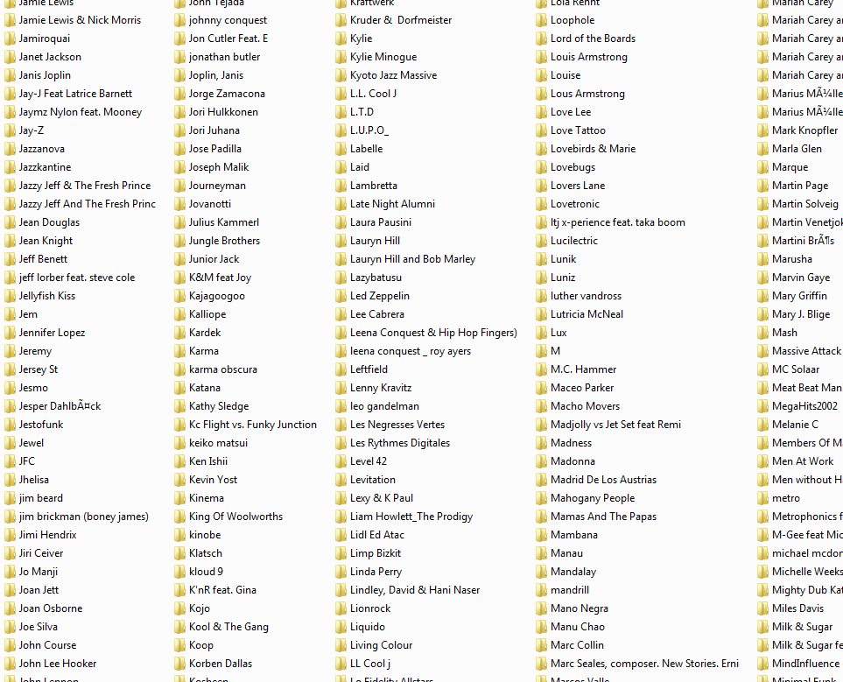
„Today, I woud like to listen to something cheerful.“
„Something like Lenny Kravitz would be great.“
„Who can help me to discover my collection?“

Slide 3
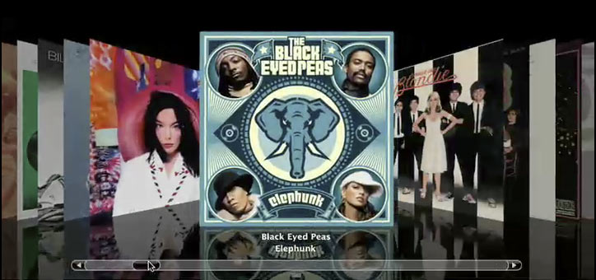
„In my shelf AC/DC is
next to the ZZ Top...“

Slide 4
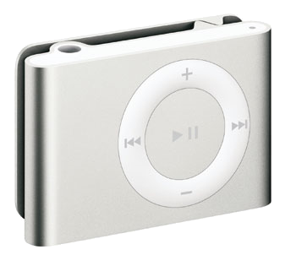
„play random songs that match my mood“

Slide 5
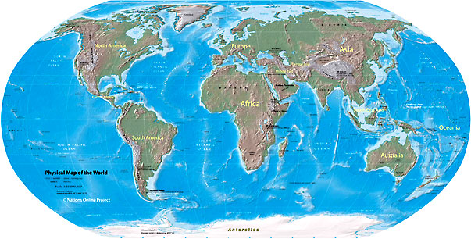
What‘s the Talk about?
basic idea: map of music
constructing the map
(MDS, PLSA)
using the map
(Youtube, Android)

Slide 6
Map of Music: What is it good for?

Slide 7
Advantages of a Map
rock
Similar songs are close to each other
Quickly find nearest neighbors
Span (and play) volumes
Create smooth playlists by interpolation
Visualize a collection
Low memory footprint
Well suited for mobile domain
Hey Jude
Imagine
Praise you
Galvanize
electronic
convenient basis to build music software
I want it that way
My Prerogative
pop

Slide 8
How to Construct a Map of Music?

Slide 9
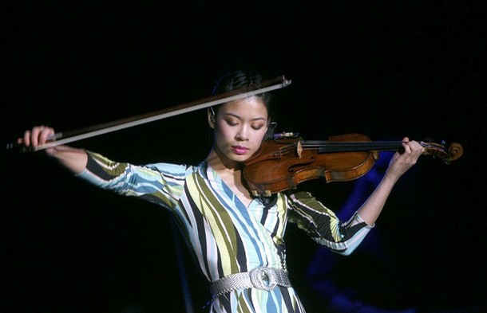
Similar or different???

Slide 10
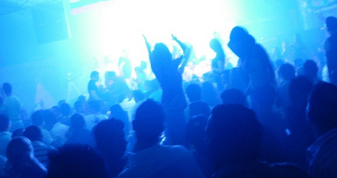
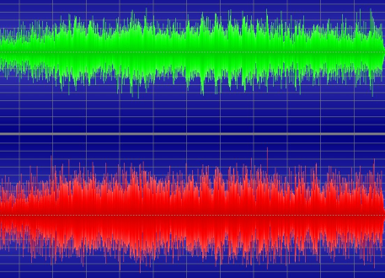
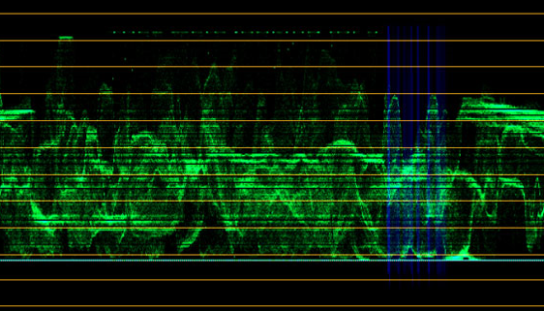
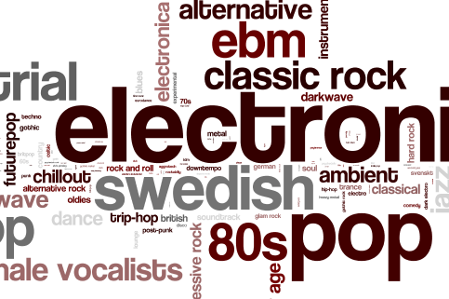
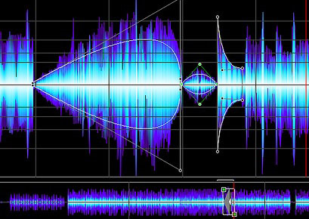
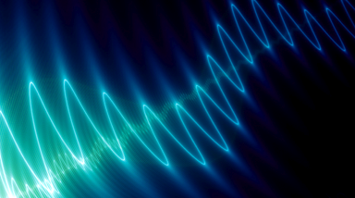
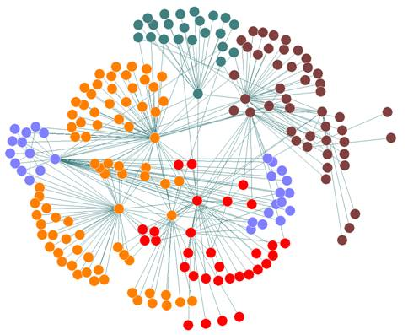
Music Similarity
Audio Analysis
Usage Data

Slide 11
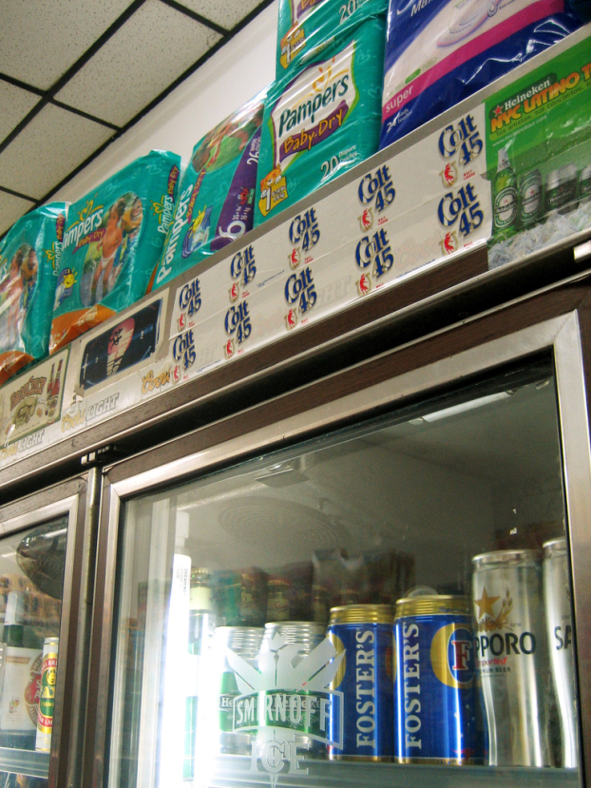
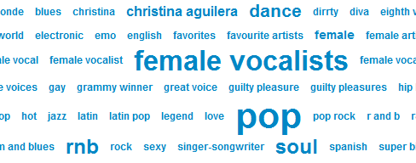
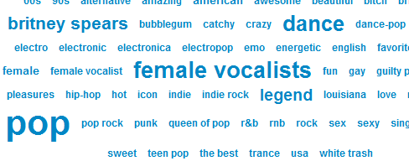
From Usage Data to Similarity
Collaborative Filtering
Folksonomies (Tags)

Slide 12
Collaborative Filtering and MDS
Method 1:

Slide 13
Basic Idea
1
d = ?
2
item-to-item
collaborative filtering
graph for all-pairs
distances
3
MDS to embed graph (i.e. distances)
into Euclidean space

Slide 14
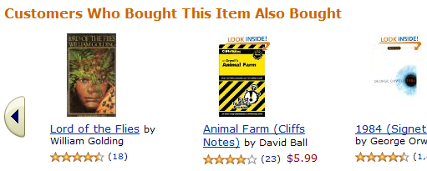
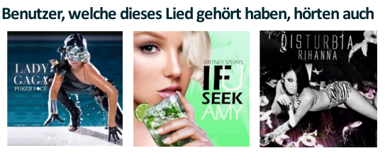
Item-to-Item Collaborative Filtering
[Linden et al., 2003]
People Who Listen To This Song also Listen to...

Slide 15
Pairwise Similarity
Users who listen to A also listen to B
Top-50 listened songs per user
Normalization (cosine similarity)
#common users
(co-occurrences)
Occurrences of song A
Occurrences of song B

Slide 16
Graph Embedding
A
C
5
2
E
B
3
D
4
4
3
B
D
C
A
5
E

Slide 17
Classical Multidimensional Scaling (MDS)
Well-known for dimensionality reduction
first described by Young and Householder, 1938
Principal Component Analysis (PCA):
Project on hyperplane that maximizes variance.
Computed by solving an eigenvalue problem.
Basic idea of MDS:
Assume that the exact positions y₁,...,y_{N} in a high-dimensional space are given.
It can be shown that knowing only the distances d(y_{i}, y_{j}) between points we can calculate the same result as applying PCA to y₁,...,y_{N}.
Problem: Complexity O(n² log n)

Slide 18
Landmark MDS
[de Silva and Tenenbaum, 1999]
Select k landmarks and embed them using MDS
For the remaining points:
Place according to distances from landmarks
Complexity: O(k n log n)

Slide 19
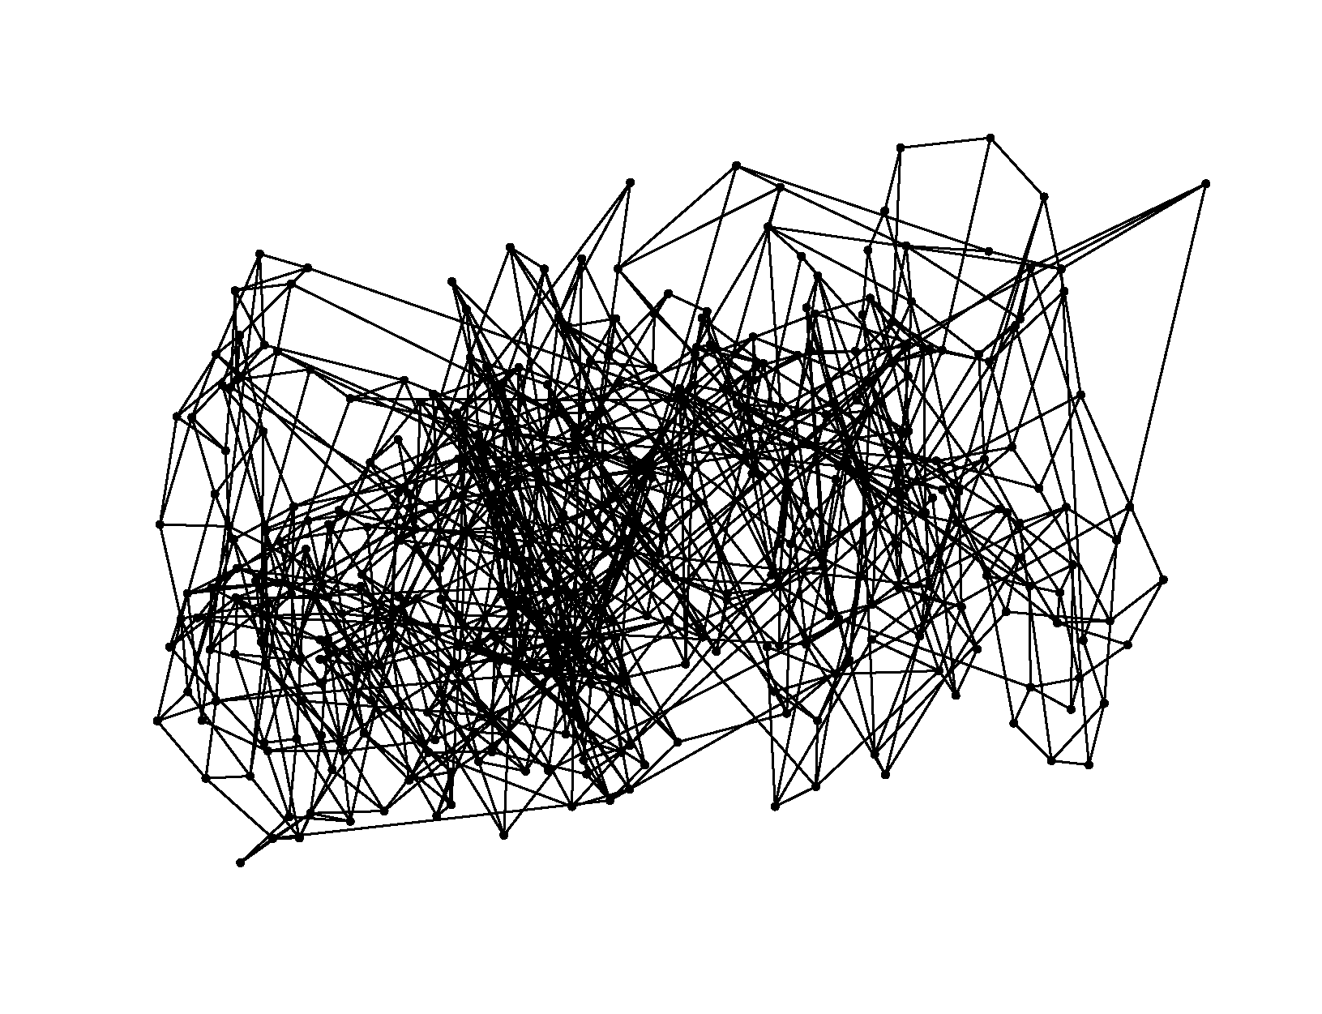
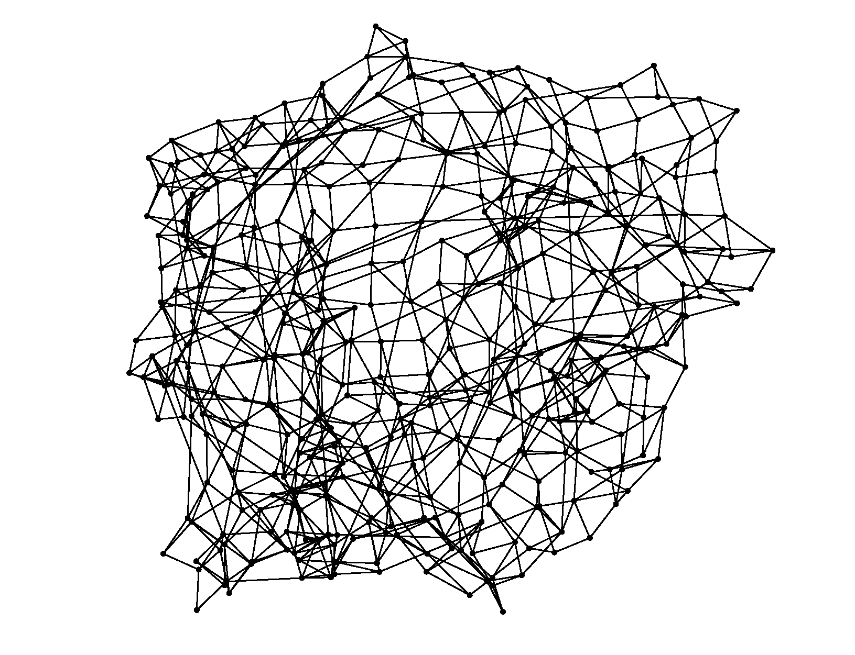
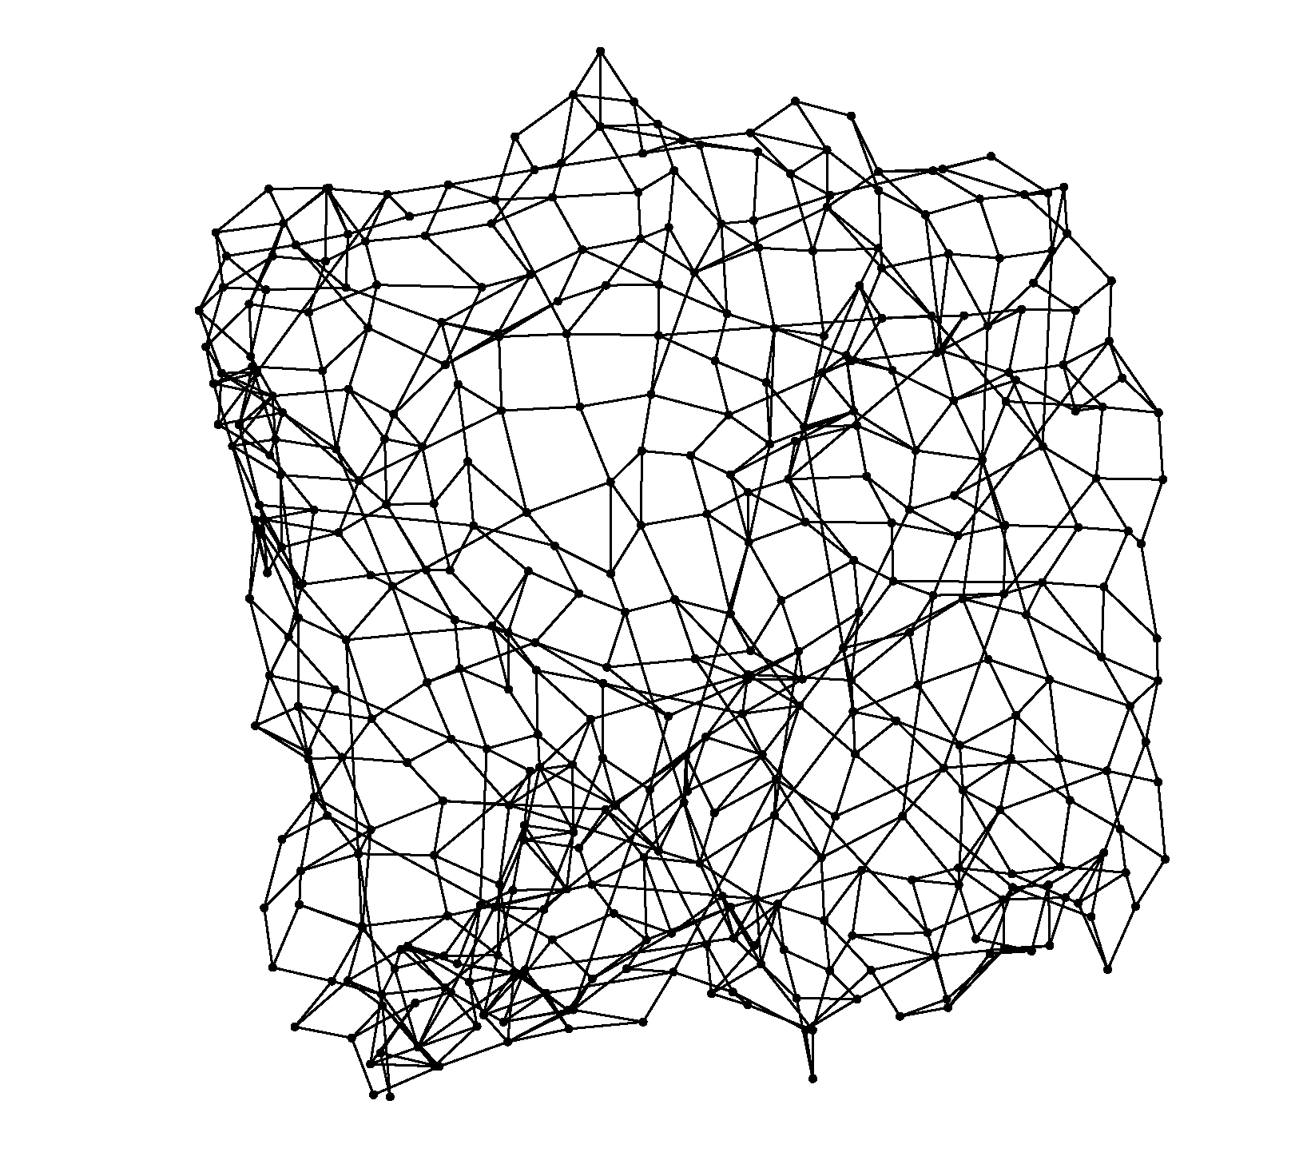
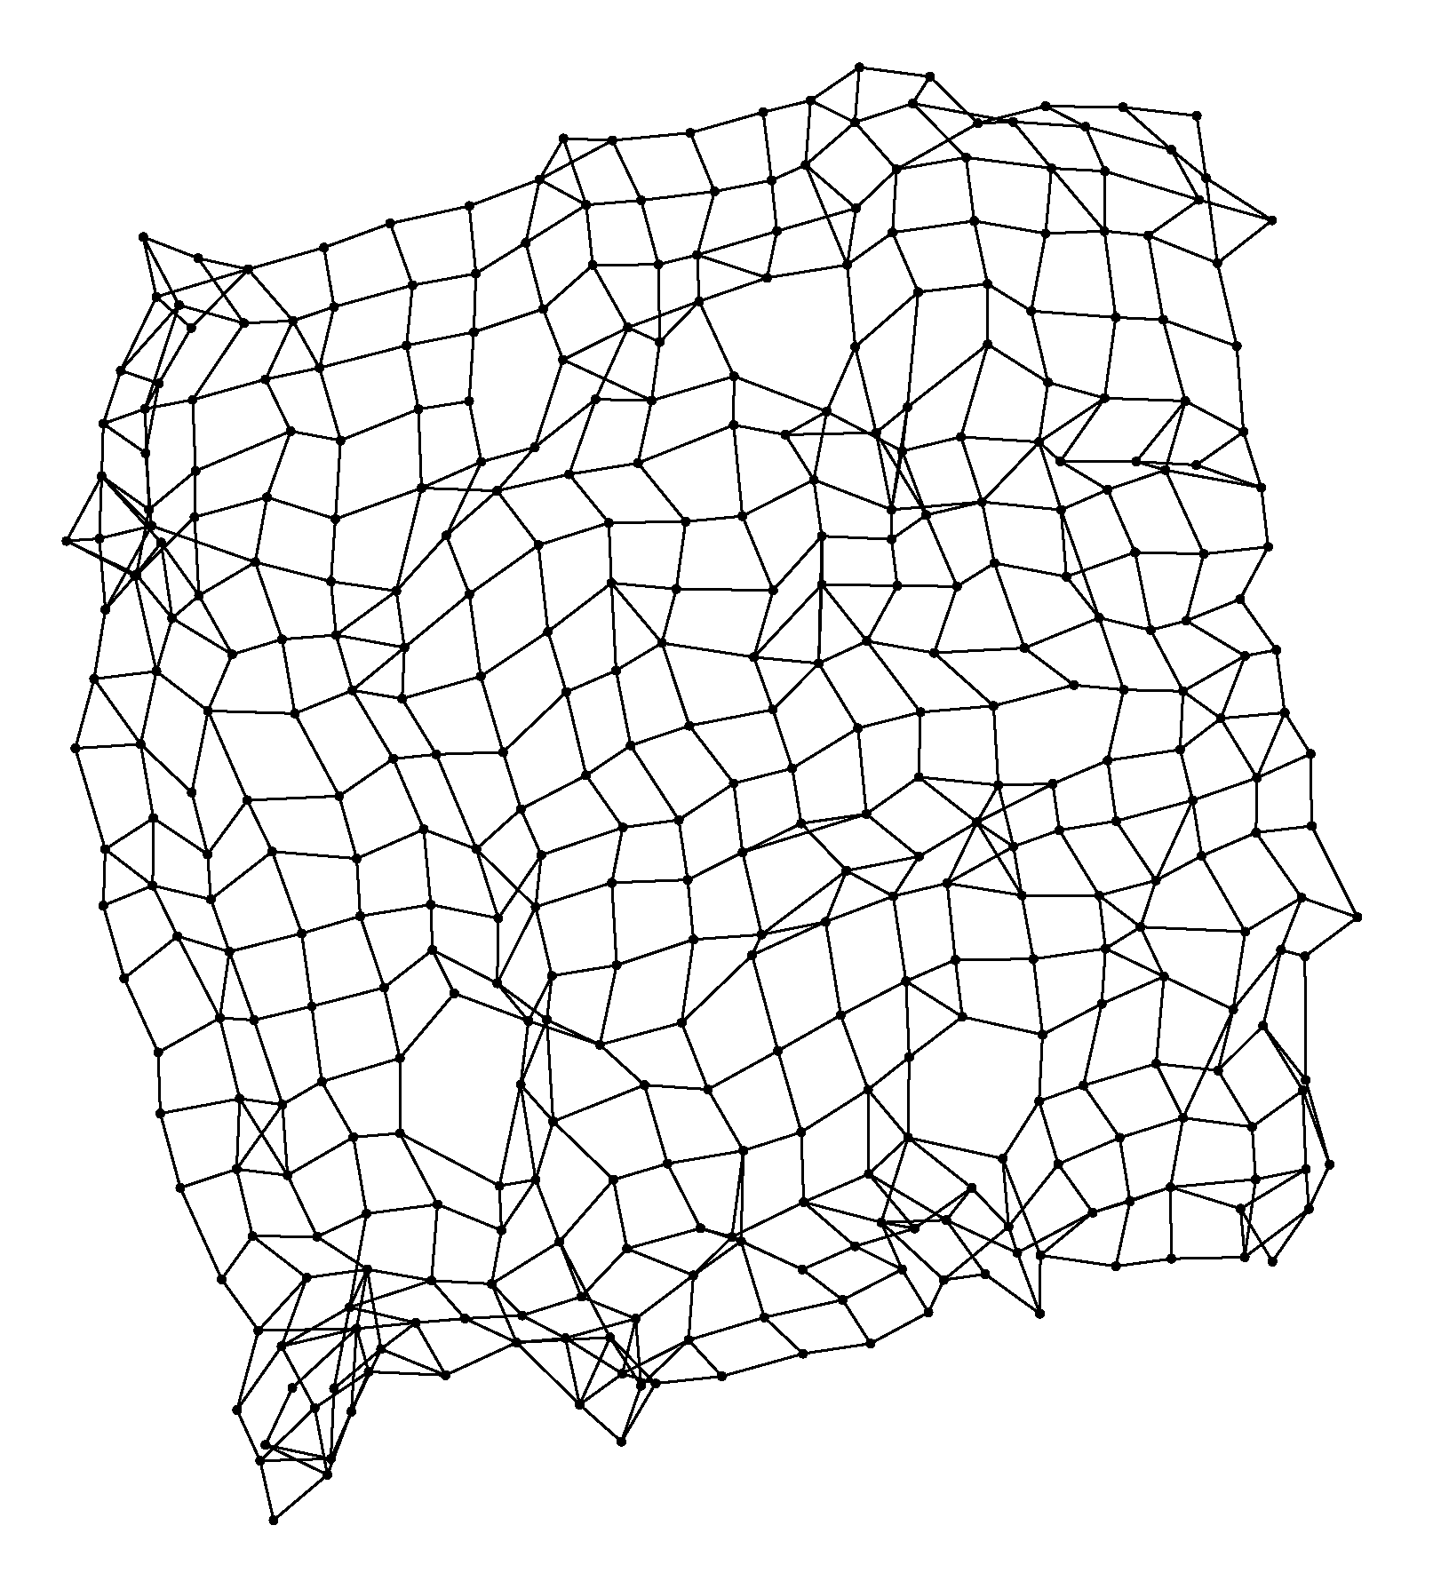
Iterative Embedding
Assumption: some links erroneously shortcut certain paths
Idea: Use embedding as estimator for distance
Shortcut edges get stretched
Remove edges with worst stretch and re-embed
Example: Kleinberg graph (20x20 grid with random edges)
Original embedding
(spring embedder)
After 6 rounds
After 12 rounds
After 30 rounds
Notes:
Kleinberg graph: grid edges + one random edge per node (follows 1/d^2 distribution, d=manhattan distance)

Slide 20
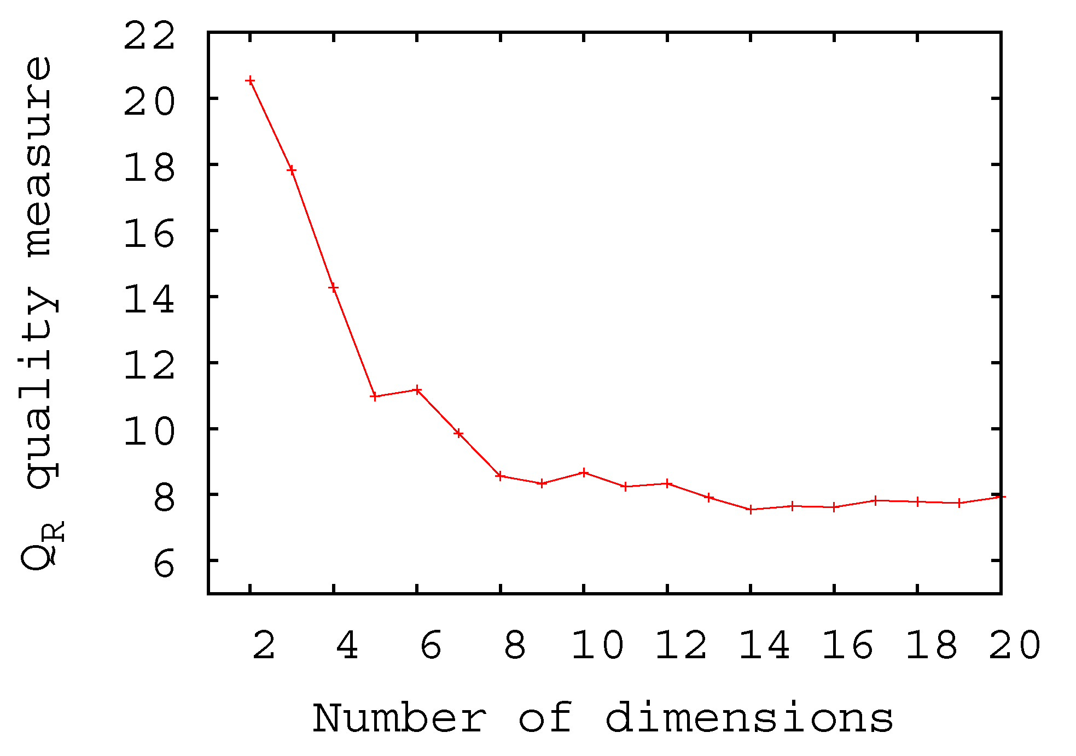
Evaluation: Dimensionality
10 Dimensions give a reasonable quality
Pink Floyd - Time
Pink Floyd - On the Run
Pink Floyd - Any Colour you Like
Pink Floyd - The Great Gig in the Sky
Pink Floyd - Eclipse
Pink Floyd - Us and Them
Pink Floyd - Brain Damage
Pink Floyd - Speak to Me
Pink Floyd - Money
Pink Floyd - Breathe
Pink Floyd - One of These Days
Miles Davis - So What
Horace Silver - Song For My Father
Bill Evans - All of You
Miles Davis - Freddie Freeloader
Nat King Cole - The More I See You
Miles Davis - So Near
Miles Davis - Flamenco Sketches
Charles Mingus - Eat That Chicken
Jimmy Smith - On the Sunny Side
Julie London - Daddy
Bill Evans – My Man‘s Gone Now
Example Neighborhoods in 10D Space
Notes:
Dimensionality:
- quality(distorsion)/space(performance) tradeoff
- max QR at 10D, in contrast to other work, which focuses on at most 3D (visualization)
- The axis are not assigned any semantical meaning (but maybe one could find that out? Open problem…)
Neighborhood lists: search a little on whether the jazz list is really good.

Slide 21
Social Tags and PLSA
Method 2:

Slide 22
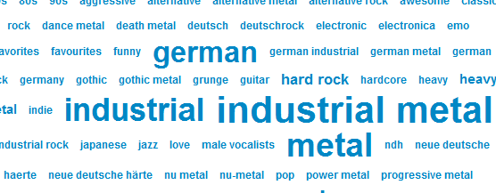
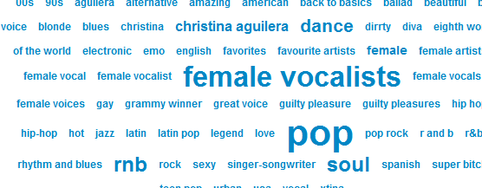
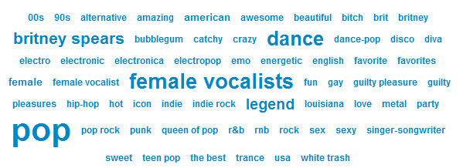
Similarity from Social Tagging

Slide 23
Probabilistic Latent Semantic Analysis (PLSA)
[Hofmann, 1999]
songs
latent music style classes
tags
documents
latent semantic classes
words
d₁
w₁
Z₁ =?
d₂
P(z|d)
P(w|z)
w₂
Z₂ =?
Z_{K} =?
d_{N}
w_{M}

Slide 24
PLSA: Interpretation as Space
can be seen as a vector that defines a point in space [Hofmann, 1999]
songs
latent music style classes
tags
d₁
w₁
Z₁ =?
d₂
P(z|d)
P(w|z)
w₂
Z₂ =?
Z_{K} =?
d_{N}
w_{M}
K small: Dimensionality reduction

Slide 25
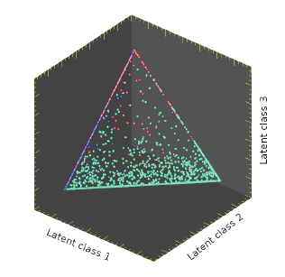
PLSA Space
Similar documents (songs) are close to each other
latent class 3
Probabilities sum to 1:
K-1 dimensional hyperplane
latent class 1
latent class 2
music space: 32 dimensions

Slide 26
LMDS vs. PLSA Space
Advantages of LMDS:
Same accurracy at lower dimensionality (10 vs. 32)
Advantages of PLSA:
Natural meaning of tags
Assignment of tags to songs (probabilistic)
Current sizes (approx.):
LMDS: 600K tracks
PLSA: 1.1M tracks

Slide 27
Using the Map

Slide 28
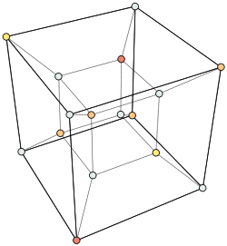
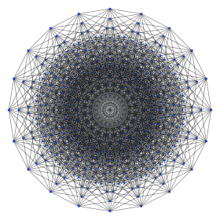
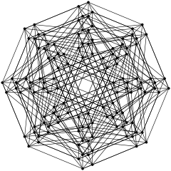
Visualization?
high-dimensional!

Slide 29
From 10D to 2D
Identify relevant tags
Find centroids of these tags in 10D
Apply Principal Component Analysis (PCA) to these centroids

Slide 30
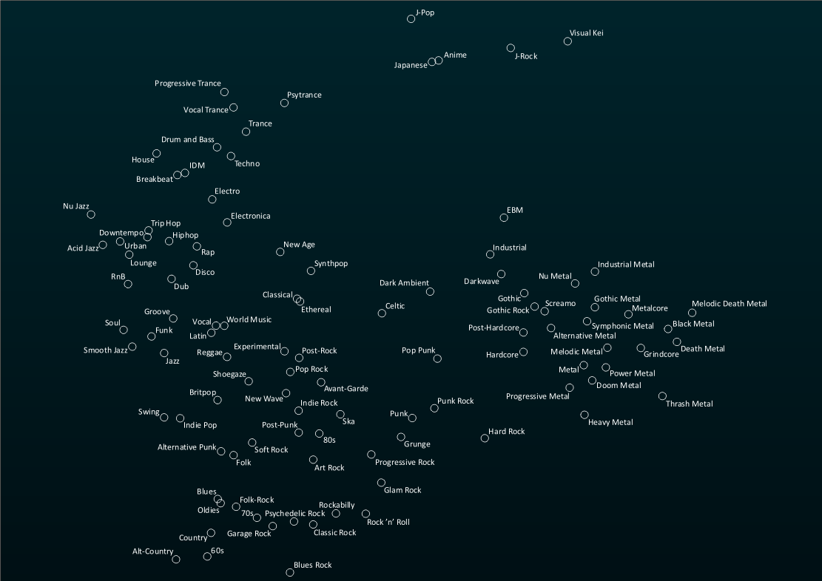
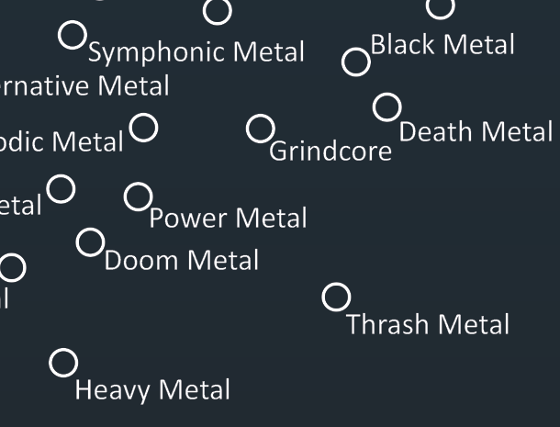
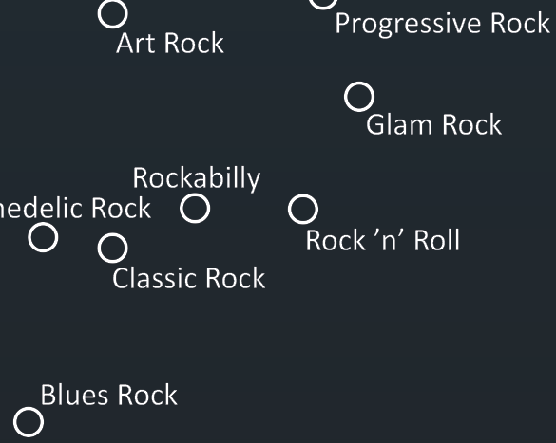

Slide 31
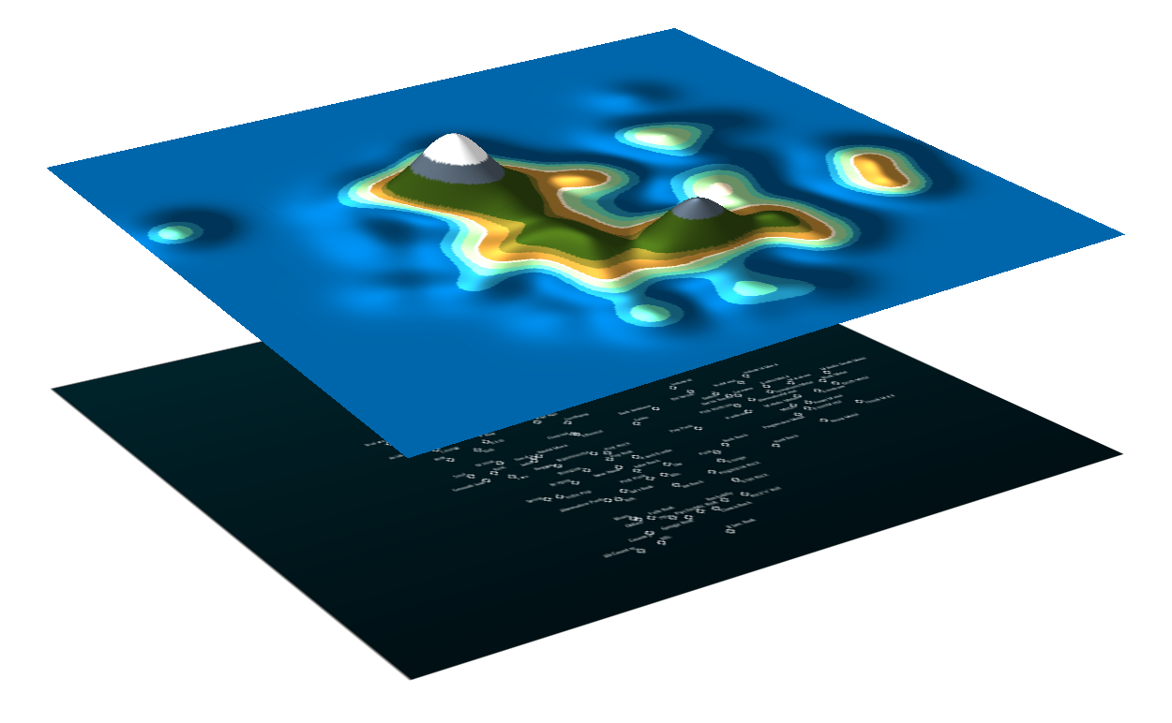
What people have chosen during the researcher‘s night in Zurich

Slide 32
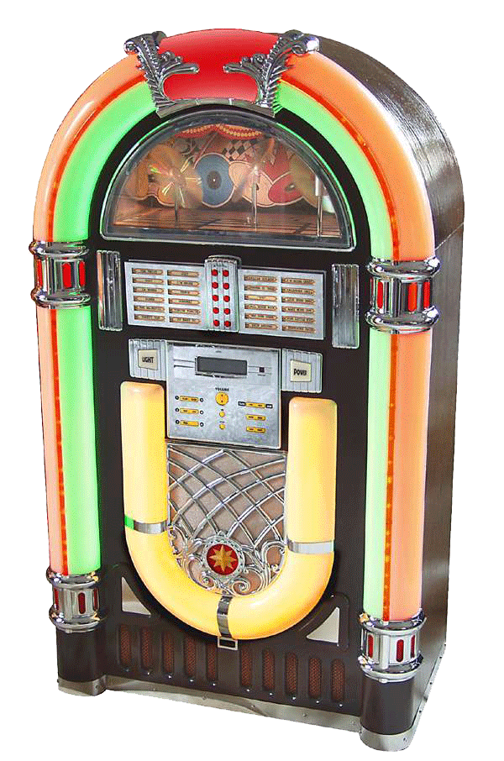
YouJuke – The YouTube Jukebox

Slide 33
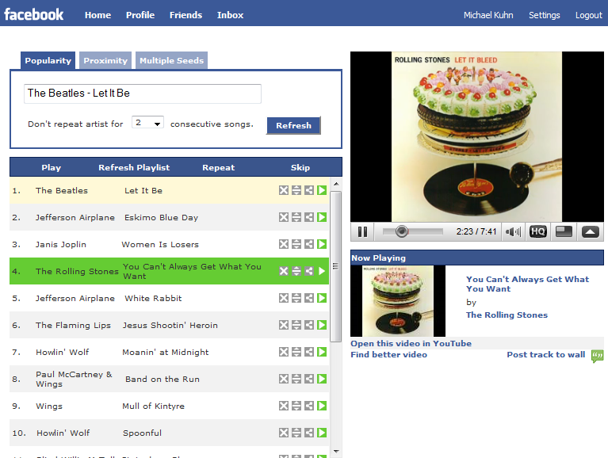
YouTube as
media source
Music map to create smart playlist

Slide 35
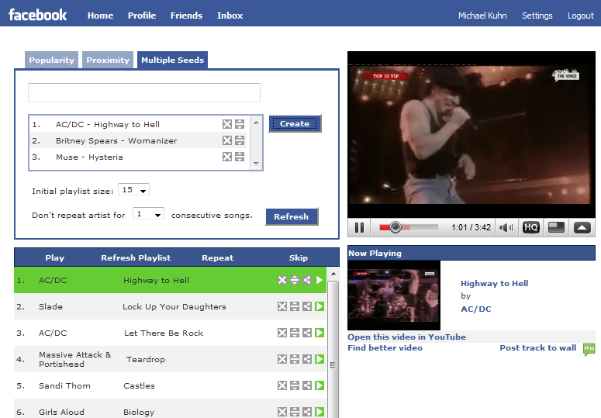

Slide 36
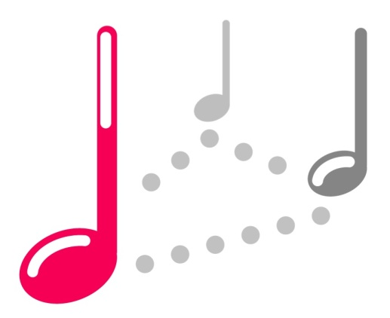
Reaching YouJuke
www.youjuke.org
apps.facebook.com/youjuke

Slide 37
μseek
μseek:
The map of music
on Android
„play random songs that
match my mood“
„In my shelf John Lennon is
next to the Beatles...“

Slide 38
An Intelligent iPod-Shuffle
listen =
skip =

Slide 39
Realization
After only few skips, we know pretty well
which songs match the user‘s mood

Slide 40
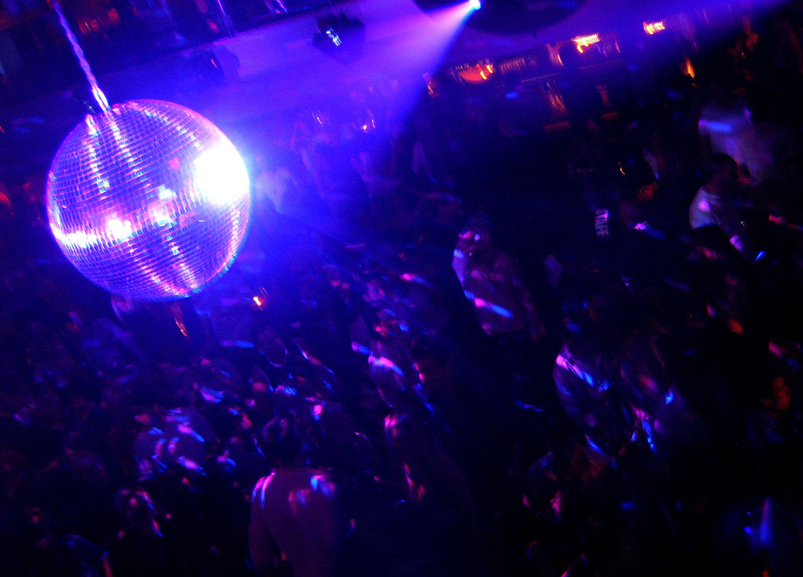
Work in Progress: Who is Dancing?
Prodigy
AC/DC
Beatles

Slide 41
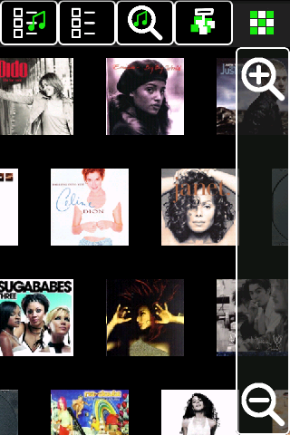
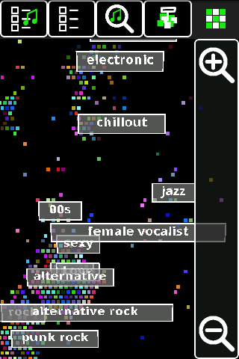
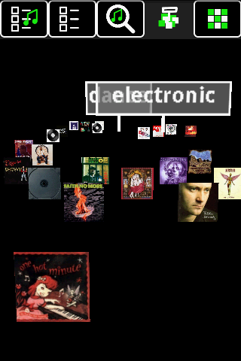
Browsing Covers
„In my shelf AC/DC is
next to the ZZ Top...“

Slide 42
Video

Slide 43
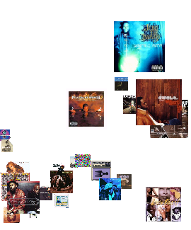
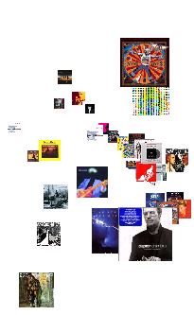
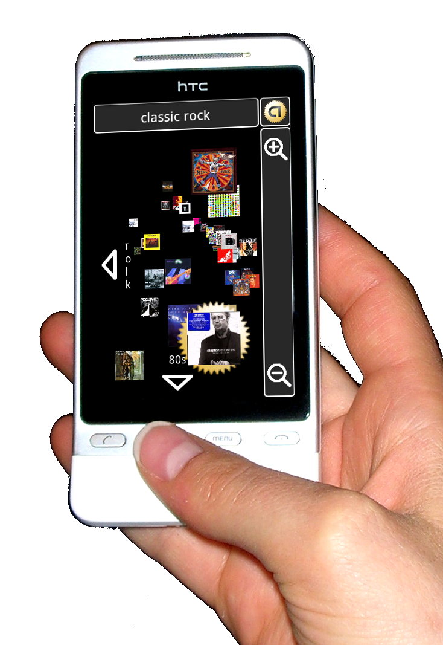
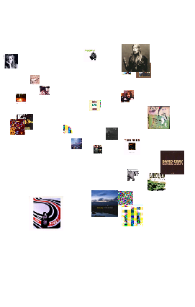
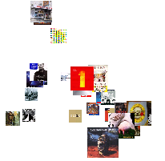
Internet connection only required at first startup!
www.musicexplorer.org/museek

Slide 44
Questions?
Thanks to:
Lukas Bossard
Mihai Calin
Olga Goussevskaia
Michael Lorenzi
Roger Wattenhofer
Samuel Welten
URLs:
www.musicexplorer.org/museek
www.youjuke.org
apps.facebook.com/youjuke
E-Mail:
kuhnmi@tik.ee.ethz.ch (Michael Kuhn)

