Slide 1
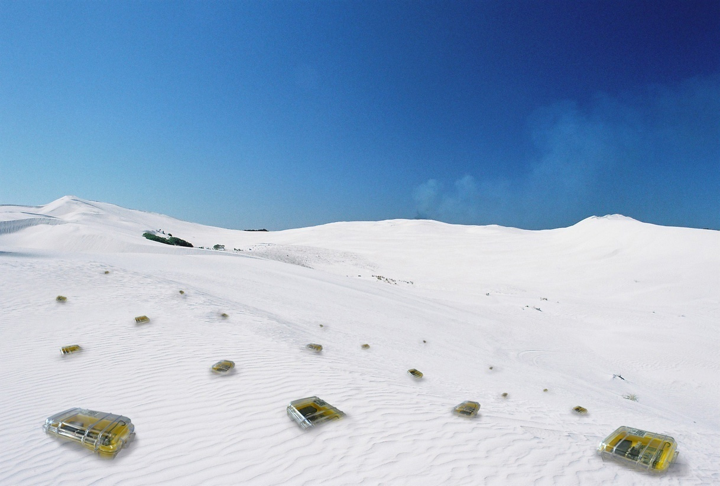

Geo-Routing
Chapter 2
TexPoint fonts used in EMF.
Read the TexPoint manual before you delete this box.: AAAA

Slide 2
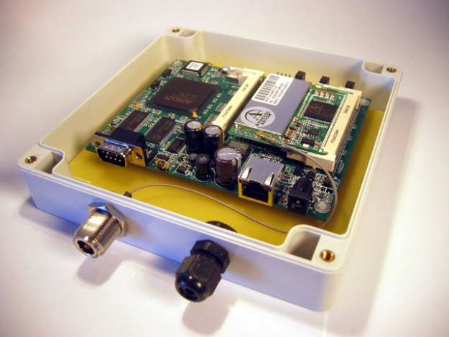
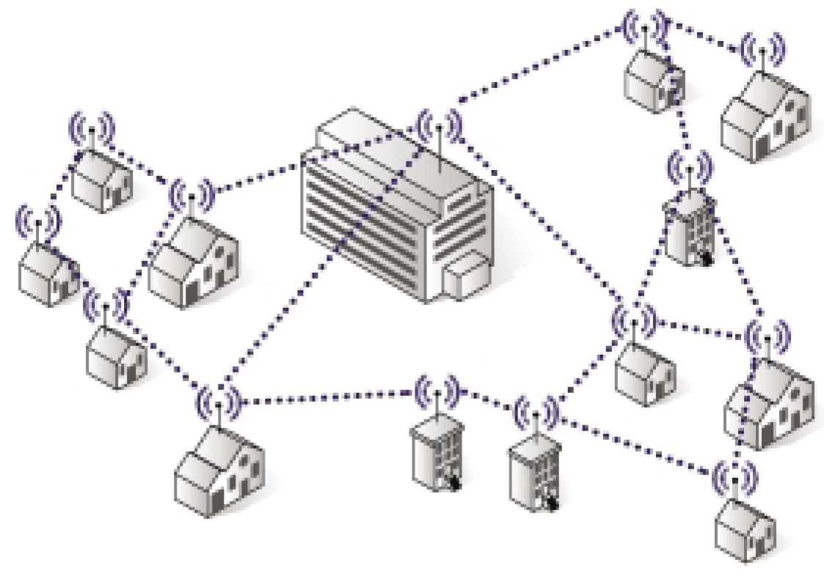
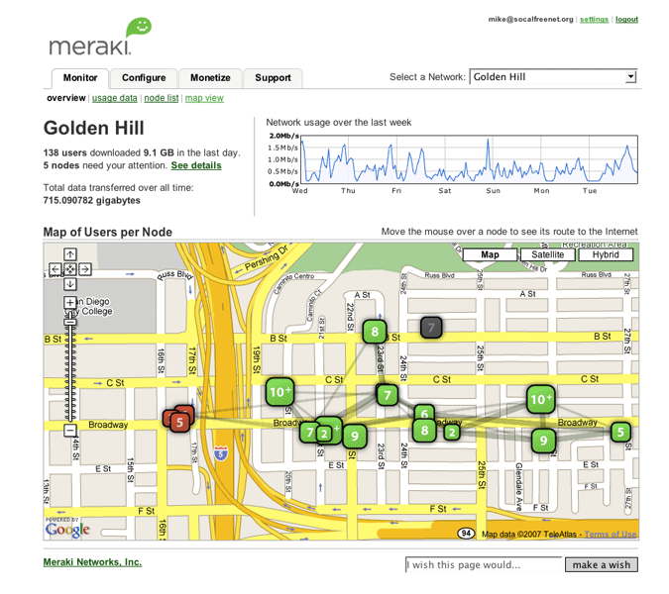
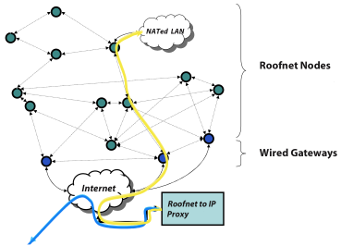
Application of the Week: Mesh Networking (Roofnet)
Sharing Internet access
Cheaper for everybody
Several gateways → fault-tolerance
Possible data backup
Community add-ons
  I borrow your hammer, you copy my homework
  Get to know your neighbors

Slide 3
Rating
Area maturity
Practical importance
Theory appeal
First steps Text book
No apps Mission critical
Boooooooring Exciting

Slide 4
Overview
Classic routing overview
Geo-routing
Greedy geo-routing
Euclidean and Planar graphs
Face Routing
Greedy and Face Routing
3D Geo-Routing

Slide 5
Classic Routing 1: Flooding
What is Routing?
„Routing is the act of moving information across a network from a source to a destination.“ (CISCO)
The simplest form of routing is “flooding”: a source s sends the message to all its neighbors; when a node other than destination t receives the message the first time it re-sends it to all its neighbors.
+ simple (sequence numbers)
– a node might see the same message
more than once. (How often?)
– what if the network is huge but the
target t sits just next to the source s?
We need a smarter routing algorithm
s
c
b
a
t

Slide 6
Classic Routing 2: Link-State Routing Protocols
Link-state routing protocols are a preferred iBGP method (within an autonomous system) in the Internet
Idea: periodic notification of all nodes about the complete graph
Routers then forward a message along (for example) the shortest path in the graph
+ message follows shortest path
– every node needs to store whole graph,
even links that are not on any path
– every node needs to send and receive
messages that describe the whole
graph regularly
s
c
b
a
t

Slide 7
Classic Routing 3: Distance Vector Routing Protocols
The predominant method for wired networks
Idea: each node stores a routing table that has an entry to each destination (destination, distance, neighbor)
If a router notices a change in its neighborhood or receives an update message from a neighbor, it updates its routing table accordingly and sends an update to all its neighbors
+ message follows shortest path
+ only send updates when topology changes
– most topology changes
are irrelevant for a given
source/destination pair
– every node needs to
store a big table
– count-to-infinity problem
t?
s
t=1
Dest | Dir | Dst
a | a | 1
b | b | 1
c | b | 2
t | b | 2
c
b
a
t
t=2

Slide 8
Discussion of Classic Routing Protocols
Proactive Routing Protocols
Both link-state and distance vector are “proactive,” that is, routes are established and updated even if they are never needed.
If there is almost no mobility, proactive algorithms are superior because they never have to exchange information and find optimal routes easily.
Reactive Routing Protocols
Flooding is “reactive,” but does not scale
If mobility is high and data transmission rare, reactive algorithms are superior; in the extreme case of almost no data and very much mobility the simple flooding protocol might be a good choice.
There is no “optimal” routing protocol; the choice of the routing protocol depends on the circumstances. Of particular importance is the mobility/data ratio.

Slide 9
Routing in Ad-Hoc Networks
Reliability
  Nodes in an ad-hoc network are not 100% reliable
  Algorithms need to find alternate routes when nodes are failing
Mobile Ad-Hoc Network (MANET)
  It is often assumed that the nodes are mobile (“Car2Car”)
10 Tricks → 2¹⁰ routing algorithms
In reality there are almost that many proposals!
Q: How good are these routing algorithms?!? Any hard results?
A: Almost none! Method-of-choice is simulation…
“If you simulate three times, you get three different results”

Slide 10
Geometric (geographic, directional, position-based) routing
…even with all the tricks there will be flooding every now and then.
In this chapter we will assume that the nodes are location aware (they have GPS, Galileo, or an ad-hoc way to figure out their coordinates), and that we know where the destination is.
Then we simply
route towards the
destination
t
s

Slide 11
Geometric routing
Problem: What if there is no path in the right direction?
We need a guaranteed way to reach a destination even in the case when there is no directional path…
Hack: as in flooding
nodes keep track
of the messages
they have already
seen, and then they
backtrack* from there
*backtracking? Does this
mean that we need a stack?!?
t
?
s

Slide 12
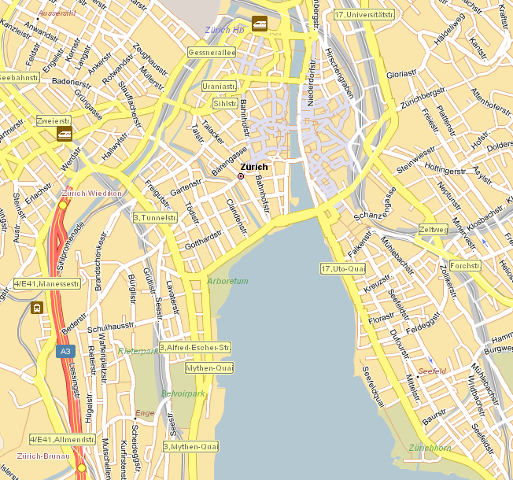
Geo-Routing: Strictly Local
???
Alice
Bob

Slide 13
Greedy Geo-Routing?
Alice
Bob

Slide 14
Greedy Geo-Routing?
Bob
?
Carol

Slide 15
What is Geographic Routing?
A.k.a. geometric, location-based, position-based, etc.
Each node knows its own position and position of neighbors
Source knows the position of the destination
No routing tables stored in nodes!
Geographic routing makes sense
  Own position: GPS/Galileo, local positioning algorithms
  Destination: Geocasting, location services, source routing++
  Learn about ad-hoc routing in general

Slide 16
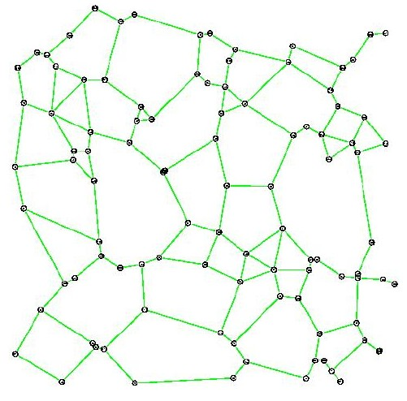
Greedy routing
Greedy routing
looks promising.
Maybe there is a
way to choose the
next neighbor
and a particular
graph where we
always reach the
destination?

Slide 17
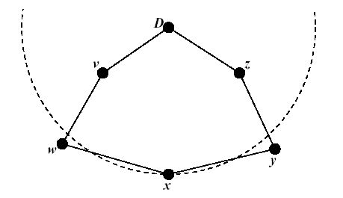
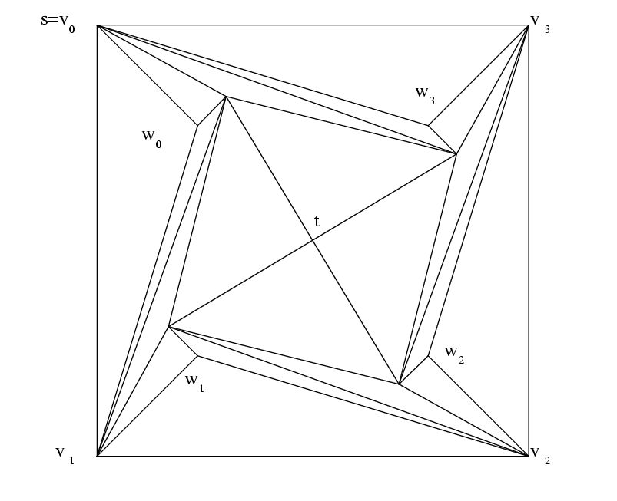
Examples why greedy algorithms fail
We greedily route to the neighbor
which is closest to the destination:
But both neighbors of x are
not closer to destination D
Also the best angle approach
might fail, even in a triangulation:
if, in the example on the right,
you always follow the edge with
the narrowest angle to destination
t, you will forward on a loop
v₀, w₀, v₁, w₁, …, v₃, w₃, v₀, …

Slide 18
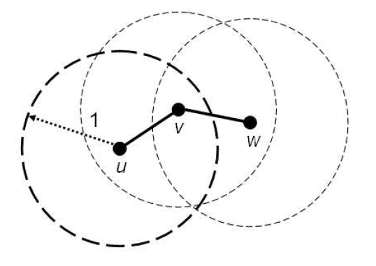
Euclidean and Planar Graphs
Euclidean: Points in the plane, with coordinates, e.g. UDG
UDG: Classic computational geometry model, special case of disk graphs
All nodes are points in the plane,
two nodes are connected iff (if and
only if) their distance is at most 1,
that is {u,v} 2 E , |u,v| · 1
+ Very simple, allows for strong analysis
– Not realistic: “If you gave me $100 for each paper written with the unit disk assumption, I still could not buy a radio that is unit disk!”
– Particularly bad in obstructed environments (walls, hills, etc.)
Natural extension: 3D UDG

Slide 19
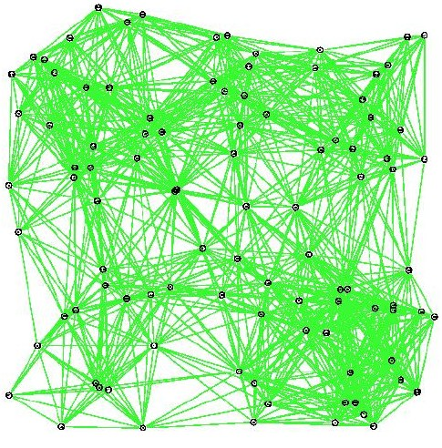
Euclidean and Planar Graphs
Planar: can be drawn without “edge crossings” in a plane
A planar graph already drawn in the plane without edge intersections is called a plane graph. In the next chapter we will see how to make a Euclidean graph planar.

Slide 20
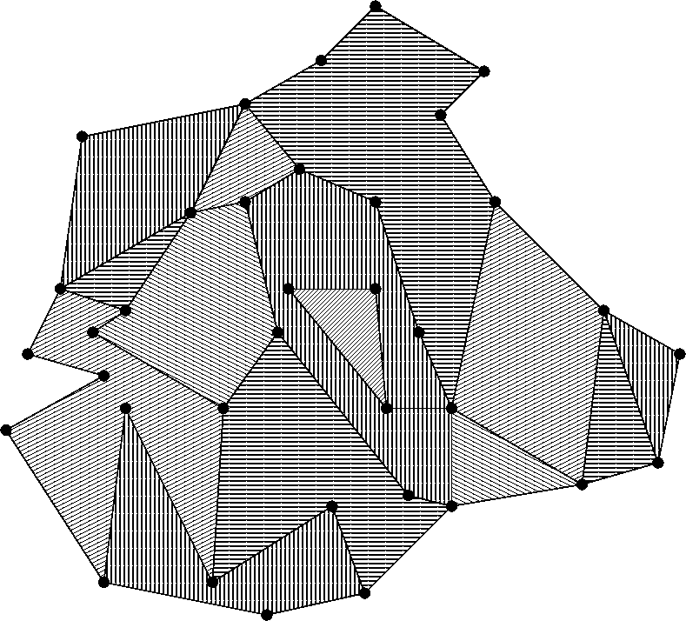
Breakthrough idea: route on faces
Remember the
faces…
Idea:
Route along the
boundaries of
the faces that
lie on the
source–destination
line

Slide 21
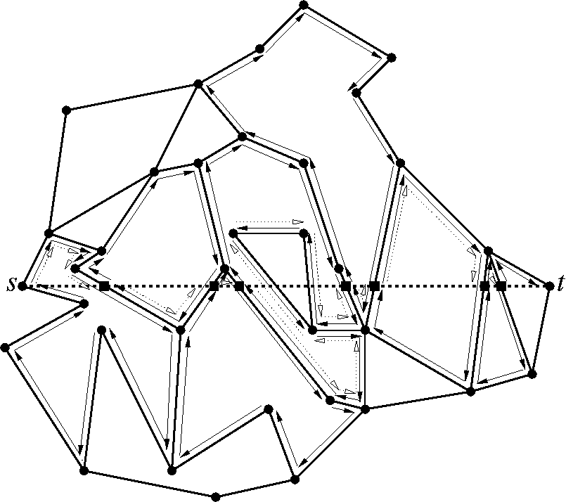
Face Routing
0. Let f be the face incident to the source s, intersected by (s,t)
Explore the boundary of f; remember the point p where the boundary
intersects with (s,t) which is nearest to t; after traversing
the whole
boundary, go back
to p, switch the face, and repeat 1 until you hit destination t.

Slide 22
Face Routing Properties
All necessary information is stored in the message
  Source and destination positions
  Point of transition to next face
Completely local:
  Knowledge about direct neighbors‘ positions sufficient
  Faces are implicit
Planarity of graph is computed locally (not an assumption)
  Computation for instance with Gabriel Graph
“Right Hand Rule”

Slide 23
Face Routing Works on Any Graph
s
t

Slide 24
Face routing is correct
Theorem: Face routing terminates on any simple planar graph in O(n) steps, where n is the number of nodes in the network
Proof: A simple planar graph has at most 3n–6 edges. You leave each face at the point that is closest to the destination, that is, you never visit a face twice, because you can order the faces that intersect the source—destination line on the exit point. Each edge is in at most 2 faces. Therefore each edge is visited at most 4 times. The algorithm terminates in O(n) steps.
Definition: f 2 O(g) → 9 c>0, 8 x>x₀: f(x) ≤ c·g(x)

Slide 25
Face Routing
Theorem: Face Routing reaches destination in O(n) steps
But: Can be very bad compared to the optimal route

Slide 26
Is there something better than Face Routing?
How can we improve Face Routing?

Slide 27
Is there something better than Face Routing?
How to improve face routing? A proposal called “Face Routing 2”
Idea: Don’t search a whole face for the best exit point, but take the first (better) exit point you find. Then you don’t have to traverse huge faces that point away from the destination.
Efficiency: Seems to be practically more efficient than face routing. But the theoretical worst case is worse – O(n²).
Problem: if source and destination are very close, we don’t want to route through all nodes of the network. Instead we want a routing algorithm where the cost is a function of the cost of the best route in the unit disk graph (and independent of the number of nodes).

Slide 28
Bounding Searchable Area
s
t

Slide 29
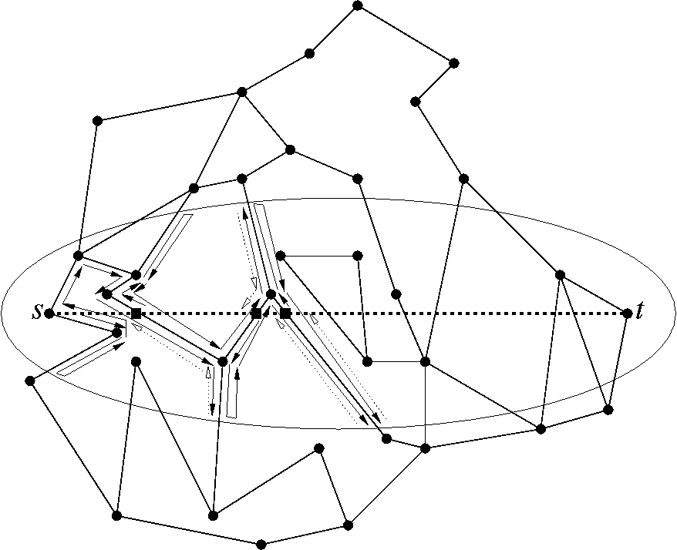
Adaptive Face Routing (AFR)
Idea: Use
face routing
together with
“growing radius”
trick:
That is, don’t
route beyond
some radius r
by branching
the planar graph
within an ellipse
of exponentially
growing size.

Slide 30
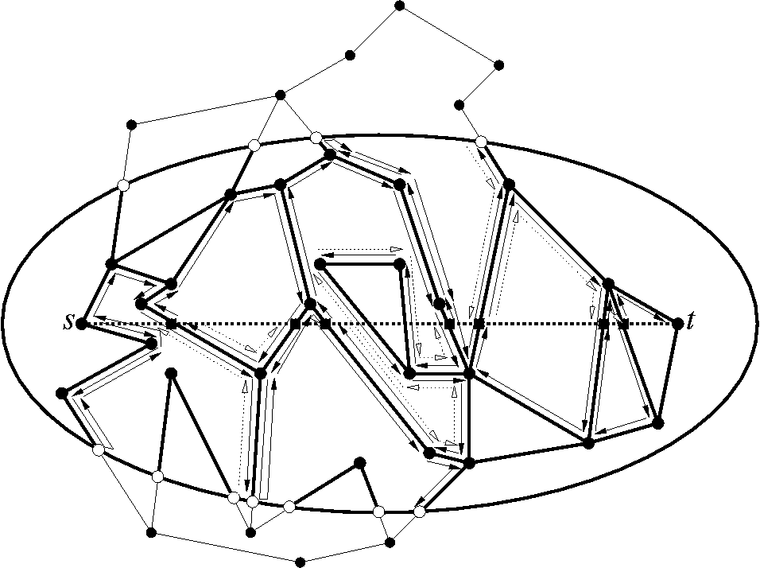
AFR Example Continued
We grow the
ellipse and
find a path

Slide 31
AFR Pseudo-Code
0. Calculate G = GG(V) Å UDG(V)
Set c to be twice the Euclidean source—destination distance.
Nodes w 2 W are nodes where the path s-w-t is larger than c. Do face routing on the graph G, but without visiting nodes in W. (This is like pruning the graph G with an ellipse.) You either reach the destination, or you are stuck at a face (that is, you do not find a better exit point.)
If step 1 did not succeed, double c and go back to step 1.
Note: All the steps can be done completely locally,
and the nodes need no local storage.

Slide 32
The Ω(1) Model
We simplify the model by assuming that nodes are sufficiently far apart; that is, there is a constant d₀ such that all pairs of nodes have at least distance d₀. We call this the Ω(1) model.
This simplification is natural because nodes with transmission range 1 (the unit disk graph) will usually not “sit right on top of each other”.
Lemma: In the Ω(1) model, all natural cost models (such as the Euclidean distance, the energy metric, the link distance, or hybrids of these) are equal up to a constant factor.
Remark: The properties we use from the Ω(1) model can also be established with a backbone graph construction.

Slide 33
Analysis of AFR in the Ω(1) model
Lemma 1: In an ellipse of size c there are at most O(c²) nodes.
Lemma 2: In an ellipse of size c, face routing terminates in O(c²) steps, either by finding the destination, or by not finding a new face.
Lemma 3: Let the optimal source—destination route in the UDG have cost c*. Then this route c* must be in any ellipse of size c* or larger.
Theorem: AFR terminates with cost O(c*²).
Proof: Summing up all the costs until we have the right ellipse size is bounded by the size of the cost of the right ellipse size.

Slide 34
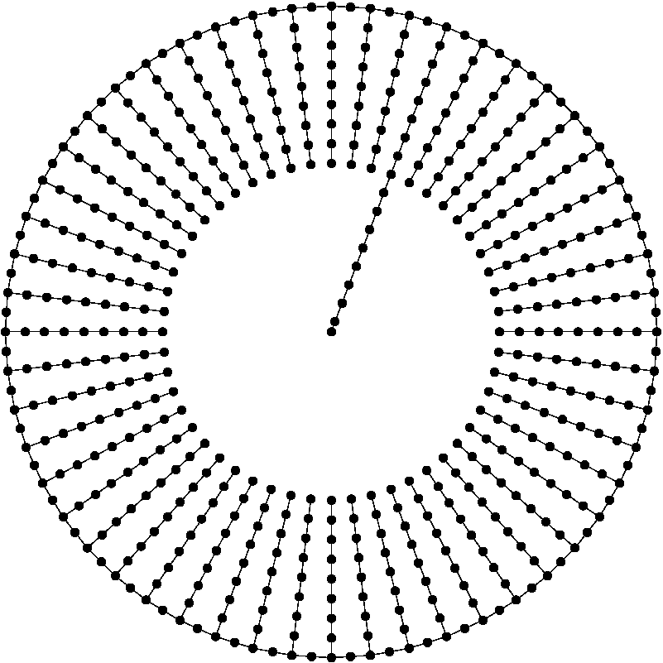
Lower Bound
The network on the right
constructs a lower bound.
The destination is the
center of the circle,
the source any node
on the ring.
Finding the right chain
costs Ω(c*²),
even for randomized
algorithms
Theorem:
AFR is asymptotically optimal.

Slide 35
Non-geometric routing algorithms
In the Ω(1) model, a standard flooding algorithm enhanced with growing search area idea will (for the same reasons) also cost O(c*²).
However, such a flooding algorithm needs O(1) extra storage at each node (a node needs to know whether it has already forwarded a message).
Therefore, there is a trade-off between O(1) storage at each node or that nodes are location aware, and also location aware about the destination. This is intriguing.

Slide 36
GOAFR – Greedy Other Adaptive Face Routing
Back to geometric routing…
AFR Algorithm is not very efficient (especially in dense graphs)
Combine Greedy and (Other Adaptive) Face Routing
  Route greedily as long as possible
  Circumvent “dead ends” by use of face routing
  Then route greedily again
Other AFR: In each face proceed to point
closest to destination

Slide 37
GOAFR+ – Greedy Other Adaptive Face Routing
Early fallback to greedy routing:
  Use counters p and q. Let u be the node where the exploration of the current face F started
    p counts the nodes closer to t than u
    q counts the nodes not closer to t than u
  Fall back to greedy routing as soon as p > σ ¢ q (constant σ > 0)
Theorem: GOAFR is still asymptotically worst-case optimal…
…and it is efficient in practice, in the average-case.
What does “practice” mean?
  Usually nodes placed
  uniformly at random

Slide 38
Average Case
Not interesting when graph not dense enough
Not interesting when graph is too dense
Critical density range (“percolation”)
  Shortest path is significantly longer than Euclidean distance
too sparse
critical density
too dense

Slide 39


Critical Density: Shortest Path vs. Euclidean Distance
Shortest path is significantly longer than Euclidean distance
Critical density range mandatory for the simulation of any routing algorithm (not only geographic)

Slide 40
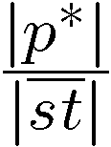
Randomly Generated Graphs: Critical Density Range
1.9
1
1.8
Connectivity
0.9
1.7
0.8
1.6
0.7
Greedy success
0.6
1.5
Shortest Path Span
Frequency
0.5
1.4
0.4
1.3
Shortest Path Span
0.3
1.2
0.2
1.1
0.1
critical
1
0
0
5
10
15
Network Density [nodes per unit disk]

Slide 41
Simulation on Randomly Generated Graphs
10
1
worse
AFR
0.9
9
8
Connectivity
0.8
7
0.7
0.6
6
Greedy success
Frequency
Performance
0.5
5
0.4
4
GOAFR+
0.3
3
0.2
better
2
0.1
critical
1
0
0
2
4
6
8
10
12
Network Density [nodes per unit disk]

Slide 42
A Word on Performance
What does a performance of 3.3 in the critical density range mean?
If an optimal path (found by Dijkstra) has cost c,
then GOAFR+ finds the destination in 3.3¢c steps.
It does not mean that the path found is 3.3 times as long as the optimal path! The path found can be much smaller…
Remarks about cost metrics
  In this lecture “cost” c = c hops
  There are other results, for instance on distance/energy/hybrid metrics
  In particular: With energy metric there is no competitive geometric routing algorithm

Slide 43
GOAFR: Summary
Face Routing
Adaptive Face Routing
s
t
Greedy Routing
GOAFR⁺
Average-case efficiency
Worst-case optimality
“Practice”
“Theory”

Slide 44
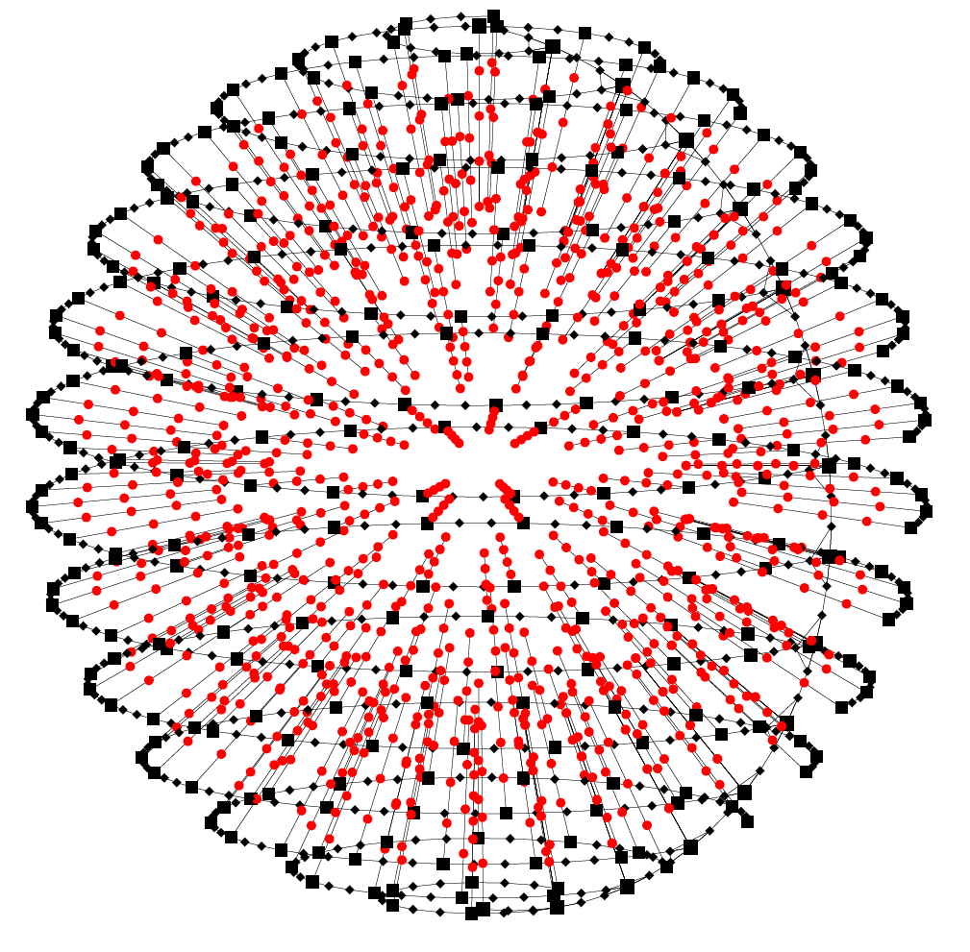
3D Geo-Routing
The world is not flat. We can certainly envision networks in 3D, e.g. in a large office building. Can we geo-route in three dimensions? Are the same techniques possible?
Certainly, if the node density is high enough (and the node distribution is kind to us), we can simply use greedy routing. But what about those local minima?!?
Is there something like a face in 3D?
The picture on the right is the 3D
equivalent of the 2D lower bound,
proving that we need at least OPT³ steps.

Slide 45
3D Geo Routing
It is proven that no deterministic k-local routing algorithm for 3D UDGs exist.
  Deterministic: Whenever a node n receives a message from node m, n determines the next hop as a function f(n,m,s,t,N(n)), where s and t are the source and the target nodes and N(n) the neighborhood of n.
  k-local: A node only knows its k-hop neighborhood
How would you do 3D routing?
Notes:
45

Slide 46
Routing with and without position information
Without position information:
  Flooding
  → does not scale
  Distance Vector Routing
  → does not scale
  Source Routing
    increased per-packet overhead
    no theoretical results, only simulation
With position information:
  Greedy Routing
    → may fail: message may get stuck in a “dead end”
  Geometric Routing
  → It is assumed that each node knows its position

Slide 47
Summary of Results
If position information is available geo-routing is a feasible option.
Face routing guarantees to deliver the message.
By restricting the search area the efficiency is OPT².
Because of a lower bound this is asymptotically optimal.
Combining greedy and face gives efficient algorithm.
3D geo-routing is impossible.
Even if there is no position information, some ideas might be helpful.
Geo-routing is probably the only class of routing that is well understood.
There are many adjacent areas: topology control, location
services, routing in general, etc.

Slide 48
Open problem
Geo-routing is one of the best understood topics. In that sense it is hard to come up with a decent open problem. Let’s try something wishy-washy.
We have seen that for a 2D UDG the efficiency of geo-routing can be quadratic to an optimal algorithm (with routing tables). However, the worst-case example is quite special.
Open problem: How much information does one need to store in the network to guarantee only constant overhead?
  Variant: Instead of UDG some more realistic model
  How can one maintain this information if the network is dynamic?

