Slide 1
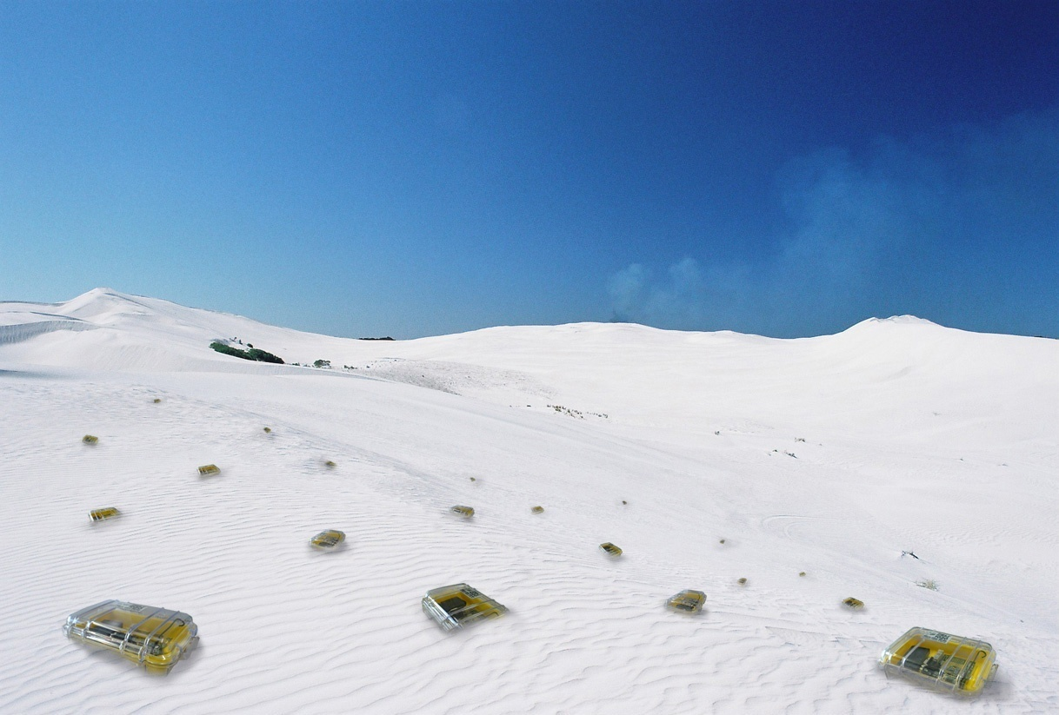

Positioning
Chapter 9
TexPoint fonts used in EMF.
Read the TexPoint manual before you delete this box.: AAAAAAA

Slide 2
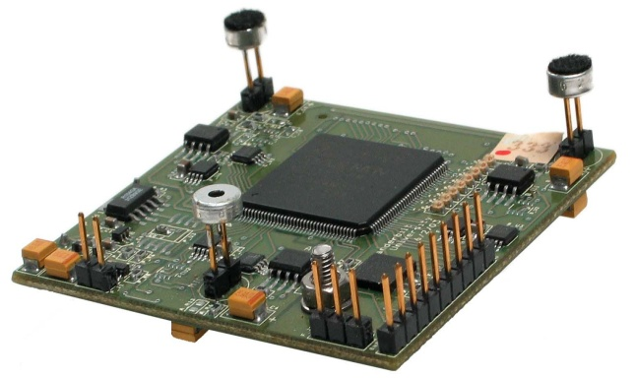
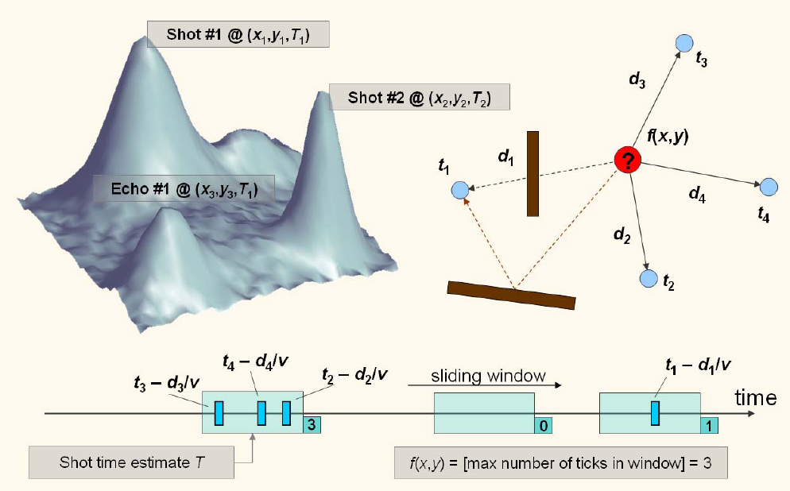
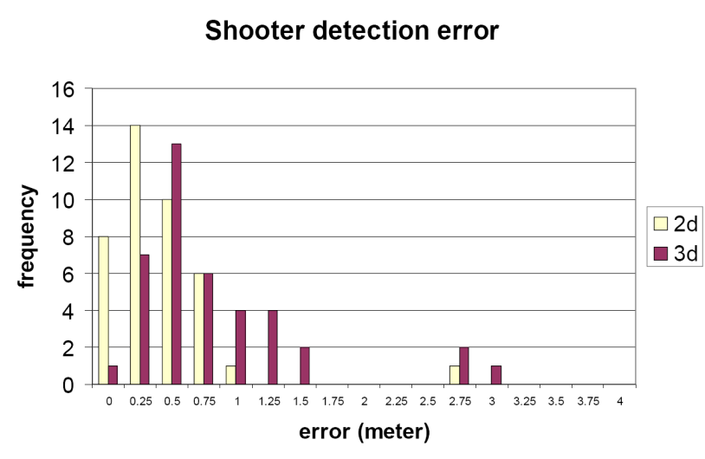
Acoustic Detection (Shooter Detection)
Sound travels much slower than a radio signal (331 m/s)
This allows for quite accurate distance estimation (cm)
Main challenge is to deal with reflections and multiple events

Slide 3
Rating
Area maturity
Practical importance
Theory appeal
First steps Text book
No apps Mission critical
Boooooooring Exciting

Slide 4
Overview
Motivation
GPS, Geodetics, etc.
Measuring Distances or Angles
Rigidity Theory
Anchors & Virtual Coordinates
Embeddings, Theory and Heuristics
Boundary Recognition

Slide 5
Motivation
Why positioning?
  Sensor nodes without location information are often meaningless
  Avoid having “costly” positioning hardware
  Geo-routing
Why not GPS (or Galileo)?
  “Heavy, large, and expensive”
  Battery drain
  Not indoors
  Accuracy?
Solution: equip small fraction with GPS (anchors)

Slide 6
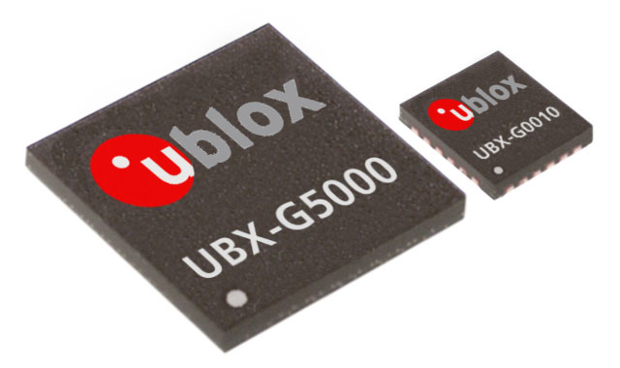
GPS
A lot of recent progress, so attaching a GPS receiver to each sensor node becomes an alternative.
Example, u-blox
  footprint size: down to 4x4mm
  Power supply: 1.8 - 4.8V
  power consumption: 50 mW
  power on: < 1 second
  update rate: 4Hz
  support for Galileo!
So GPS is definitely becoming more attractive; however, some of the problems of GPS (indoors, accuracy, etc.) remain.

Slide 7
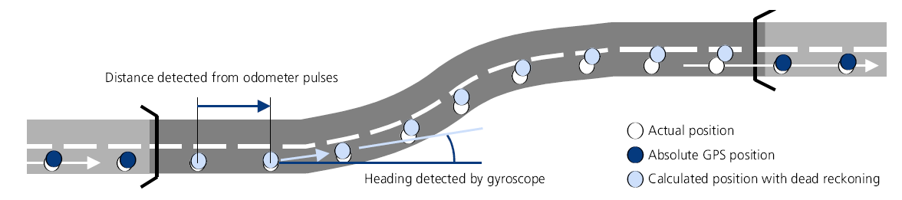
GPS Extensions
GPS chips can be extended with other sensors such as gyroscope, direction indications, or tachometer pulses (in cars). With these add-ons, mobile devices get continued coverage indoors.
Affordable technology has a distance error of less than 5% per distance travelled, and a direction error of less than 3 degrees per minute.
[u-blox]

Slide 8
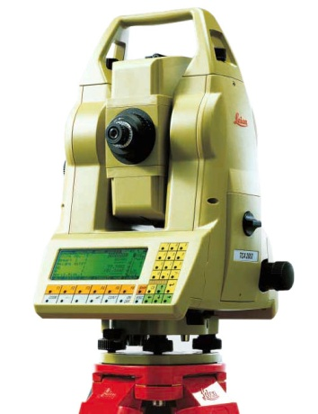
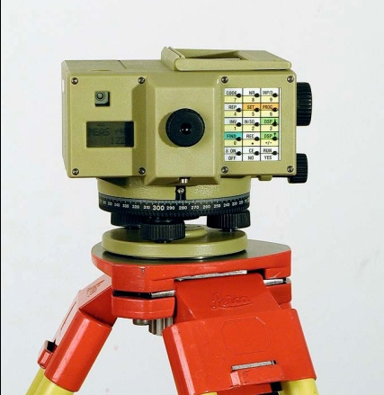
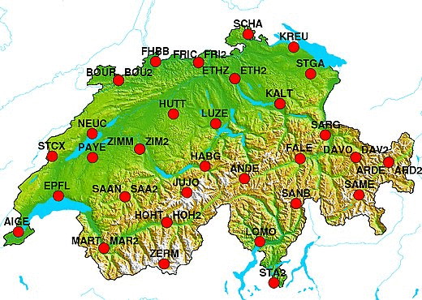
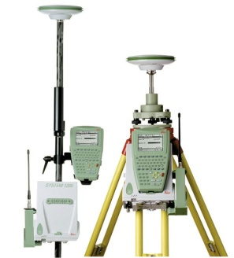
Geodetic Networks
[Geodesy pics by Rainer Mautz]
Optical Sensors
  Positions through
  reference points
  and object points
  Very accurate (mm)
GNSS
  Global Navigation Satellite System
  Allow phase measurements

Slide 9
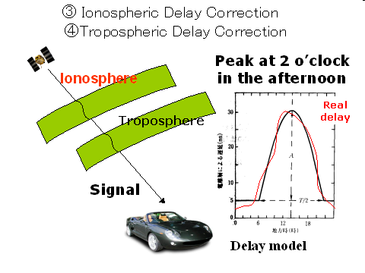
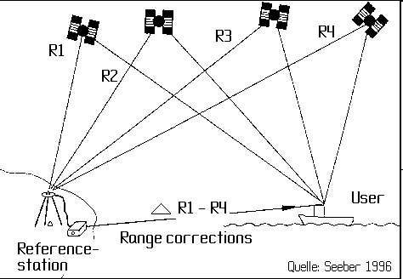
GPS meets Geodesy
Use of both GPS frequencies L1 & L2
Phase measurements
DGPS (relative measurements)
→ elimination of ionosphere delays
mm accuracy

Slide 10
More “Distance” Sensors
Geotechnical Sensors
  one-dimensional, relative measurements
Meteorological Sensors
  correction of other sensors
Digital Cameras

Slide 11
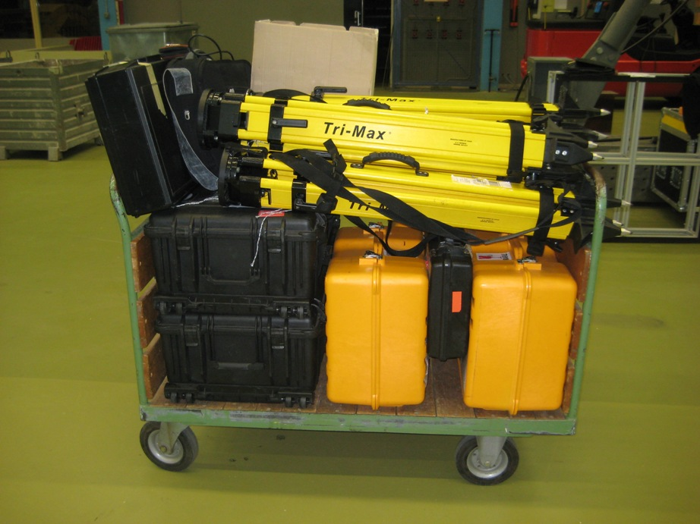
Geodesy vs. Sensor Nodes
availability: high
timeliness: real time
reliability: no failures
hybrid systems: to be avoided
local installations: none
accuracy: mm - cm
coverage: global
… but:

Slide 12
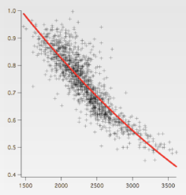
Measurements with reasonably priced hardware
Distance estimation
Received Signal Strength Indicator (RSSI)
  The further away, the weaker the received signal.
  Mainly used for RF signals.
Time of Arrival (ToA) or Time Difference of Arrival (TDoA)
  Signal propagation time translates to distance.
  Routing trip time measurements with specific hardware: accuracy 2-3m
  Better: Mixing RF, acoustic, infrared or ultrasound.
Angle estimation
Angle of Arrival (AoA)
  Determining the direction of propagation of a radio-frequency wave incident on an antenna array.
Directional Antenna
Special hardware, e.g., laser transmitter and receivers.

Slide 13
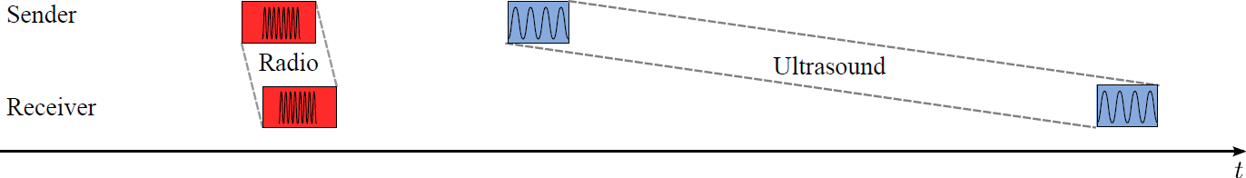
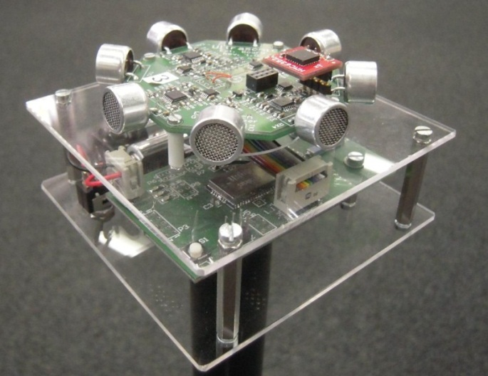
Example: Measuring distance with ultrasound
Particularly interesting if the signal speed differs substantially, e.g. sound propagation is at about 331 m/s (depending on temperature, humidity, etc.), which is of course much less than the speed of light.
If you have line of sight you may achieve
about a 1cm accuracy. But there are problems
  (Ultra)sound does not travel far
  For good results you really need line of sight
  You have to deal with reflections

Slide 14
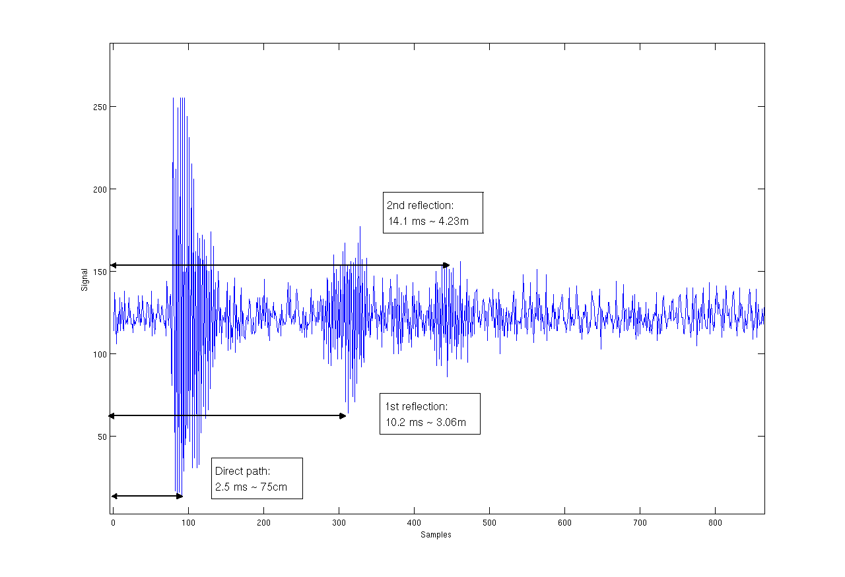
Example: Multipath effects with ultrasound

Slide 15
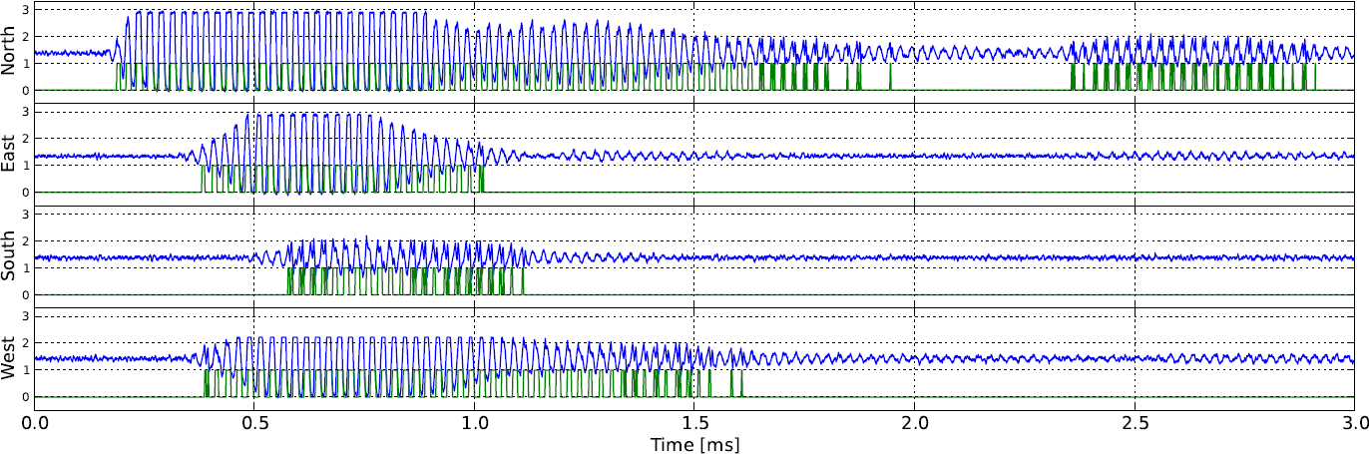

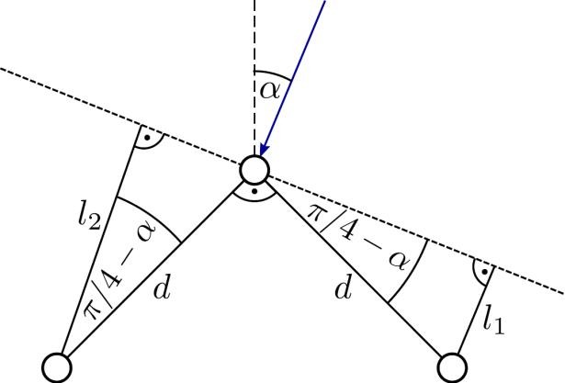
Example: Measuring angles with ultrasound
By measuring the time of arrival at multiple receivers we can determine the angle of arrival of the ultrasound signal.

Slide 16
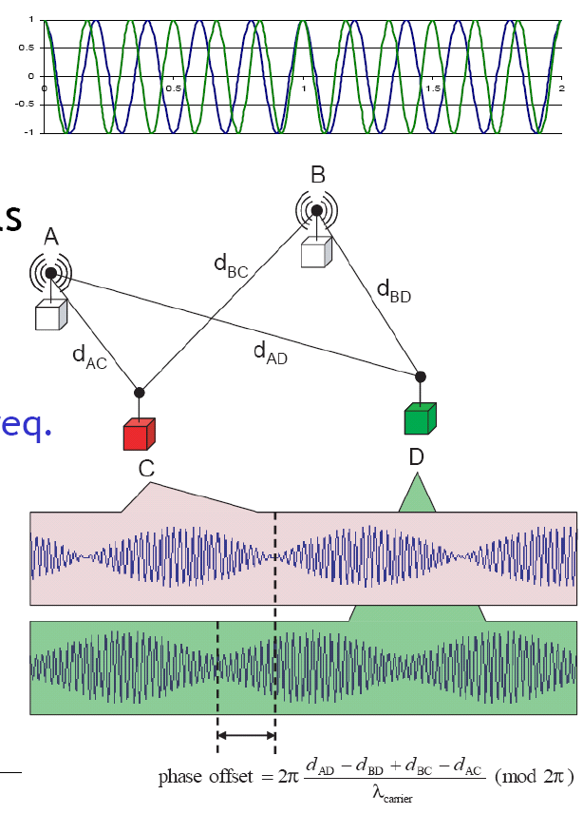
Interferometry
Interferometry is the technique of superimposing (interfering) two or more waves, to detect differences between them
Signals transmitted with a few hundred Hz difference at senders A and B will give different phase offsets at C and D. Using this, one can compute the total distance of the four points A, B, C, D.
However, one needs to solve a linear equation system, and one needs very accurate time synchronization (¹s order)

Slide 17
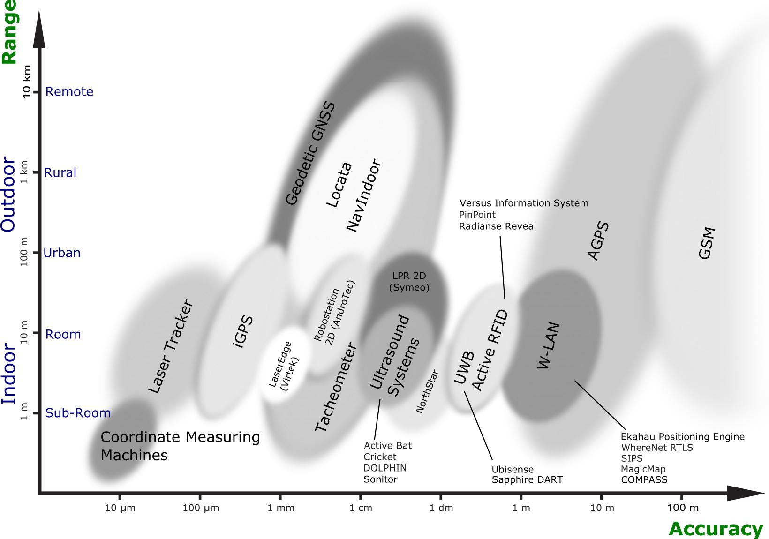
Positioning Systems: An Overview

Slide 18
Positioning in Networks
Task: Given distance or angle measurements or mere connectivity information, find the locations of the sensors.
Anchor-based
  Some nodes know their locations, either by a GPS or as pre-specified.
Anchor-free
  Relative location only. Sometimes called virtual coordinates.
  Theoretically cleaner model (less parameters, such as anchor density)
Range-based
  Use range information (distance or angle estimation)
Range-free
  No distance estimation, use connectivity information such as hop count.
  It was shown that bad measurements don’t help a lot anyway.

Slide 19
Overview
distance/angle information
connectivity information only
Positioning
(Solution quality depends on anchor density)
with anchors
Distance/Angle based
Virtual Coordinates
Connectivity based
Virtual Coordinates
without anchors

Slide 20
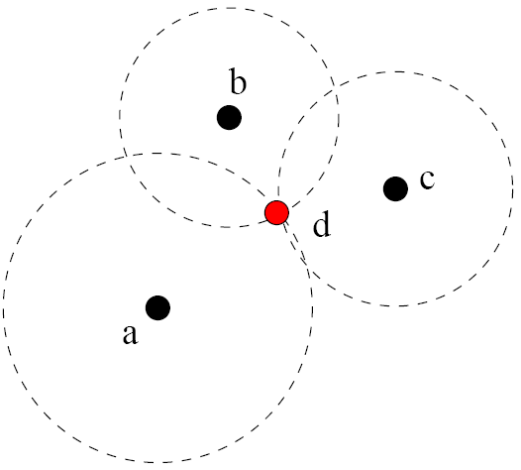
Trilateration and Triangulation
Use geometry, measure the distances/angles to three anchors.
Trilateration: use distances
  Global Positioning System (GPS)
Triangulation: use angles
  Some cell phone systems
How to deal with inaccurate
measurements?
  Least squares type of approach
  What about strictly more than
  3 (inaccurate) measurements?

Slide 21
Iterative Multilateration
initial anchor
becomes anchor in 1st step
becomes anchor in 2nd step
becomes anchor in 3rd step
Cooperative Multihop Multilateration:

Slide 22
Problems with Distance Measurements
No information
  Pair of nodes simply too far apart
  Physical obstacles: Line-of-sight needed for ultrasound, laser, infrared, …
  Limitations of ranging hardware: Might not be omni-directional.
Not enough information
  Too sparse deployment to determine a “globally rigid” structure
Inaccurate information
  Measurement errors will sum up
  Idea: Reduce “depth” of iterative multilateration
  Trying to get an over-constrained system (to decrease errors)
  Problem well known in mobile robotics

Slide 23
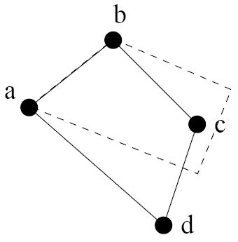
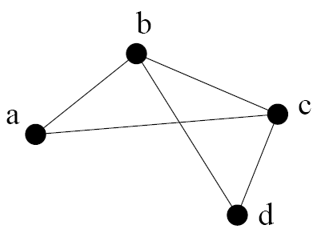
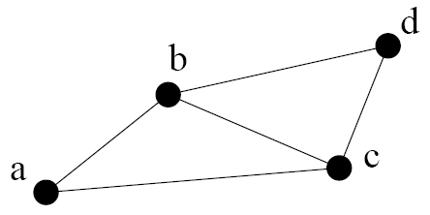
Rigidity Theory
Given a set of rigid bars connected by hinges, rigidity theory studies whether you can move them continuously.
  Continuous deformations, or flips
[Jie Gao]

Slide 24
Rigidity Theory
Theory concerned with when we are guaranteed uniqueness of structures in 2D or 3D (or higher D).
  Applications to structural engineering, molecular structures
Definition: An n-point formation P in d-space consists of:
  Coordinates in d-space for points p₁,…,p_{n}, and
  A set of edges between some points (indices).
  In other words, a graph embedded in d-dimensional space.
Definition: An n-point formation P in d-space is globally rigid provided that any other n-point formation Q with the same edges and the same distances on those edges is the same as P, up to translation, rotation, and reflection.
  Flips are at least locally rigid. Local rigidity makes sense in
  e.g. structural engineering
  Continuous deformations are not rigid at all

Slide 25
Global Rigidity
There are some simple rules that guarantee global rigidity:
In 2D, a triangle with distances between all pairs is globally rigid. Starting with a triangle, if we repeatedly add a node and edges (with distances) to at least 3 non-collinear points, it results in a globally rigid point formation.
In 3D, a tetrahedron (with all 6 distances) is globally rigid. Starting with a tetrahedron, if we repeatedly add a node and edges (with distances) to at least 4 non-coplanar points, it results in a globally rigid point formation.

Slide 26
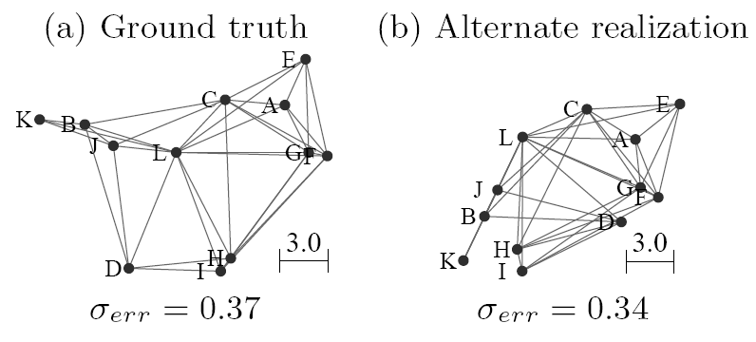
Noisy distance estimates
Noise can introduce anomalies
  We might no longer get exact solutions, but may have some error (difference between given and computed distances). Tolerable, unavoidable.
  Solutions may no longer be unique, even allowing for small errors: varying the measurements a tiny amount could yield drastically different best solutions.
  Errors caused by noisy measurements can become compounded through an iterative coordinate assignment procedure.
[Jie Gao]

Slide 27
Coping with noisy measurements
Idea: Robust quadrilaterals
  Robust with respect to a bound e on error in distance calculations.
  4 nodes in 2D, edges (and distances) between all pairs.
  Nodes spaced so, even with errors, only one realization is possible.
Method
  Parameterized by bound e on measurement error.
  Start with a robust quadrilateral, and then add nodes iteratively.
Discussion
  Avoids certain kinds of ambiguities (“flip”, discontinuous behavior)
  But not enough to guarantee global rigidity
  To guarantee global rigidity, additional constraints are needed, e.g. on angles
  Intuitively: if angles are too small, then flips are easy, even if noise is bounded

Slide 28
Rigidity alternative: Simple hop-based algorithms
Algorithm
  Get hop distance h to anchor(s)
  Intersect circles around anchors
    radius = distance to anchor
  Choose point such that maximum error is minimal
    Find enclosing circle (ball) of minimal radius
    Center is calculated location
In higher dimensions: 1 < d · h
  Rule of thumb: Sparse graph
  → bad performance

Slide 29
How about no anchors at all...?
In absence of anchors...
→ ...nodes are clueless about real coordinates.
For many applications, real coordinates are not necessary
→ Virtual coordinates are sufficient
→ Geometric Routing requires only virtual coordinates
    Require no routing tables
    Resource-frugal and scalable
s
d

Slide 30
Virtual Coordinates
Idea:
Close-by nodes have similar coordinates
Distant nodes have very different coordinates
→ Similar coordinates imply physical proximity!
Applications
  Geo-Routing
  Locality-sensitive queries
  Obtaining meta information on the network
  Anycast services („Which of the service nodes is closest to me?“)
  Outside the sensor network domain: e.g., Internet mapping

Slide 31
Model
Unit Disk Graph (UDG) to model
wireless multi-hop network
  Two nodes can communicate iff
  Euclidean distance is at most 1
Sensor nodes may not be capable of
  Sensing directions to neighbors
  Measuring distances to neighbors
Goal: Derive topologically correct coordinate information from connectivity information only.
  Even the simplest nodes can derive connectivity information
v
1
u

Slide 32
Virtual Coordinates UDG Embedding
Given the connectivity information for each node...
v₁
v₂
v₃
v₄
v₅
...and knowing the underlying graph is a UDG...
v₂
v₅
v₁
v₃
v₂
v₄
v₅
v₃
v₅
v₁
v₃
v₄
...find a UDG embedding in the plane
such that all connectivity requirements are
fulfilled! (→ Find a realization of a UDG)
v₁
v₂
v₅
This problem is NP-hard!
(Simple reduction to UDG-recognition
problem, which is NP-hard)
[Breu, Kirkpatrick, Comp.Geom.Theory 1998]
v₄
v₃

Slide 33
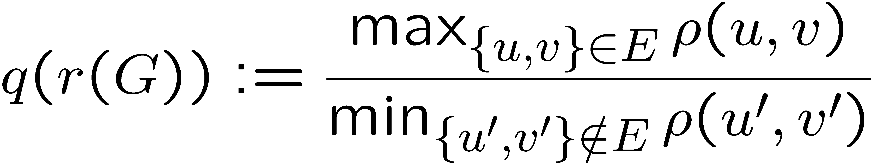
UDG Approximation – Quality of Embedding
Finding an exact realization of a UDG is NP-hard.
→ Find an embedding r(G) which approximates a realization.
Particularly,
→ Map adjacent vertices (edges) to points which are close together.
→ Map non-adjacent vertices („non-edges“) to far apart points.
Define quality of embedding q(r(G)) as:
Ratio between longest edge to shortest non-edge in the
embedding.
Let ρ(u,v) be the distance between points u and v in the embedding.

Slide 34

UDG Approximation
For each UDG G, there exists
an embedding r(G), such
that, q(r(G)) · 1.
(a realization of G)
Finding such an embedding is NP-hard
An algorithm ALG achieves approximation ratio α if for all unit disk graphs G, q(r_{ALG}(G))· α.
Example:
v₃
v₁
v₅
v₁
v₂
v₃
v₄
v₅
v₂
v₅
v₁
v₃
v₂
v₄
v₅
v₃
v₅
v₁
v₃
v₄
v₂
v₄
r(q(G)) = 1.8 / 0.7 = 2.6

Slide 35
Some Results
There are a few virtual coordinates algorithms
Almost all of them evaluated only by simulation on random graphs
In fact there are very few provable approximation algorithms
There is an algorithm which achieves an approximation
ratio of O(log^{2.5} n), n being the number of nodes in G.
[Pemmaraju and Pirwani, 2007]
Plus there are lower bounds on the approximability.
There is no algorithm with approximation
ratio better than √3/2 – ² unless P = NP.

Slide 36
Approximation Algorithm: Overview
Four major steps
  Compute metric on MIS of input
  graph → Spreading constraints
  (Key conceptual difference to
  previous approaches!)
  Volume-respecting,
  high dimensional embedding
  Random projection to 2D
  Final embedding
UDG Graph G with MIS M.
Approximate pairwise distances between nodes such that, MIS nodes are neatly spread out.
Volume respecting embedding of nodes in R^{n} with small distortion.
Nodes spread out fairly well in R².
Final embedding of G in R².

Slide 37
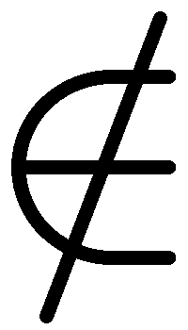
Lower Bound: Quasi Unit Disk Graph
Definition Quasi Unit Disk Graph:
Let V2 R², and d 2 [0,1]. The symmetric Euclidean graph G=(V,E), such that for any pair u,v 2 V
    dist(u,v) · d ) {u,v} 2 E
    dist(u,v) > 1 ) {u,v} E
is called d-quasi unit disk graph.
1
d
Note that between d and 1, the existence of an edge is unspecified.

Slide 38


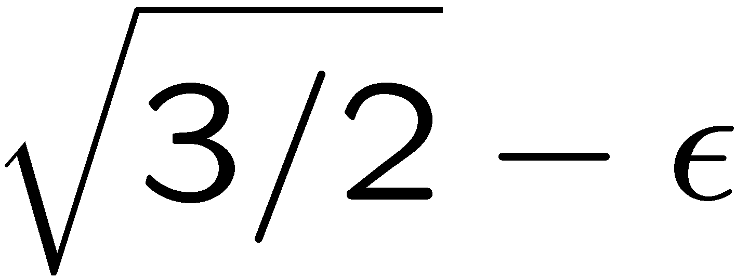
Reduction
We want to show that finding an embedding with
, where ε goes to 0 for n → 1 is NP-hard.
We prove an equivalent statement:
Given a unit disk graph G=(V,E), it is NP-hard to find a realization of G as a d-quasi unit disk graph with , where ε tends to 0 for n→1.
Even when allowing non-edges to be smaller than 1, embedding a unit disk graph remains NP-hard!
It follows that finding an approximation ratio better than
is also NP-hard.

Slide 39

Reduction
Reduction from 3-SAT (each variable appears in at most 3 clauses)
Given a instance C of this 3-SAT, we give a polynomial time construction of G_{C}=(V_{C}, E_{C}) such that the following holds:
  C is satisfiable ) G_{C} is realizable as a unit disk graph
  C is not satisfiable ) G_{C} is not realizable as a d-quasi unit disk
    graph with
Unless P=NP, there is no approximation algorithm with approximation ratio better than .

Slide 40
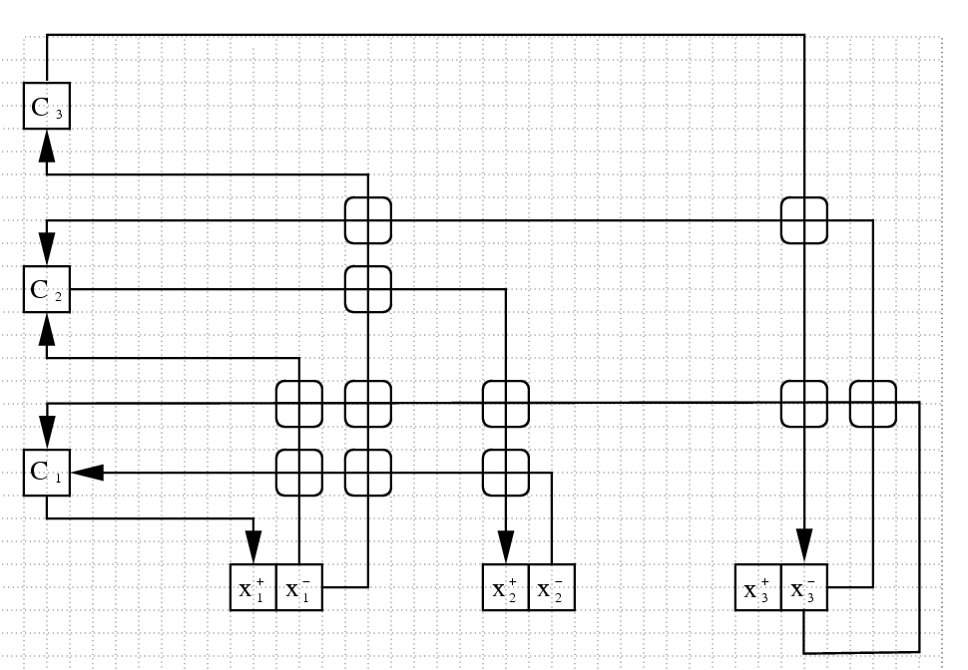
Proof idea
Construct a grid drawing of the SAT instance.
Grid drawing is orientable iff SAT instance is satisfiable.
Grid components (clauses, literals, wires, crossings,...) are composed of nodes → Graph G_{C}.
G_{C} is realizable as a d-quasi unit disk graph with
iff grid drawing is orientable.

Slide 41
Heuristics: Spring embedder
Nodes are “masses”, edges are “springs”.
Length of the spring equals the distance measurement.
Springs put forces to the nodes, nodes move, until stabilization.
Force: F_{ij} =d_{ij} – r_{ij}, along the direction p_{i}p_{j}.
Total force on n_{i}: F_{i}=Σ F_{ij}.
Move the node n_{i} by a small distance (proportional to F_{i}).
p_{j}
j
F_{ij}
d_{ij}
i
p_{i}

Slide 42
Spring Embedder Discussion
Problems:
  may deadlock in local minimum
  may never converge/stabilize (e.g. just two nodes)
Solution: Need to start from a reasonably good initial estimation.
[Jie Gao]

Slide 43
Heuristics: Priyantha et al.
[Fleischer & Pich]

Slide 44
Heuristics: Priyantha et al. (continued)
Phase 2: Spring Embedder
[Fleischer & Pich]

Slide 45
Heuristics: Gotsman et al.
[Fleischer & Pich]

Slide 46
Heuristics: Gotsman et al. (continued)
[Fleischer & Pich]

Slide 47
Heuristics: Shang et al.
[Fleischer & Pich]

Slide 48
Heuristics: Bruck et al.
[Fleischer & Pich]

Slide 49
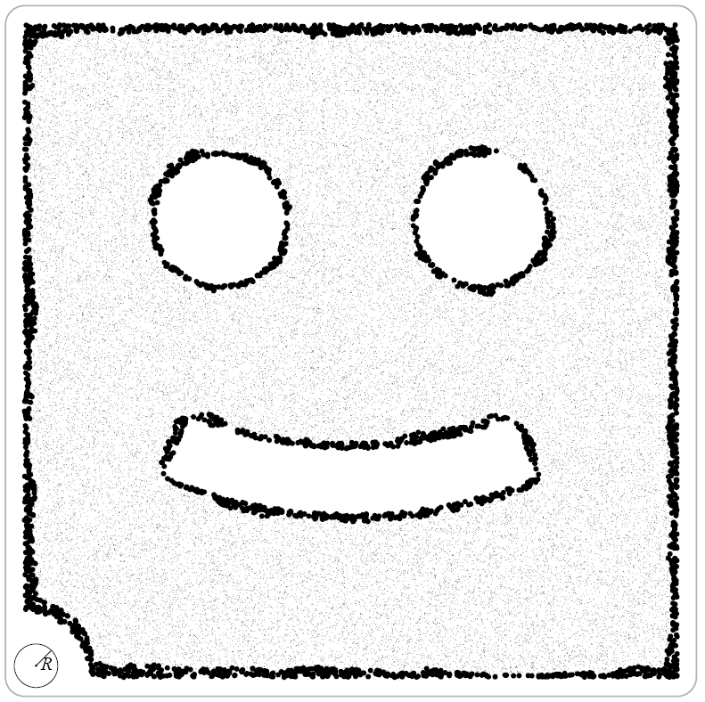
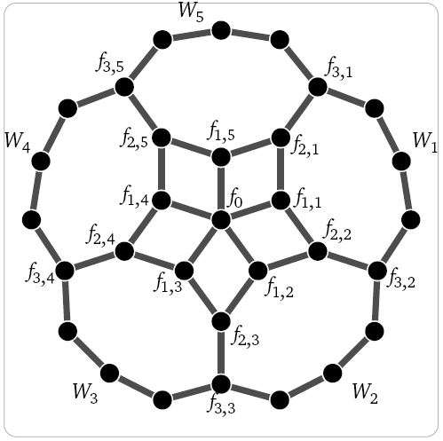
Boundary recognition
Related problem, given a connectivity graph, what is the boundary?
So far heuristics only, one heuristic uses the idea of independent nodes; specifically, an interior (non-boundary) node sees enough (e.g. 5) independent neighbors which in turn have a ring around them; these are called “flowers”. Flowers can be grown and connected to compute the boundary.
However, this is only a heuristic, and does not always work…

Slide 50
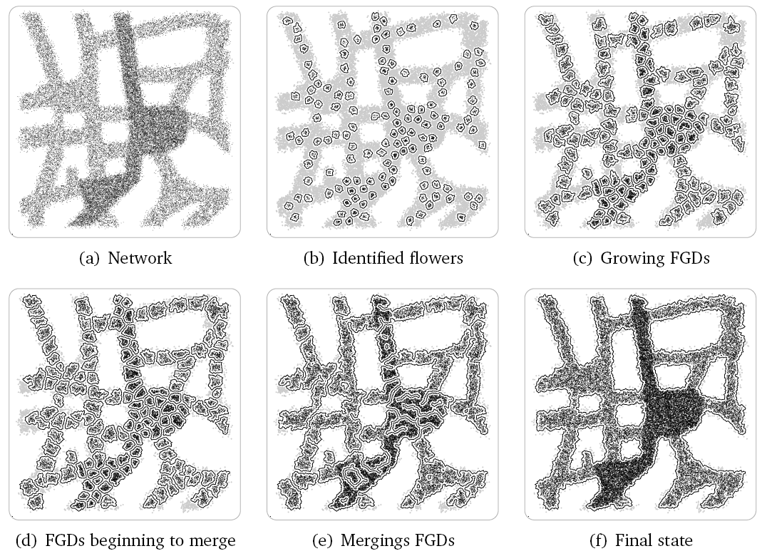
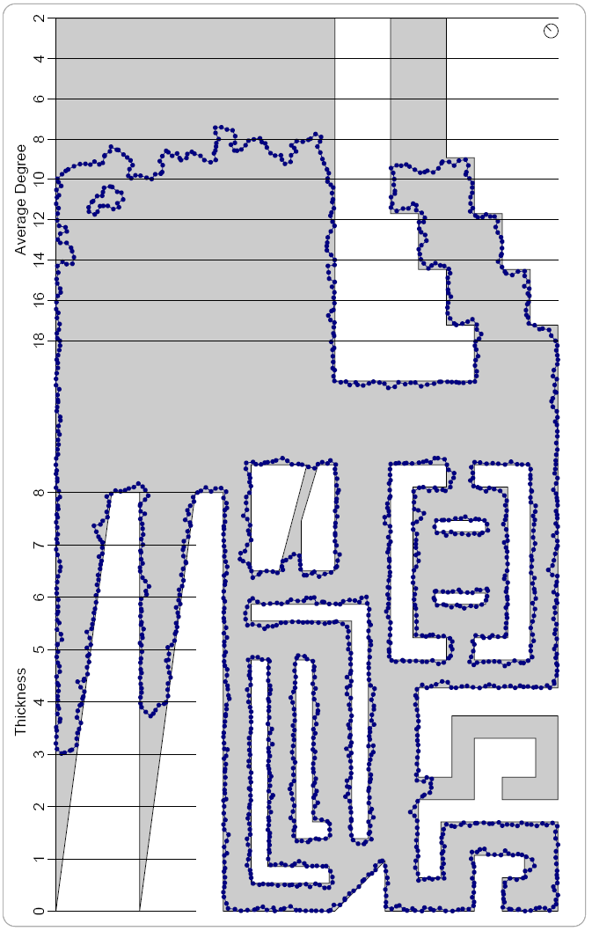
Boundary recognition

Slide 51
Open problem
One tough open problem of this chapter obviously is the UDG embedding problem: Given the adjacency matrix of a unit disk graph, find positions for all nodes in the Euclidean plane such that the ratio between the maximum distance between any two adjacent nodes and the minimum distance between any two non-adjacent nodes is as small as possible.
There is a large gap between the best known lower bound, which is a constant, and the polylogarithmic upper bound. It is a challenging task to either come up with a better approximation algorithm or prove a stronger (non-constant) lower bound. Once we understand this better, we can try networks with anchors, or with (approximate) distance/angle information.
Generally, beyond GPS this area is in its infancy.

