Slide 1
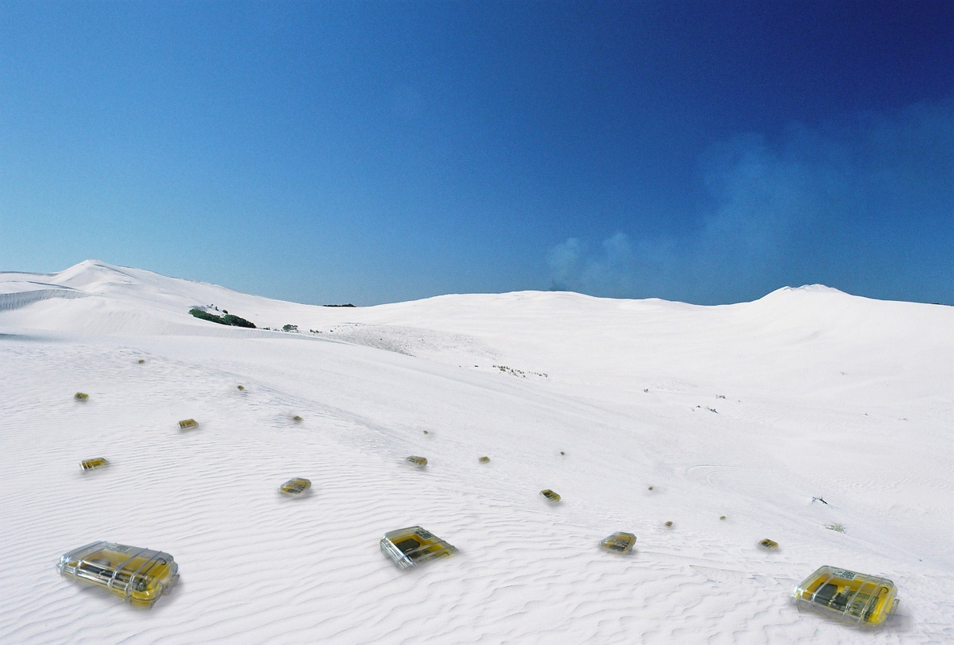

Data Gathering
Chapter 4
TexPoint fonts used in EMF.
Read the TexPoint manual before you delete this box.: AAAAAAA

Slide 2

Environmental Monitoring (PermaSense)
Understand global warming in alpine environment
Harsh environmental conditions
Swiss made (Basel, Zurich)
Go

Slide 3
Rating
Area maturity
Practical importance
Theory appeal
First steps Text book
No apps Mission critical
Boooooooring Exciting

Slide 4
Overview
Motivation
Data gathering
  Max, Min, Average, Median, …
Universal Spanning Tree: Data gathering with changing subsets
Energy-efficient data gathering: Dozer

Slide 5









Sensor networks
Sensor nodes
  Processor & memory
  Short-range radio
  Battery powered
Requirements
  Monitoring geographic region
  Unattended operation
  Long lifetime
What kind of traffic patterns may
occur in a sensor network?

Slide 6
Data Gathering
Different traffic demands require different solutions
Continuous data collection
  Every node sends a sensor reading once every two minutes
Database-like network queries
  “Which sensors measure a temperature higher than 21°C?”
Event notifications
  A sensor sends an emergency message in case of fire detection.

Slide 7
Sensor Network as a Database
Use paradigms familiar from relational databases to simplify the
“programming” interface for the application developer.
TinyDB is a service that supports
SQL-like queries on a sensor network.
  Flooding/echo communication
  Uses in-network aggregation to
  speed up result propagation.

Slide 8
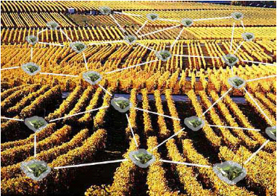
Distributed Aggregation
Growing interest in distributed aggregation
  Sensor networks, distributed databases...
Aggregation functions?
  Distributive (max, min, sum, count)
  Algebraic (plus, minus, average)
  Holistic (median, k^{th} smallest/largest value)
Combinations of these functions enable complex queries.
  „What is the average of the 10% largest values?“
What cannot be computed using these functions?

Slide 9
Aggregation Model
How difficult is it to compute these aggregation primitives?
Model:
  All nodes hold a single element.
  A spanning tree is available
    Shortest path tree (SPT), all nodes on shortest path to sink, radius D
  Messages can only contain 1 or 2 elements.
Can be generalized to an arbitrary number of elements!
O(1)
8
65
36
9
27
45
19
71
19
28
3
96
100
20

Slide 10
Computing the Minimum Value…
Use a simple flooding-echo procedure → convergecast
Time complexity: Θ(D)
Number of messages: Θ(n)
send me the min-value!
minimum = 3
8
3
65
36
36
9
19
3
27
9
45
19
3
45
19
71
96
20
19
28
3
100
20
3
96
20
28

Slide 11
Distributive & Algebraic Functions
How do you compute the sum of all values?
... what about the average?
... what about a random value?
... or even the median?

Slide 12
Holistic Functions
It is widely believed that holistic functions are hard to compute using in-network aggregation.
  Example: TAG is an aggregation service for sensor networks. It is fast for other aggregates, but not for the MEDIAN aggregate.
„Thus, we have shown that (...) in network aggregation can reduce communication costs by an order of magnitude over centralized approaches, and that, even in the worst case (such as with MEDIAN), it provides performance equal to the centralized approach.“
TAG simulation: 2500 nodes in a 50x50 grid

Slide 13
Randomized Algorithm
Choosing elements uniformly at random is a good idea...
  How is this done?
Assuming that all nodes know the
sizes n₁,...,n_{t} of the subtrees rooted
at their children v₁,...,v_{t}, the request
is forwarded to node v_{i} with probability:
p_{i} := n_{i} / (1+ Σ_{k} n_{k}).
Key observation: Choosing an element randomly requires O(D) time!
  Use pipe-lining to select several random elements!
v
p₁
p_{t}
p₂
request
n₁
n₂
...
n_{t}
With probability 1 / (1+ Σ_{k} n_{k})
node v chooses itself.
D elements in O(D) time!

Slide 14
Randomized Algorithm
The algorithm operates in phases
  A candidate is a node whose element is possibly the solution.
  The set of candidates decreases in each phase.
A phase of the randomized algorithm:
Count the number of candidates in all subtrees
Pick O(D) elements x₁,...,x_{d} uniformly at random
For all those elements, count the number of
smaller elements!
Each step can be performed in O(D) time!
-1
x₁
x₂
x_{d}
1
n₁ elem.
n₂ elem.
n_{d+1} elem.
a₁
a₂
…
…
…
a_{n-1}
a_{n}

Slide 15
Randomized Algorithm
Using these counts, the number of candidates can be reduced by a factor of D in a constant number of phases with high probability.
It can be shown that Ω(D·log_{D} n) is a lower bound for finding the median. In other words, this simple randomized algorithm is asymptotically optimal.
The only remaining question: Is randomization needed,
or, what can we do deterministically?
The time complexity is O(D·log_{D} n) w.h.p.
With probability at least 1-1/n^{c} for a constant c≥1.

Slide 16
Deterministic Algorithm
Why is it difficult to find a good deterministic algorithm?
  Finding a good selection of elements that provably reduces
  the set of candidates is hard.
Idea: Always propagate the median of all received values.
Problem: In one phase, only the
h^{th} smallest element is found if h
is the height of the tree...
  Time complexity: O(n/h)
3
3
2
100
2
100
1
100
99
102
One could do a lot better!!!
(Not shown in this course.)
1
100
99
102

Slide 17
Median Summary
One can generalize the median problem: In k-selection we are looking for the k^{th} smallest element.
  We have seen a simple randomized algorithm with time complexity O(D·log_{D} n) w.h.p., which is asympotitally optimal.
  There fastest known deterministic algorithm has time
  complexity O(D·log_{D}² n).
  If ∃c ≤ 1: D = n^{c}, k-selection can be solved efficiently in
  Θ(D) time even deterministically.
Recall the 50x50 grid used to evaluate TAG

Slide 18
Sensor Network as a Database
We do not always require information from all sensor nodes.
  SELECT MAX(temp) FROM sensors WHERE node_id < “H”.
Max = 23
23
22
W
18
17
22
Z
G
19
X
A
20
23
C
22
F
Y
20
B
15
E
D

Slide 19
Selective data aggregation
In sensor network applications
  Queries can be frequent
  Sensor groups are time-varying
  Events happen in a dynamic fashion
Option 1: Construct aggregation trees for each group
  Setting up a good tree incurs communication overhead
Option 2: Construct a single spanning tree
  When given a sensor group, simply use the induced tree
  In other words, cut all the branches that are not used

Slide 20
Example
The red tree is the universal spanning tree. All links cost 1.
root/sink

Slide 21
Given the lime subset…
root/sink

Slide 22
Induced Subtree
The cost of the induced subtree for this set S is 11. The optimal is 8.
root/sink

Slide 23
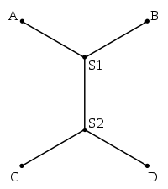
Universal Spanning Tree Problem
Given
  A set of nodes V in the Euclidean plane (or in a metric space)
  A root node r 2 V
  Define stretch of a universal spanning tree T to be
  We’re looking for a spanning tree T on V with minimum stretch.
Remark: A Steiner tree for a set of nodes S
is like a MST, except that it may use nodes
and edges outside S to help.
  Example: Steiner Tree for nodes A, B, C, D,
  with potentially all points in the plane helping

Slide 24
Main results
Upper bound:
For the minimum UST problem in Euclidean plane, with edge cost being distance, an approximation of O(log n) can be achieved.
Lower bound:
No polynomial time algorithm can approximate the minimum UST problem with stretch better than Ω(log n / log log n).
[Jia, Lin, Noubir, Rajaraman and Sundaram, STOC 2005]
Question: Why are MST or SPT not good as UST?
  Again, nodes in the plane, cost Euclidean distance

Slide 25
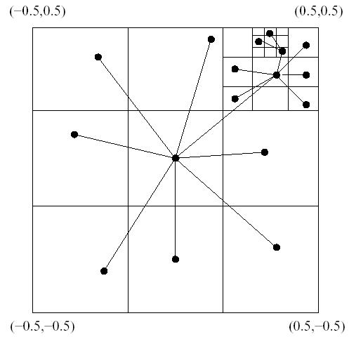
Algorithm sketch
For the simplest Euclidean case:
Recursively divide the plane and select random node.
Results: The induced tree
has logarithmic overhead.
The aggregation delay is
also constant.

Slide 26
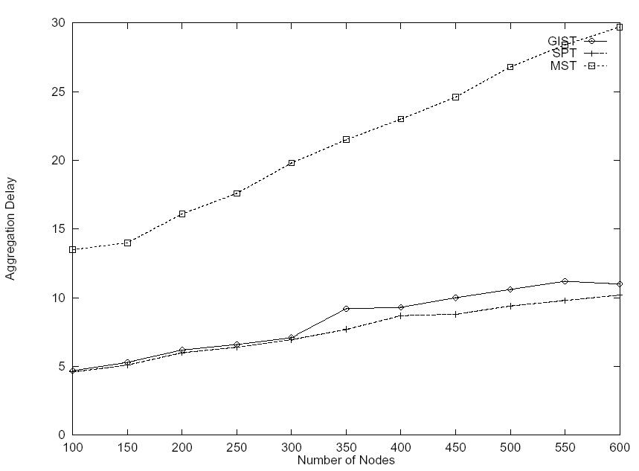
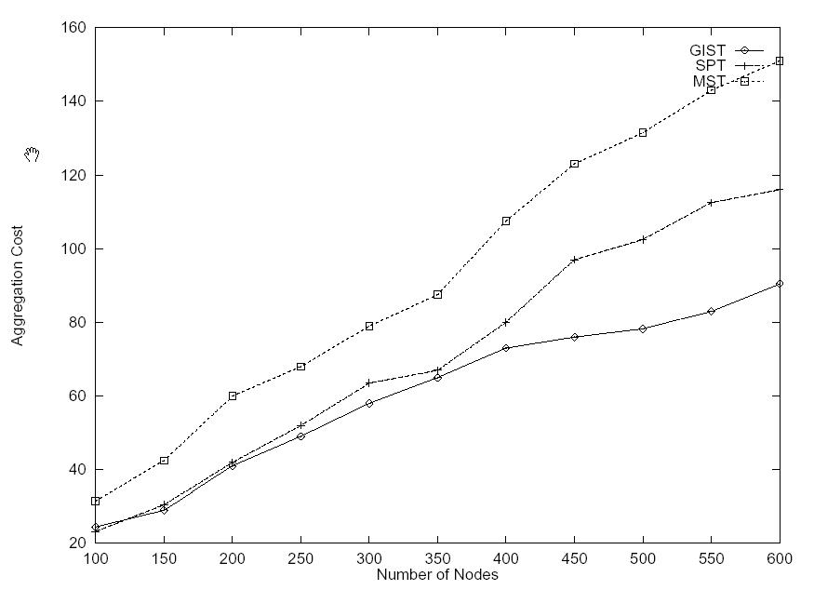
Simulation with random node distribution & random events
[Note: UST = GIST, Group-Independent Spanning Tree]

Slide 27
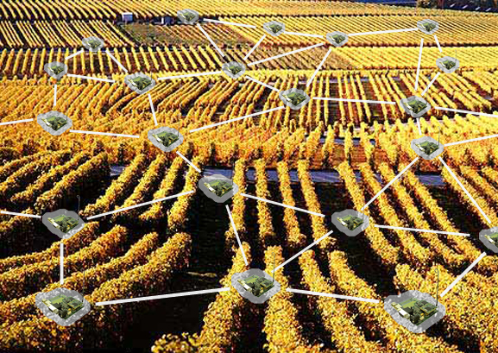
Continuous Data Gathering
Long-term measurements
Unattended operation
Low data rates
Battery powered
Network latency
Dynamic bandwidth demands
Energy conservation is crucial to prolong network lifetime

Slide 28
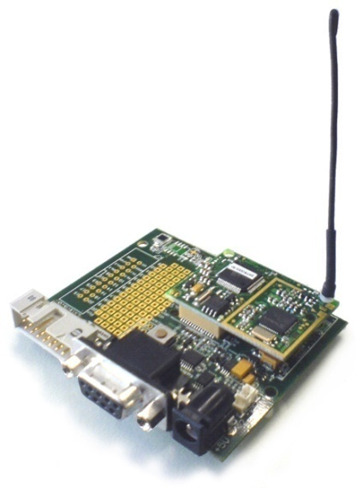
Energy-Efficient Protocol Design
Communication subsystem is the main energy consumer
  Power down radio as much as possible
Issue is tackled at various layers
  MAC
  Topology control / clustering
  Routing
TinyNode | Power Consumption
uC sleep, radio off | 0.015 mW
Radio idle, RX, TX | 30 – 40 mW
Orchestration of the whole network stack
to achieve radio duty cycles of ~1‰

Slide 29

Dozer System
Tree based routing towards data sink
  No energy wastage due to multiple paths
  Current strategy: Shortest Path Tree
“TDMA based” link scheduling
  Each node has two independent schedules
  No global time synchronization
The parent initiates each TDMA round with a beacon
  Enables integration of disconnected nodes
  Children tune in to their parent’s schedule
parent
child
activation frame
beacon
contention window
beacon
time

Slide 30
Dozer System
Parent decides on its children data upload times
  Each interval is divided into upload slots of equal length
  Upon connecting each child gets its own slot
  Data transmissions are always acknowledged
No traditional MAC layer
  Transmissions happen at exactly predetermined point in time
  Collisions are explicitly accepted
  Random jitter resolves schedule collisions
data transfer
jitter
slot 1
slot 2
slot k
time

Slide 31
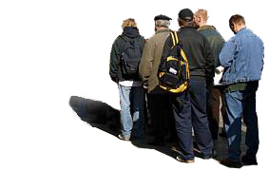
Dozer System
Lightweight backchannel
  Beacon messages comprise commands
Bootstrap
  Scan for a full interval
  Suspend mode during network downtime
Potential parents
  Avoid costly bootstrap mode on link failure
  Periodically refresh the list
periodic channel activity check

Slide 32
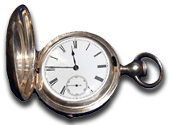
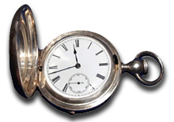
Dozer System
Clock drift compensation
  Dynamic adaptation to clock drift of the parent node
Application scheduling
  Make sure no computation is blocking the network stack
  TDMA is highly time critical
Queuing strategy
  Fixed size buffers

Slide 33
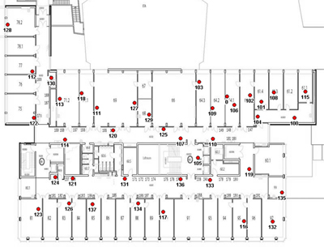
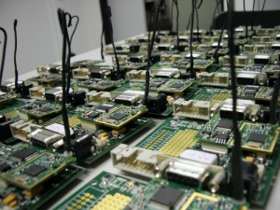
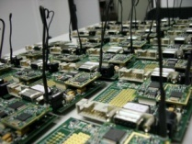
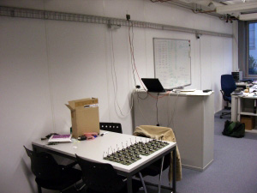
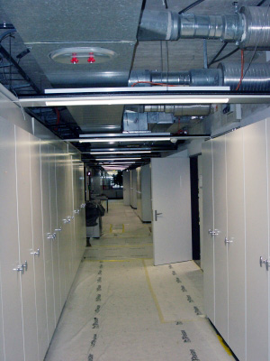
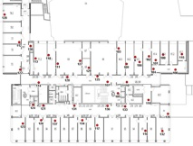


Evaluation
Platform
  TinyNode
    MSP 430
    Semtech XE1205
  TinyOS 1.x
Testbed
  40 Nodes
  Indoor deployment
  > 1 month uptime
  30 sec beacon interval
  2 min data sampling interval

Slide 34
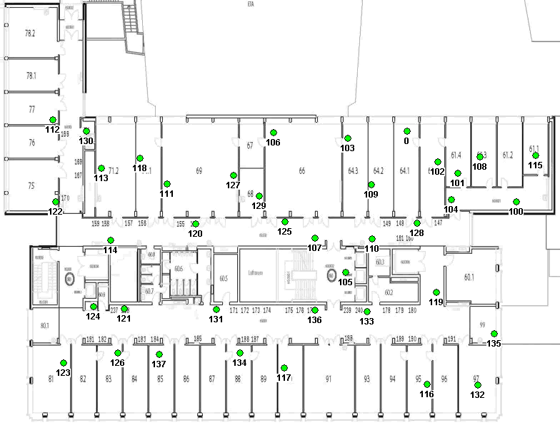
Dozer in Action

Slide 35
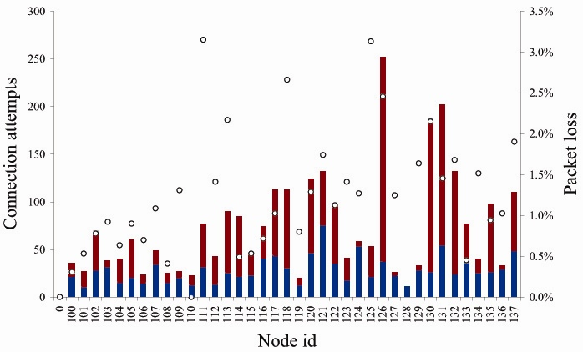
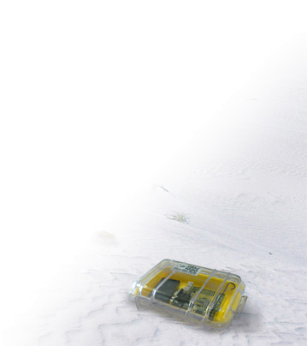
Tree Maintenance
1 week of operation
on average 1.2%

Slide 36
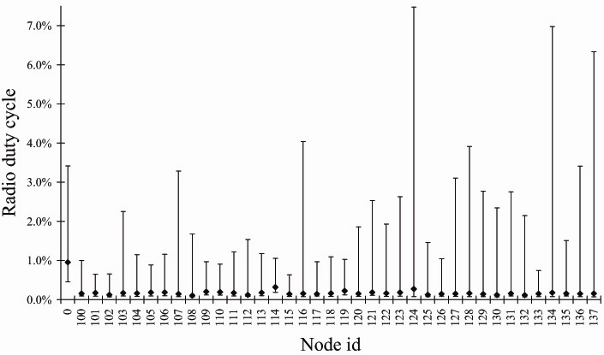
Energy Consumption
on average 0.16%
Mean energy consumption of 0.082 mW

Slide 37
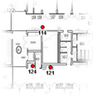
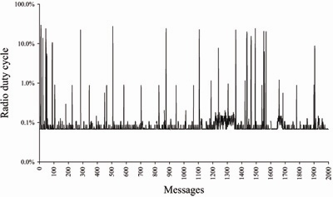
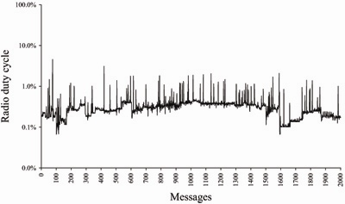
Energy Consumption
0.32% duty cycle
0.28% duty cycle
scanning
overhearing
updating
#children
Leaf node
Few neighbors
Short disruptions
Relay node
No scanning

Slide 38
More than one sink?
Use the anycast approach and send to the closest sink.
In the simplest case, a source wants to minimize the number of hops. To make anycast work, we only need to implement the regular distance-vector routing algorithm.
However, one can imagine more complicated schemes where e.g. sink load is balanced, or even intermediate load is balanced.

Slide 39
Dozer Conclusions & Possible Future Work
Conclusions
  Dozer achieves duty cycles in the magnitude of 0.1%.
  Abandoning collision avoidance was the right thing to do.
Possible Future work
  Optimize delivery latency of sampled sensor data.
  Make use of multiple frequencies to further reduce collisions.

Slide 40
Open problem
Continuous data gathering is somewhat well understood, both practically and theoretically, in contrast to the two other paradigms, event detection and query processing.
One possible open question is about event detection. Assume that you have a battery-operated sensor network, both sensing and having your radio turned on costs energy. How can you build a network that raises an alarm quickly if some large-scale event (many nodes will notice the event if sensors are turned on) happens? What if nodes often sense false positives (nodes often sense something even if there is no large-scale event)?

