Slide 1
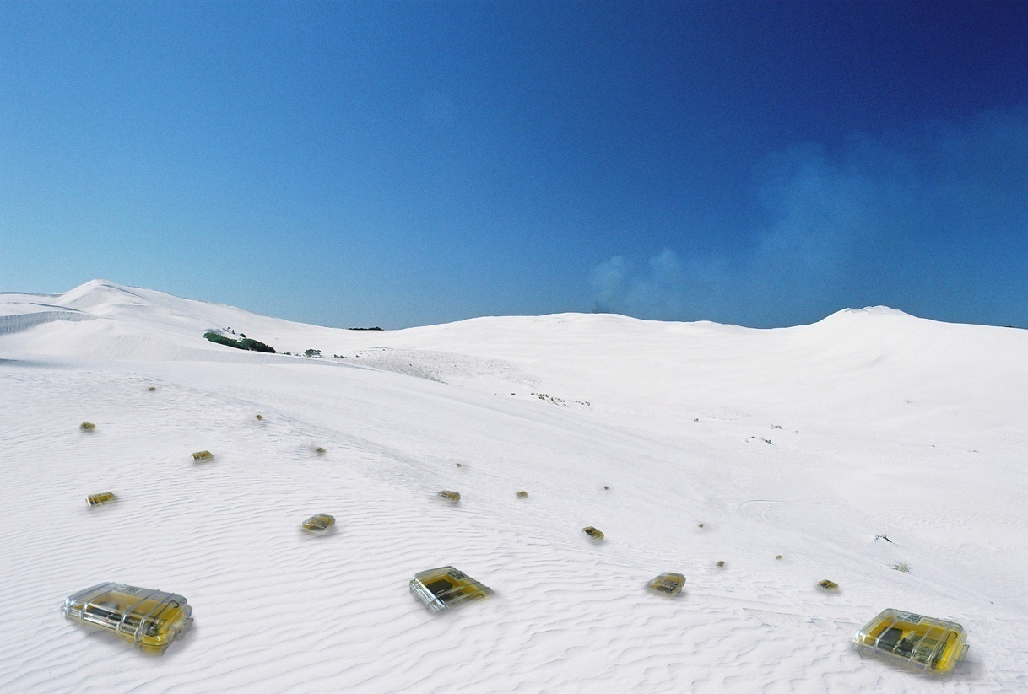

Topology Control
Chapter 3
TexPoint fonts used in EMF.
Read the TexPoint manual before you delete this box.: AAAA

Slide 2
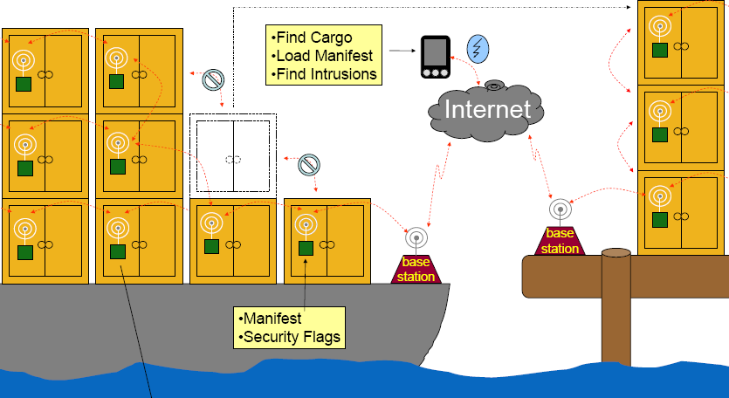

Inventory Tracking (Cargo Tracking)
Current tracking systems require line-of-sight to satellite.
Count and locate containers
Search containers for specific item
Monitor accelerometer for sudden motion
Monitor light sensor for unauthorized entry into container

Slide 3

Rating
Area maturity
Practical importance
Theory appeal
First steps Text book
No apps Mission critical
Boooooooring Exciting

Slide 4
Overview – Topology Control
Proximity Graphs: Gabriel Graph et al.
Practical Topology Control: XTC
Interference

Slide 5
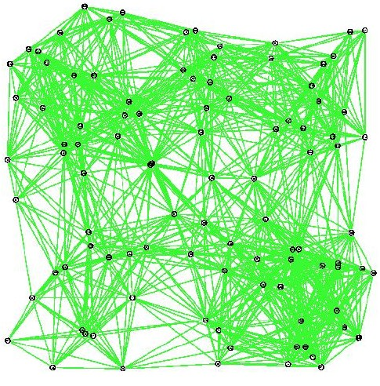
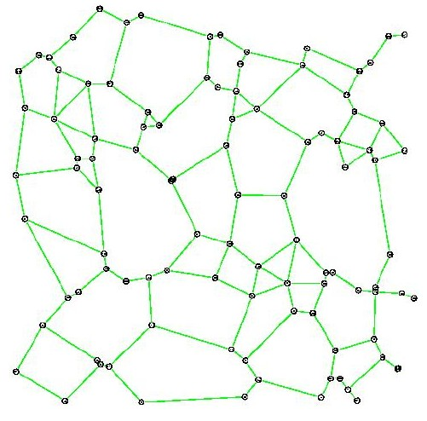
Topology Control
Drop long-range neighbors: Reduces interference and energy!
But still stay connected (or even spanner)

Slide 6
Topology Control as a Trade-Off
Topology Control
Network Connectivity
Spanner Property
Conserve Energy
Reduce Interference
Sparse Graph, Low Degree
Planarity
Symmetric Links
Less Dynamics
d_{TC} (u,v) · c ¢ d(u,v)

Slide 7
Spanners
Let the distance of a path from node u to node v, denoted as d(u,v), be the sum of the Euclidean distances of the links of the shortest path.
  Writing d(u,v)^{p} is short for taking each link distance to the power of p, again summing up over all links.
Basic idea: S is spanner of graph G if S is a subgraph of G that has certain properties for all pairs of nodes, e.g.
  Geometric spanner: d_{S}(u,v) ≤ c¢d_{G}(u,v)
  Power spanner: d_{S}(u,v)^{α} ≤ c¢d_{G}(u,v)^{α}, for path loss exponent α
  Weak spanner: path of S from u to v within disk of diameter c¢d_{G}(u,v)
  Hop spanner: d_{S}(u,v)⁰ ≤ c¢d_{G}(u,v)⁰
  Additive hop spanner: d_{S}(u,v)⁰ ≤ d_{G}(u,v)⁰ + c
  (α, β) spanner: d_{S}(u,v)⁰ ≤ α¢d_{G}(u,v)⁰ + β
  The stretch can be defined as maximum ratio d_{S}/d_{G}

Slide 8
Gabriel Graph
Let disk(u,v) be a disk with diameter (u,v)
that is determined by the two points u,v.
The Gabriel Graph GG(V) is defined
as an undirected graph (with E being
a set of undirected edges). There is an
edge between two nodes u,v iff the
disk(u,v) including boundary contains no
other points.
As we will see the Gabriel Graph
has interesting properties.
v
disk(u,v)
u

Slide 9
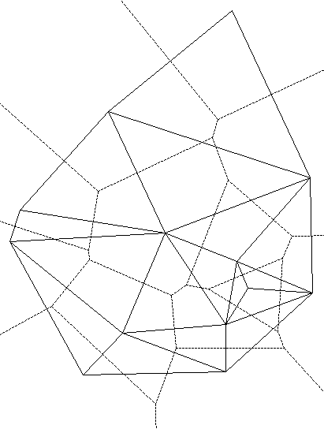
Delaunay Triangulation
Let disk(u,v,w) be a disk defined by
the three points u,v,w.
The Delaunay Triangulation (Graph)
DT(V) is defined as an undirected
graph (with E being a set of undirected
edges). There is a triangle of edges
between three nodes u,v,w iff the
disk(u,v,w) contains no other points.
The Delaunay Triangulation is the
dual of the Voronoi diagram, and
widely used in various CS areas
  the DT is planar
  the DT is a geometric spanner
v
disk(u,v,w)
w
u

Slide 10
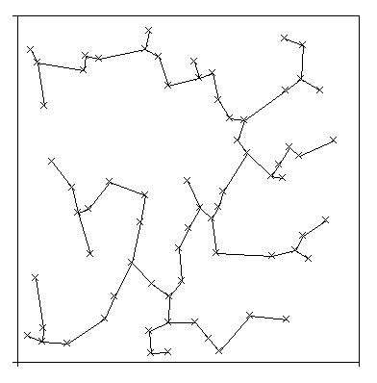
Other Proximity Graphs
Relative Neighborhood Graph RNG(V)
  An edge e = (u,v) is in the RNG(V) iff
  there is no node w in the “lune” of (u,v),
  i.e., no noe with with (u,w) < (u,v) and
  (v,w) < (u,v).
Minimum Spanning Tree MST(V)
  A subset of E of G of minimum weight
  which forms a tree on V.
u
v

Slide 11
Properties of Proximity Graphs
Theorem 1:
MST µ RNG µ GG µ DT
Corollary:
Since the MST is connected and the DT is planar, all the graphs in Theorem 1 are connected and planar.
Theorem 2:
The Gabriel Graph is a power spanner (for path loss exponent α ¸ 2). So is GG Å UDG.
Remaining issue: either high degree (RNG and up), and/or no spanner (RNG and down). There is an extensive and ongoing search for “Swiss Army Knife” topology control algorithms.

Slide 12
More Proximity Graphs
β-Skeleton
  Disk diameters are β¢d(u,v), going through u resp. v
  Generalizing GG (β = 1) and RNG (β = 2)
Yao-Graph
  Each node partitions directions in
  k cones and then connects to the
  closest node in each cone
Cone-Based Graph
  Dynamic version of the Yao
  Graph. Neighbors are visited
  in order of their distance,
  and used only if they cover
  not yet covered angle

Slide 13
Lightweight Topology Control
Topology Control commonly assumes that the node positions are known.
What if we do not have access to position information?

Slide 14
XTC: Lightweight Topology Control without Geometry
D
C
B
G
Each node produces “ranking” of neighbors.
Examples
  Distance (closest)
  Energy (lowest)
  Link quality (best)
  Must be symmetric!
Not necessarily depending on explicit positions
Nodes exchange rankings with neighbors
A
E
1. C
2. E
3. B
4. F
5. D
6. G
F

Slide 15
XTC Algorithm (Part 2)
3. B
4. A
6. G
8. D
2. C
4. G
5. A
4. B
6. A
7. C
D
C
7. A
8. C
9. E
B
G
1. F
3. A
6. D
Each node locally goes through all neighbors in order of their ranking
If the candidate (current neighbor) ranks any of your already processed neighbors higher than yourself, then you do not need to connect to the candidate.
A
E
1. C
2. E
3. B
4. F
5. D
6. G
F
3. E
7. A

Slide 16
XTC Analysis (Part 1)
Symmetry: A node u wants a node v as a neighbor if and only if v wants u.
Proof:
  Assume 1) u → v and 2) u ← v
  Assumption 2) ⇒ 9w: (i) w Á_{v} u and (ii) w Á_{u} v
In node u’s neighbor
list, w is better than v
Contradicts Assumption 1)

Slide 17

XTC Analysis (Part 1)
Symmetry: A node u wants a node v as a neighbor if and only if v wants u.
Connectivity: If two nodes are connected originally, they will stay so (easy to show if rankings are based on symmetric link-weights).
If the ranking is energy or link quality based, then XTC will choose a topology that routes around walls and obstacles.

Slide 18
XTC Analysis (Part 2)
If the given graph is a Unit Disk Graph (no obstacles, nodes homogeneous, but not necessarily uniformly distributed), then …
The degree of each node is at most 6.
The topology is planar.
The graph is a subgraph of the RNG.
Relative Neighborhood Graph RNG(V):
  An edge e = (u,v) is in the RNG(V) iff
  there is no node w with (u,w) < (u,v)
  and (v,w) < (u,v).
u
v

Slide 19
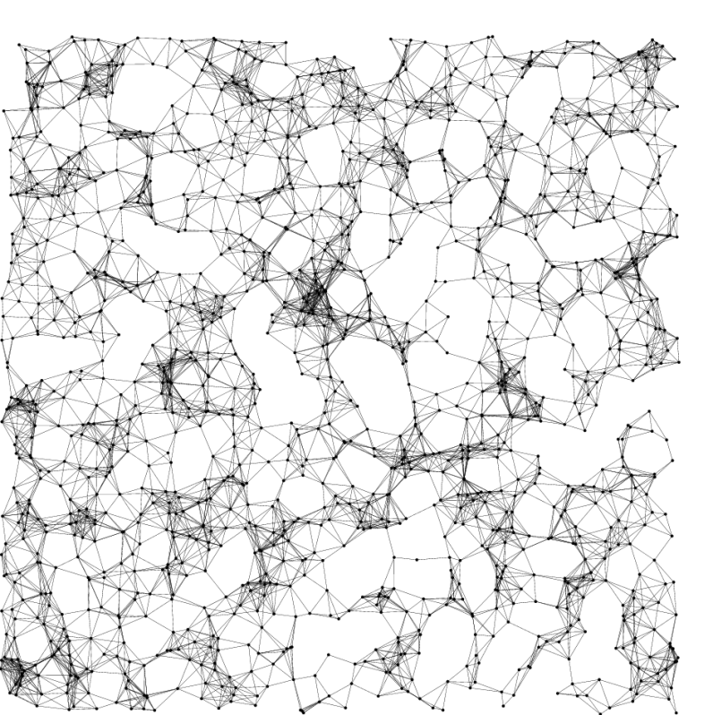
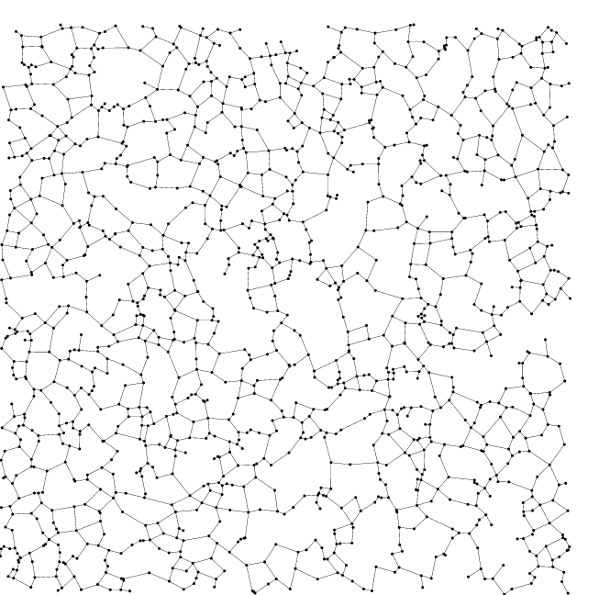
XTC Average-Case
Unit Disk Graph XTC

Slide 20
XTC Average-Case (Degrees)
v
u
UDG max
UDG avg
GG max
GG avg
XTC max
XTC avg

Slide 21
XTC Average-Case (Stretch Factor)
XTC vs. UDG – Geometric
GG vs. UDG – Geometric
XTC vs. UDG – Power
GG vs. UDG – Power

Slide 22
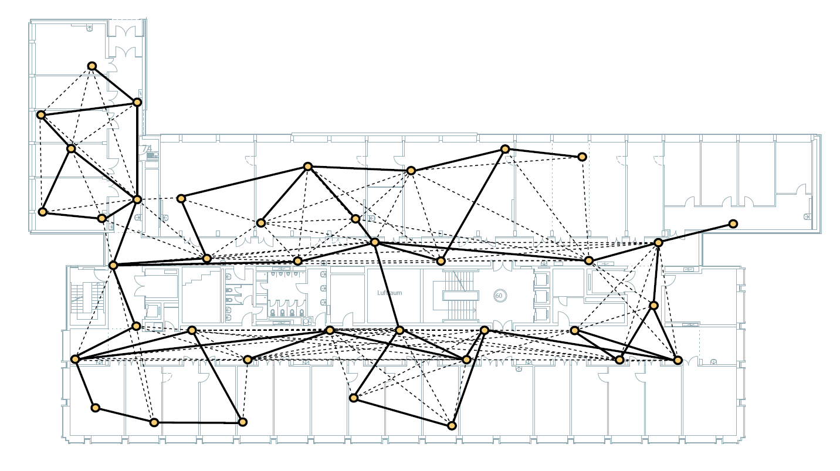
Implementing XTC, e.g. BTnodes v3

Slide 23
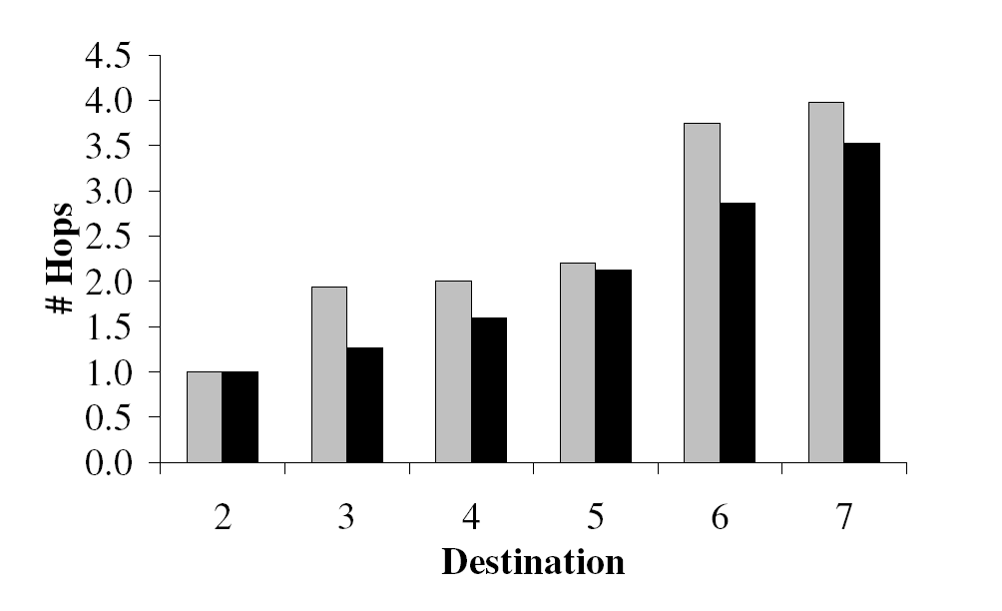
Implementing XTC, e.g. on mica2 motes
Idea:
  XTC chooses the reliable links
  The quality measure is a moving average of the received packet ratio
  Source routing: route discovery (flooding) over these reliable links only
  (black: using all links, grey: with XTC)

Slide 24
Topology Control as a Trade-Off
Topology Control
Network Connectivity
Spanner Property
Conserve Energy
Reduce Interference
Sparse Graph, Low Degree
Planarity
Symmetric Links
Less Dynamics
Really?!?

Slide 25
What is Interference?
Exact size of interference range
does not change the results
Link-based Interference Model
Node-based Interference Model
Interference 8
Interference 2
„How many nodes are affected by communication over a given link?“
„By how many other nodes can a given network node be disturbed?“
Problem statement
  We want to minimize maximum interference
  At the same time topology must be connected or spanner

Slide 26
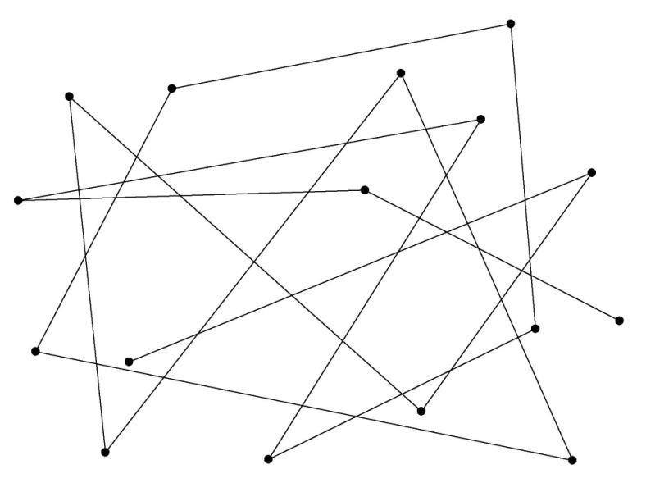
Low Node Degree Topology Control?
Low node degree does not necessarily imply low interference:
Very low node degree
but huge interference

Slide 27
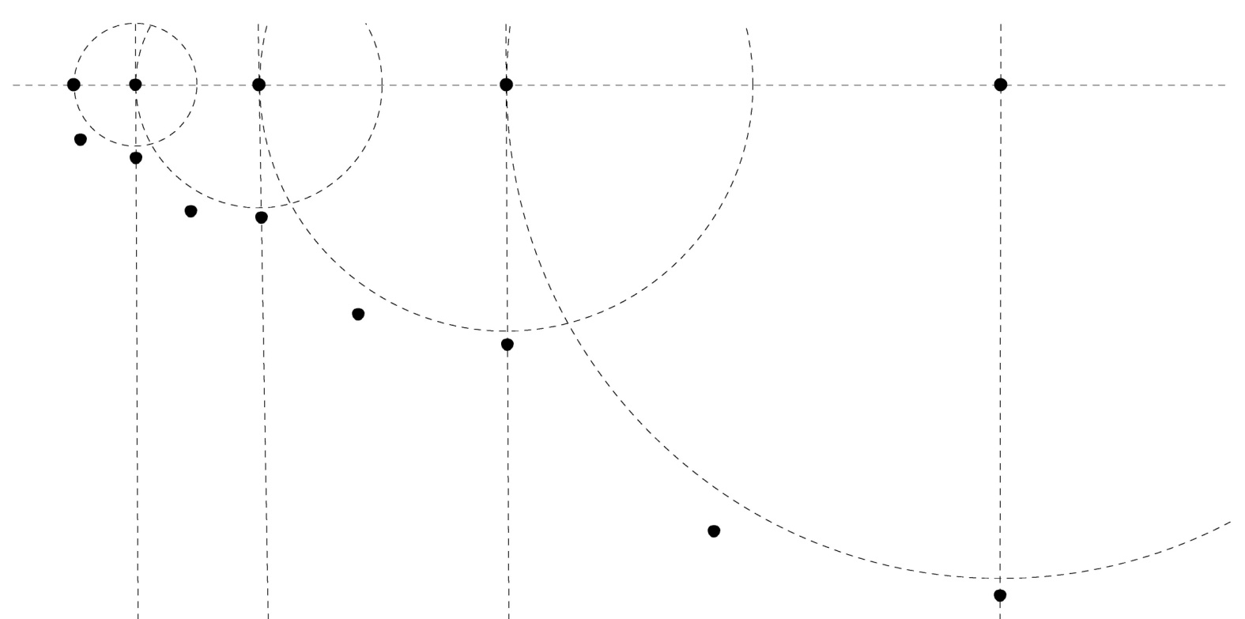
Let’s Study the Following Topology!
…from a worst-case perspective

Slide 28
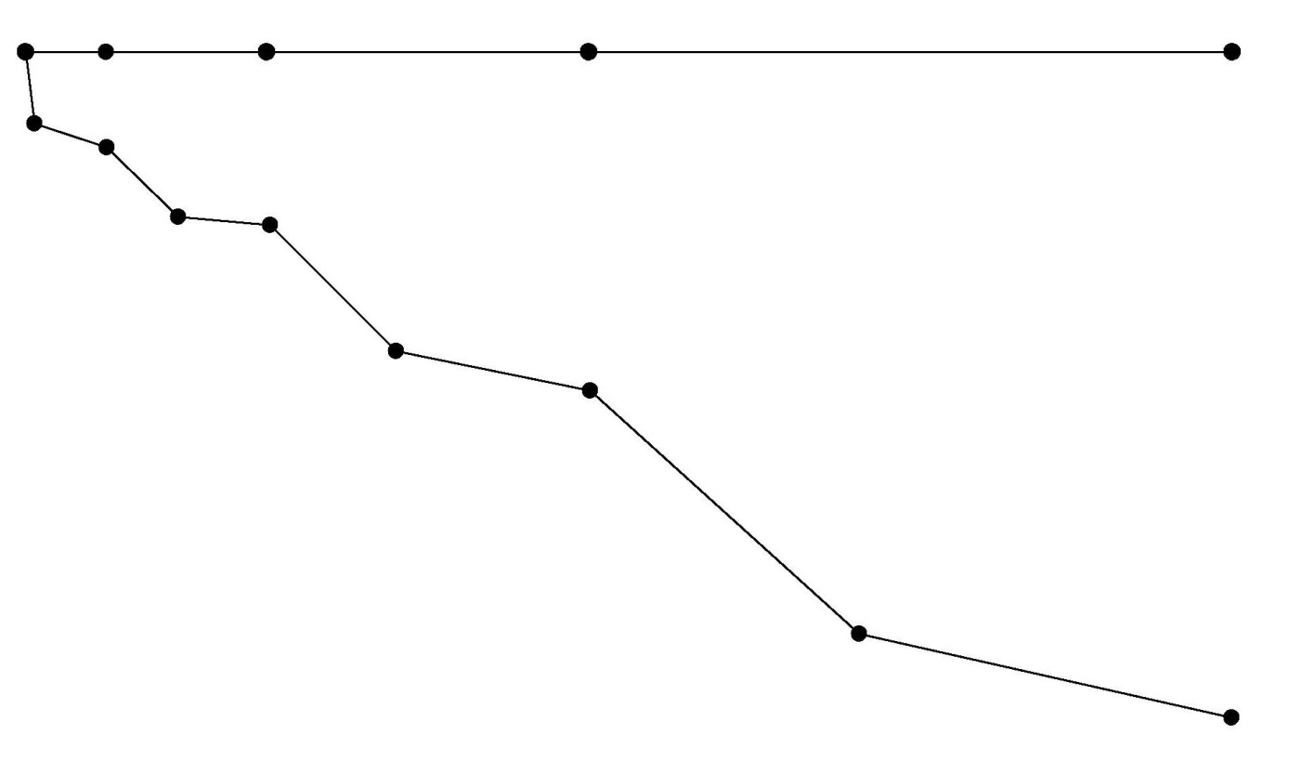
Topology Control Algorithms Produce…
All known topology control algorithms (with symmetric edges) include the nearest neighbor forest as a subgraph and produce something like this:
The interference of this
graph is Ω(n)!

Slide 29
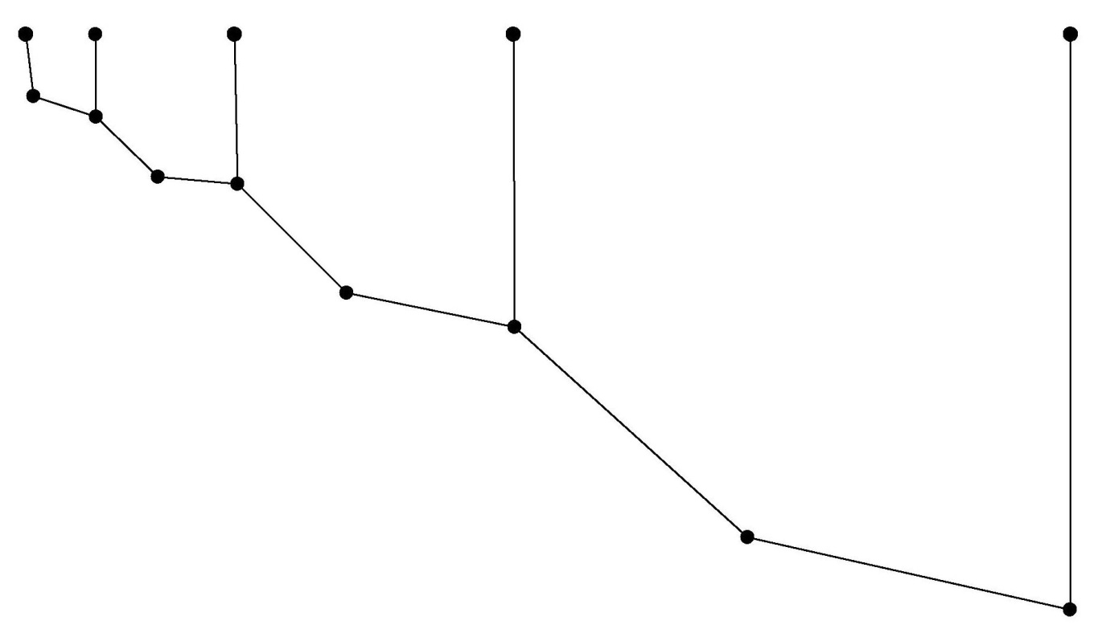
But Interference…
Interference does not need to be high…
This topology has interference O(1)!!

Slide 30
Link-based Interference Model
There is no local algorithm
that can find a good
interference topology
The optimal topology
will not be planar
u
v
5
9
9
8
3
4
8
2

Slide 31
Link-based Interference Model
LIFE (Low Interference Forest Establisher)
  Preserves Graph Connectivity
LIFE
5
3
4
6
3
10
5
  Attribute interference values as weights to edges
  Compute minimum spanning tree/forest (Kruskal’s algorithm)
2
4
9
11
3
4
8
11
9
2
7
8
7
3
8
6
2
5
4
3
3
7
4
3
2
8
4
Interference 4
LIFE constructs a minimum- interference forest

Slide 32
Average-Case Interference: Preserve Connectivity
UDG
GG
RNG
LIFE

Slide 33
Node-based Interference Model
Already 1-dimensional node distributions seem to yield inherently high interference...
Connecting linearly results in interference O(n)
1
2
4
8
...but the exponential node chain can be connected in a better way

Slide 34

Node-based Interference Model
Already 1-dimensional node distributions seem to yield inherently high interference...
Connecting linearly results in interference O(n)
...but the exponential node chain can be connected in a better way
Interference
Matches an existing lower bound

Slide 35
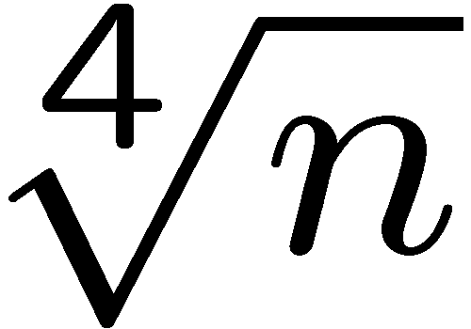

Node-based Interference Model
Arbitrary distributed nodes in one dimension
  Approximation algorithm with approximation ratio in O( )
Two-dimensional node distributions
  Simple randomized algorithm resulting in interference O( )
  Can be improved to O(√n)

Slide 36
Open problem
On the theory side there are quite a few open problems. Even the simplest questions of the node-based interference model are open:
We are given n nodes (points) in the plane, in arbitrary (worst-case) position. You must connect the nodes by a spanning tree. The neighbors of a node are the direct neighbors in the spanning tree. Now draw a circle around each node, centered at the node, with the radius being the minimal radius such that all the nodes’ neighbors are included in the circle. The interference of a node u is defined as the number of circles that include the node u. The interference of the graph is the maximum node interference. We are interested to construct the spanning tree in a way that minimizes the interference. Many questions are open: Is this problem in P, or is it NP-complete? Is there a good approximation algorithm? Etc.

