Slide 1
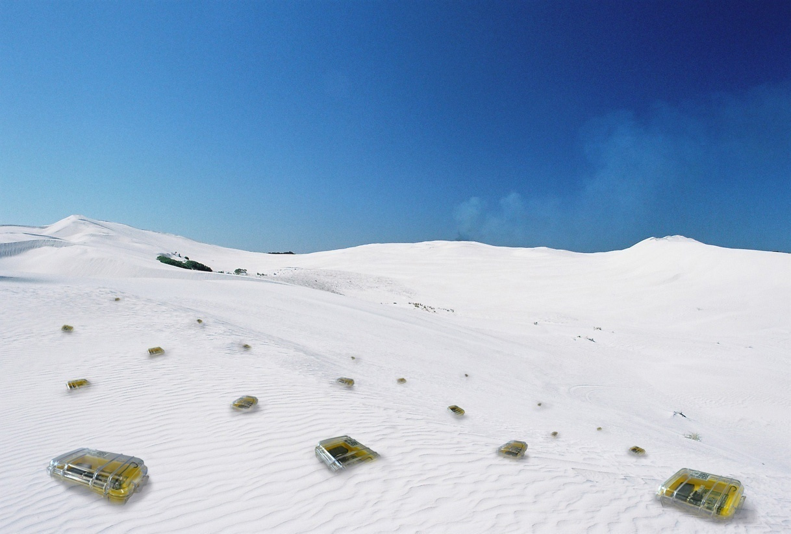

Clustering
Chapter 10
TexPoint fonts used in EMF.
Read the TexPoint manual before you delete this box.: AAAAAAA

Slide 2

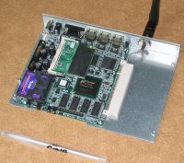
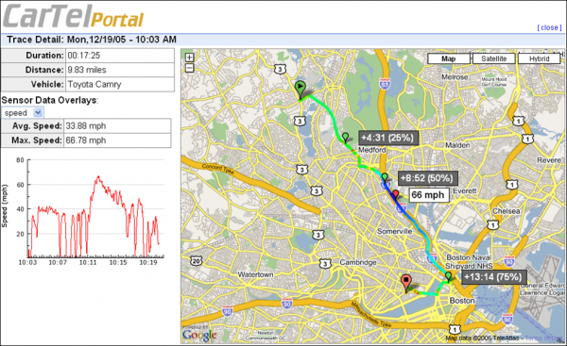
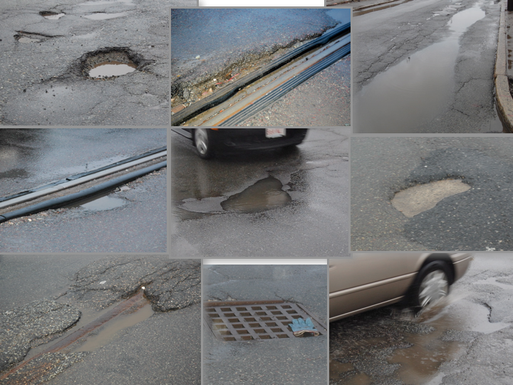
Traffic Monitoring and Routing Planning (CarTel)
GPS equipped cars for optimal route predictions, not necessarily “shortest” or “fastest” but also “most likely to get me to target by 9am”
Various other
applications
e.g. Pothole Patrol

Slide 3
Rating
Area maturity
Practical importance
Theoretical importance
First steps Text book
No apps Mission critical
Not really Must have

Slide 4
Overview
Motivation
(Connected) Dominating Set
Some Algorithms
  The “Greedy” Algorithm
  The “Tree Growing” Algorithm
  The “Marking” Algorithm
  The “Complicated” Algorithm
Connectivity Models: UDG, BIG, UBG, …
More Algorithms
  The “Largest ID” Algorithm
  The “MIS” Algorithm

Slide 5
Motivation
In theory clustering is the answer to dozens of questions in ad hoc and sensor networks. It improves almost any algorithm, e.g. in data gathering it selects cluster heads which do the work while other nodes can save energy by sleeping. Also clustering is related to other things, like coloring (which itself is related to TDMA). Here, we motivate clustering with routing:
There are thousands of routing algorithms…
Q: How good are these routing algorithms?!? Any hard results?
A: Almost none! Method-of-choice is simulation…
Flooding is key component of (many) proposed algorithms,
including most prominent ones (AODV, DSR)
At least flooding should be efficient

Slide 6
Finding a Destination by Flooding

Slide 7
Finding a Destination Efficiently

Slide 8
Backbone
Idea: Some nodes become backbone nodes (gateways). Each node can access and be accessed by at least one backbone node.
Routing:
If source is not a
gateway, transmit
message to gateway
Gateway acts as
proxy source and
routes message on
backbone to gateway
of destination.
Transmission gateway
to destination.

Slide 9
(Connected) Dominating Set
A Dominating Set DS is a subset of nodes such that each node is either in DS or has a neighbor in DS.
A Connected Dominating Set CDS is a connected DS, that is, there is a path between any two nodes in CDS that does not use nodes that are not in CDS.
A CDS is a good choice
for a backbone.
It might be favorable to
have few nodes in the
CDS. This is known as the
Minimum CDS problem

Slide 10
Formal Problem Definition: M(C)DS
Input: We are given an (arbitrary) undirected graph.
Output: Find a Minimum (Connected) Dominating Set,
that is, a (C)DS with a minimum number of nodes.
Problems
  M(C)DS is NP-hard
  Find a (C)DS that is “close” to minimum (approximation)
  The solution must be local (global solutions are impractical for dynamic networks) – topology of graph “far away” should not influence decision which nodes belong to (C)DS

Slide 11
Greedy Algorithm for Dominating Sets
Idea: Greedily choose “good” nodes into the dominating set.
Black nodes are in the DS
Grey nodes are neighbors of nodes in the DS
White nodes are not yet dominated, initially all nodes are white.
Algorithm: Greedily choose a node that colors most white nodes.
One can show that this gives a log Δ approximation, if Δ is the maximum node degree of the graph.
  The proof is similar to the “Tree Growing” proof on the following slides
  It was shown that there is no polynomial algorithm with better performance unless P¼NP.

Slide 12
CDS: The “too simple tree growing” algorithm
Idea: start with the root, and then greedily choose a neighbor of the tree that dominates as many as possible new nodes.
Black nodes are in the CDS.
Grey nodes are neighbors of nodes in the CDS.
White nodes are not yet dominated, initially all nodes are white.
Start: Choose a node with maximum degree, and make it the root of the CDS, that is, color it black (and its white neighbors grey).
Step: Choose a grey node with a maximum number of white neighbors and color it black (and its white neighbors grey).

Slide 13
Example of the “too simple tree growing” algorithm
Graph with 2n+2 nodes; tree growing: |CDS|=n+2; Minimum |CDS|=4
tree growing: starting … Minimum CDS
u
u
u
v
v
v

Slide 14
Tree Growing Algorithm
Idea: Don’t scan one but two nodes!
Alternative step: Choose a grey node and its white neighbor node with a maximum sum of white neighbors and color both black (and their white neighbors grey).

Slide 15
Analysis of the tree growing algorithm
Theorem: The tree growing algorithm finds a connected dominating
set of size |CDS| · 2(1+H(Δ)) ¢ |DS_{OPT}|.
  DS_{OPT} is a (not connected) minimum dominating set
  Δ is the maximum node degree in the graph
  H is the harmonic number with H(n) ¼ log n + 0.7
  In other words, the connected dominating set of the tree growing algorithm is at most a O(log Δ) factor worse than an optimum minimum dominating set (which is NP-hard to compute).
  With a lower bound argument (reduction to set cover) one can show that a better approximation factor is impossible, unless P¼NP.

Slide 16
Proof Sketch
The proof is done with amortized analysis.
Let S_{u} be the set of nodes dominated by u 2 DS_{OPT}, or u itself. If a node is dominated by more than one node in DS_{OPT}, we put it in any one of the sets.
Each node we color black costs 1. However, we share this cost and charge the nodes in the graph for each node we color black. In particular we charge all the newly colored grey nodes. Since we color a node grey at most once, it is charged at most once. Coloring 2 nodes black will turn ° nodes from white to grey, hence each of the ° nodes will be charged cost 2/°. We will show that the total charge on the vertices in S_{u} is at most 2(1+H(Δ)), for any u.

Slide 17
Charge on S_{u}
Initially |S_{u}| = u₀ (in the example picture u₀ = 9).
Whenever we color some nodes of S_{u}, we call this a step.
The number of white nodes in S_{u} after step i is u_{i}.
After step k there are no more white nodes in S_{u}.
In the first step u₀ – u₁ nodes are colored
(grey or black). Each vertex gets a charge of
at most 2/(u₀ – u₁).
After the first step, node u becomes eligible to be colored black (as part of a pair with one of the grey nodes in S_{u}). If u is not chosen in step i (with a potential to paint u_{i} nodes grey), then we have found a better (pair of) node. That is, the charge to any of the new grey nodes in step i in S_{u} is at most 2/u_{i}.
u

Slide 18
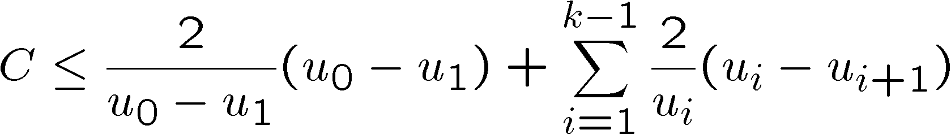
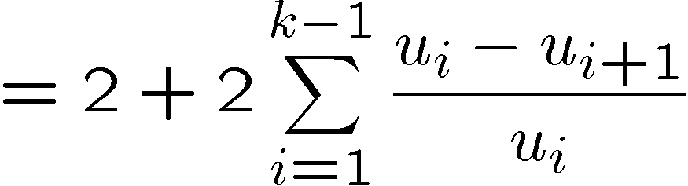
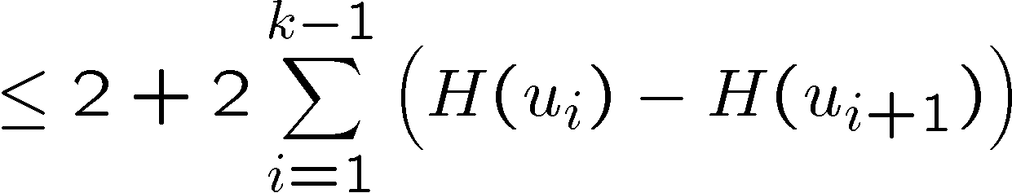
Adding up the charges in S_{u}

Slide 19
Discussion of the tree growing algorithm
We have an extremely simple algorithm that is asymptotically optimal unless P¼NP. And even the constants are small.
Are we happy?
Not really. How do we implement this algorithm in a real (dynamic) network? How do we figure out where the best grey/white pair of nodes is? How slow is this algorithm in a distributed setting?
We need a fully distributed algorithm. Nodes should only consider local information.

Slide 20
The Marking Algorithm
Idea: The connected dominating set CDS consists of the nodes that have two neighbors that are not neighboring.
1. Each node u compiles the set of neighbors N(u)
Each node u transmits N(u), and receives N(v) from all its neighbors
If node u has two neighbors v,w and w is not in N(v) (and since the graph is undirected v is not in N(w)), then u marks itself being in the set CDS.
+ Completely local; only exchange N(u) with all neighbors
+ Each node sends only 1 message, and receives at most Δ
Is the marking algorithm really producing a
connected dominating set? How good is the set?

Slide 21
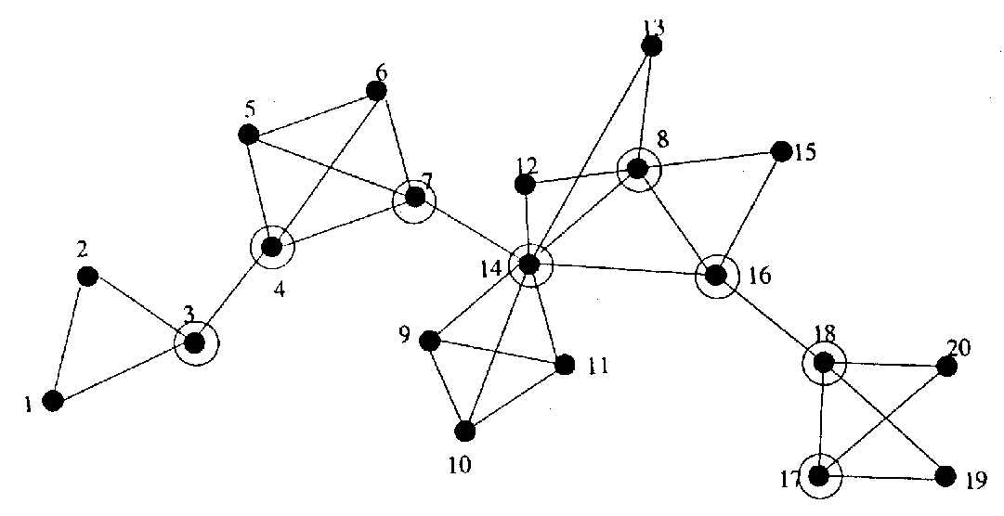
Example for the Marking Algorithm
[J. Wu]

Slide 22
Correctness of Marking Algorithm
We assume that the input graph G is connected but not a clique.
Note: If G was a clique then constructing a CDS would not make sense. Note that in a clique (complete graph), no node would get marked.
We show:
The set of marked nodes CDS is
a) a dominating set
b) connected
c) a shortest path in G between two nodes of the CDS is in CDS

Slide 23
Proof of a) dominating set
Proof: Assume for the sake of contradiction that node u is a node that is not in the dominating set, and also not dominated. We study the nodes in N⁺(u) := u [ N(u):
  If a node v 2 N(u) has a neighbor w outside N(u), then node v would be in the dominating set (since u and w are not neighboring).
  In other words, nodes in N⁺(u) only have neighbors in N⁺(u). If any two nodes v,w in N(u) are not neighboring, node u itself would be in the dominating set. In other words, our graph is the complete graph (clique) N⁺(u). We precluded this in the assumptions, therefore we have a contradiction.

Slide 24
Proof of b) connected, c) shortest path in CDS
Proof: Let p be any shortest path between the two nodes u and v, with u,v 2 CDS.
Assume for the sake of contradiction that there is a node w on this shortest path that is not in the connected dominating set.
Then the two neighbors of w must be connected, which gives us a shorter path. This is a contradiction.
w
u
v

Slide 25
Improved Marking Algorithm
If neighbors with larger ID are connected and cover all other neighbors, then don’t join CDS, else join CDS
9
2
8
6
5
4
1
7
3

Slide 26
Correctness of Improved Marking Algorithm
Theorem: Algorithm computes a CDS S
Proof (by induction of node IDs):
  assume that initially all nodes are in S
  look at nodes u in increasing ID order and remove from S if higher-ID neighbors of u are connected
  S remains a DS at all times: (assume that u is removed from S)
  S remains connected:
  replace connection v-u-v’ by v-n₁,…,n_{k}-v’ (n_{i}: higher-ID neighbors of u)
u
lower-ID
neigbors
higher-ID
neighbors
higher-ID neighbors
cover lower-ID neighbors

Slide 27
Quality of the (Improved) Marking Algorithm
Given an Euclidean chain of n homogeneous nodes
The transmission range of each node is such that it is connected to the k left and right neighbors, the IDs of the nodes are ascending.
An optimal algorithm (and also the tree growing algorithm) puts every k^{th} node into the CDS. Thus |CDS_{OPT}| ¼ n/k; with k = n/c for some positive constant c we have |CDS_{OPT}| = O(1).
The marking algorithm (also the improved version) does mark all the nodes (except the k leftmost and/or rightmost ones). Thus |CDS_{Marking}| = n – k; with k = n/c we have |CDS_{Marking}| = Ω(n).
This is as bad as not doing anything!
  Is there at all a fast distributed way to compute a dominating set?

Slide 28
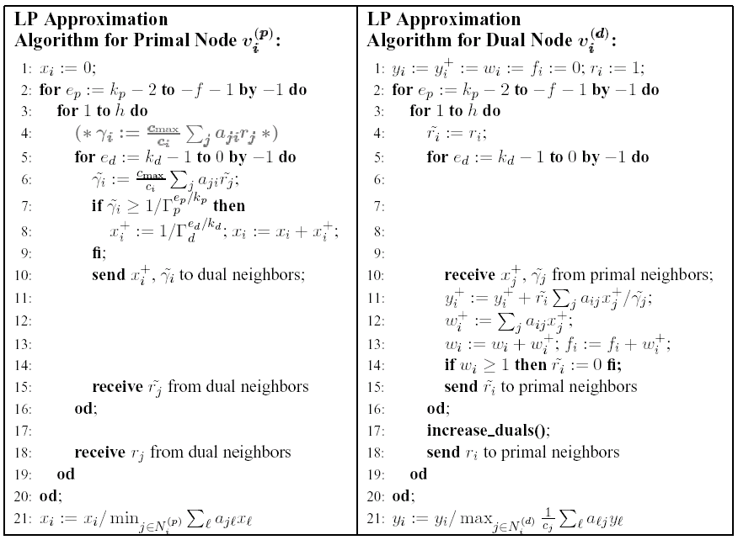
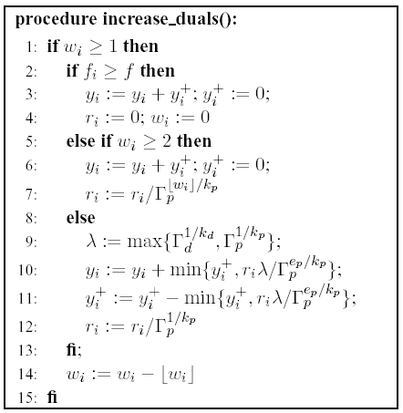
This problem is tough…
… however, there are some complicated algorithms that achieve non-trivial results, e.g. in k rounds of communications
[Kuhn et al., 2006]

Slide 29
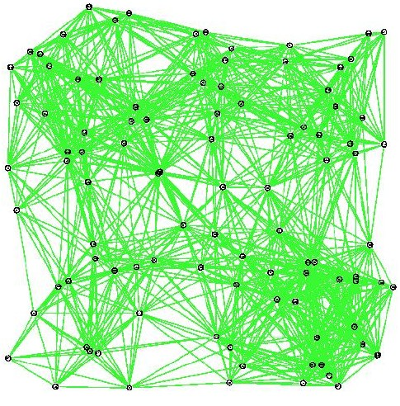
Better and faster algorithm
Assume that graph is a unit disk graph (UDG)
Assume that nodes know their positions (GPS)
v
1
u

Slide 30
Then…
transmission radius

Slide 31
Grid Algorithm
Beacon your position
If, in your virtual grid cell, you are the node closest to the center of the cell, then join the DS, else do not join.
That’s it.
1 transmission per node, O(1) approximation.
If you have mobility/dynamics, then simply “loop” through algorithm, as fast as your application/mobility wants you to.

Slide 32

Comparison
Complicated algorithm
Algorithm computes DS
k²+O(1) transmissions/node
O(Δ^{O(1)/k} log Δ) approximation
General graph
No position information
Grid algorithm
Algorithm computes DS
1 transmission/node
O(1) approximation
Unit disk graph (UDG)
Position information (GPS)
The model determines the distributed
complexity of clustering

Slide 33
Let’s talk about models…
General Graph
Captures obstacles
Captures directional radios
Often too pessimistic
UDG & GPS
UDG is not realistic
GPS not always available
  Indoors
2D → 3D?
Often too optimistic
too pessimistic
too optimistic
Let‘s look at models in
between these extremes!

Slide 34
Why are models needed?
Formal models help us understanding a problem
Formal proofs of correctness and efficiency
Common basis to compare results
Unfortunately, for ad hoc and sensor networks, a myriad of models exist, most of them make sense in some way or another. On the next few slides we look at a few selected models

Slide 35
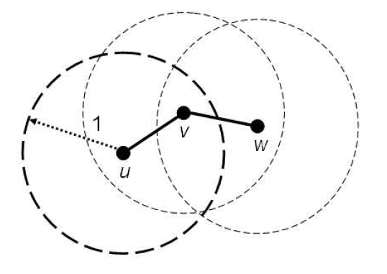
Unit Disk Graph (UDG)
Classic computational geometry model, special case of disk graphs
All nodes are points in the plane,
two nodes are connected iff (if and
only if) their distance is at most 1,
that is {u,v} 2 E , |u,v| · 1
+ Very simple, allows for strong analysis
– Not realistic: “If you gave me $100 for each paper written with the unit disk assumption, I still could not buy a radio that is unit disk!”
– Particularly bad in obstructed environments (walls, hills, etc.)
Natural extension: 3D UDG

Slide 36
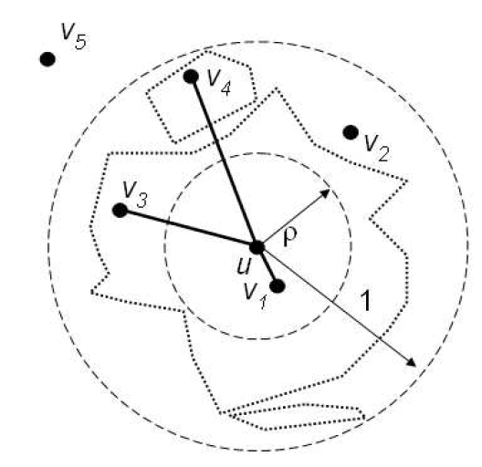
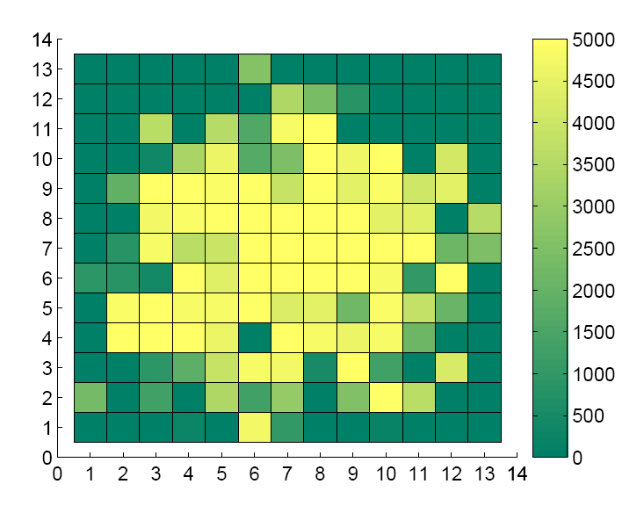
Quasi Unit Disk Graph (QUDG)
Two radii, 1 and ½, with ½ · 1
  |u,v| · ½ ⬄ {u,v} 2 E
  1 < |u,v| ⬄ {u,v} 2 E
  ½ < |u,v| · 1 ⬄ it depends!
    … on an adversary
    … on probabilistic model
    …
+ Simple, analyzable
+ More realistic than UDG
– Still bad in obstructed environments (walls, hills, etc.)
Natural extension: 3D QUDG

Slide 37
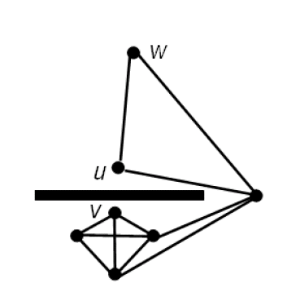
Bounded Independence Graph (BIG)
How realistic is a QUDG?
  u and v can be close but not adjacent
  model requires very small ½
  in obstructed environments (walls)
However: in practice, neighbors are often also neighboring
Solution: BIG Model
  Bounded independence graph
  Size of any independent set grows
  polynomially with hop distance r
  e.g., f(r) = O(r²) or O(r³)
  A set S of nodes is an independent set, if
  there is no edge between any two nodes in S.
  BIG model also known as bounded-growth
    Unfortunately, the term bounded-growth is ambiguous

Slide 38
Unit Ball Graph (UBG)
9 metric (V,d) with constant doubling dimension.
Metric: Each edge has a distance d, with
  d(u,v) ¸ 0 (non-negativity)
  d(u,v) = 0 iff u = v (identity of indiscernibles)
  d(u,v) = d(v,u) (symmetry)
  d(u,w) · d(u,v) + d(v,w) (triangle inequality)
Doubling dimension: log(#balls of radius r/2 to cover ball of radius r)
  Constant: you only need a constant number of balls of half the radius
Connectivity graph is same as UDG:
such that: d(u,v) · 1 : (u,v) 2 E
such that: d(u,v) > 1 : (u,v) 2 E

Slide 39

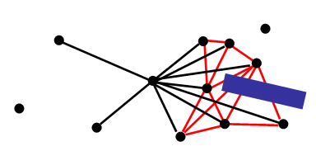
Connectivity Models: Overview
General
Graph
UDG
too pessimistic
too optimistic
Bounded
Independence
Unit Ball
Graph
Quasi
UDG

Slide 40
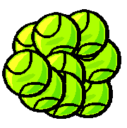
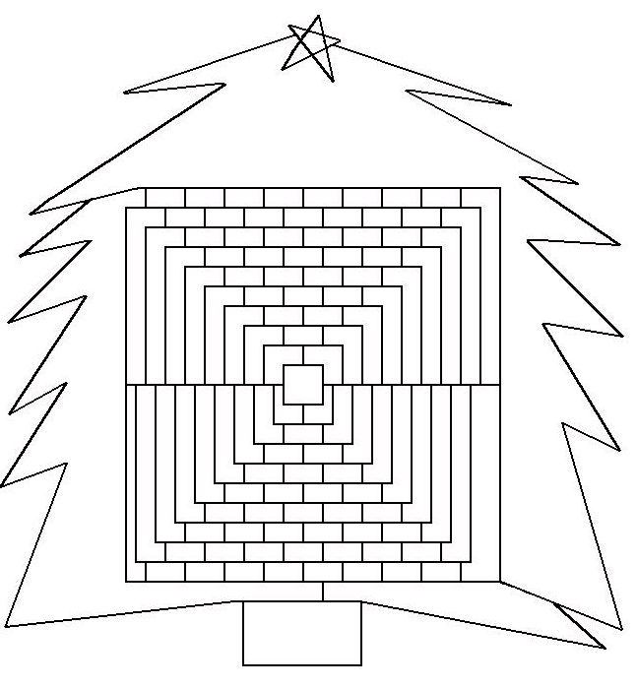
Models are related
GG
BIG is special case of general graph, BIG µ GG
UBG µ BIG because the size of the independent sets of any UBG is polynomially bounded
QUDG(constant ½) µ UBG
QUDG(½=1) = UDG
BIG
UBG
QUDG
UDG

Slide 41
The “Largest-ID” Algorithm
All nodes have unique IDs, chosen at random.
Algorithm for each node:
  Send ID to all neighbors
  Tell node with largest ID in neighborhood that it has to join the DS
Algorithm computes a DS in 2 rounds (very local!)
7
6
4
1
2
9
10
3
8
5

Slide 42
“Largest ID” Algorithm, Analysis 1
To simplify analysis: assume graph is UDG
(same analysis works for UBG based on doubling metric)
We look at a disk S of diameter 1:
Nodes inside S have
distance at most 1.
! they form a clique
S
Diameter: 1
How many nodes in S
are selected for the DS?

Slide 43
“Largest ID” Algorithm, Analysis 2
Nodes which select nodes in S are in disk of radius 3/2 which
can be covered by S and 20 other disks S_{i} of diameter 1
(UBG: number of small disks depends on doubling dimension)
S
1
1
1

Slide 44
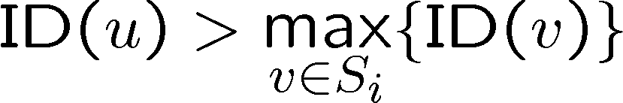
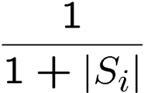
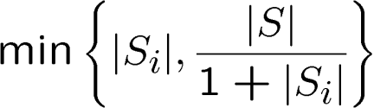
“Largest ID” Algorithm: Analysis 3
How many nodes in S are chosen by nodes in a disk S_{i}?
A node u2S is only chosen by a node in S_{i} if
(all nodes in S_{i} see each other).
The probability for this is:
Therefore, the expected number of nodes in S chosen by nodes in S_{i} is at most:
Because at most |S_{i}| nodes in S_{i} can choose
nodes in S and because of linearity of expectation.

Slide 45
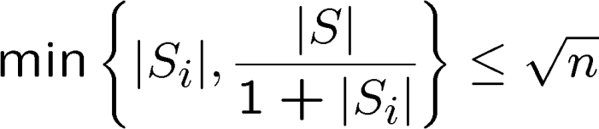


“Largest ID” Algorithm, Analysis 4
From |S| · n and |S_{i}| · n, it follows that
Hence, in expectation the DS contains at most nodes
per disk with diameter 1.
An optimal algorithm needs to choose at least 1 node in the disk with radius 1 around any node.
This disk can be covered by a constant (9) number of disks of diameter 1.
The algorithm chooses at most times more disks than an optimal one

Slide 46


“Largest ID” Algorithm, Remarks
For typical settings, the “Largest ID” algorithm produces very good dominating sets (also for non-UDGs)
There are UDGs where the “Largest ID” algorithm computes an
-approximation (analysis is tight).
complete
sub-graph
Optimal DS: size 2
“Largest ID” algorithm:
bottom nodes choose top nodes with probability¼1/2
1 node every 2nd group
nodes
nodes
complete
sub-graph

Slide 47
Maximal Independent Set (MIS)
A Maximal Independent Set (MIS) is a non-extendable set of pair-wise non-adjacent nodes:
An MIS is also a dominating set:
  assume that there is a node v which is not dominated
  v∉MIS, (u,v)∈E ! u∉MIS
  add v to MIS
In contrast: A Maximum Independent Set (MaxIS)
is an independent set of maximum cardinality.

Slide 48
Computing a MIS
Lemma: On BIG: |MIS| · O(1)¢|DS_{OPT}|
Proof:
  Assign every MIS node to an adjacent node of DS_{OPT}
  u2DS_{OPT} has at most f(1) neighbors v2MIS
  At most f(1) MIS nodes assigned to every node of DS_{OPT}
  → |MIS| · f(1)¢|DS_{OPT}|
Time to compute MIS on BIGs: O(log*n) [Schneider et al., 2008]
  The function „log-star“ says how often you need to take the logarithm of a value to end up with 1 or less. Even if n was the number of atoms in the universe, we have log*n = 5.

Slide 49
MIS (DS) → CDS
MIS gives a dominating set.
But it is not connected.
  Connect any two MIS nodes which can be connected by one additional node.
  Connect unconnected MIS nodes which can be connected by two additional nodes.
  This gives a CDS!
  #2-hop connectors · f(2)¢|MIS|
  #3-hop connectors · 2f(3)¢|MIS|
  |CDS| = O(|MIS|)
Similarly, one can compute other structures, e.g. coloring, very fast!

Slide 50
Open problem
This chapter got a lot of attention from the research community in the last few years, and it made remarkable progress. Many problems open just a few years ago are solved now.
However, some problems are still open. The classic open problem in this area is MIS for general graphs. A randomized algorithm [Luby 1985, and others] constructs a MIS in time O(log n). It is unknown whether this can be improved, or matched by a deterministic algorithm.
Another nice open question is what can be achieved in constant time? For instance, even though we know that an MIS (or CDS or
¢-coloring) can be computed in O(log*n) time on a UDG [Schneider
et al., 2008], it is unclear what can be done in constant time!

