Slide 1
In Defense of Wireless Carrier Sense Micah Z. Brodsky, Robert T. Morris SIGCOMM 2009
Presenter: Manuel Stocker Mentor: Philipp Sommer

Slide 2
So what is Carrier Sense?
Problem: One medium (wire, frequency, …) shared between multiple senders
Possible solution: Listen on medium before transmitting
Monitor for power vs. detect valid packets
Many variants: CSMA/CD, CSMA/CA, probability-based, fixed-order, …

Slide 3
Problems with Carrier Sense
Carrier sensing is done by the sender, it cannot determine the signal level at the receiver (→ hidden/exposed node/terminal)
R
S₂
R
S₁
S₂
S₁

Slide 4
Fixing Hidden Terminal Issues
Instead of just trying to transmit, schedule transmissions
Needs a mechanism to coordinate senders
Hybrid approach taken by WiFi: CSMA/CA & RTS/CTS
Sender sends an RTS frame to reserve medium around itself
Receiver responds with CTS to also reserve medium around receiver
Sender sends data
Receiver acknowledges data

Slide 5
Concurrency vs. Multiplexing
Concurrency | Multiplexing
Senders transmit at the same time | Senders take turns
Interference contributes to noise | No interference
If SINR too low, decoding fails | If SNR too low, decoding fails
Full throughput on both pairs | Throughput only 50% on both pairs

Slide 6
Motivation
Carrier sense has been challenged in the past and schemes for TDMA, such as WiMAX, have been proposed as an alternative.
This paper analyses the performance of carrier sense based on a general model to evaluate how close to optimal carrier sense performs

Slide 7
Model
Two sender-receiver pairs
Distance between senders: D
Average over all possible receiver locations within R_{max}
R_{max}
R₂
R₁
S₁
S₂
D

Slide 8
Capacity Model
Shannon’s capacity formula:
$$\frac{Capacity [bits]}{Bandwidth [Hz]}= \log_{2}\left(1+ \frac{Signal [W]}{Noise [W]}\right)$$
usually given in dB:
$$SNR \left[dB\right]=10∗\log_{10}{\frac{S}{N}}$$

Slide 9
Capacity Model
Shannon’s capacity formula:
And with interference:
$$\frac{Capacity [bits]}{Bandwidth [Hz]}= \log_{2}\left(1+ \frac{Signal [W]}{Noise [W]}\right)$$
usually given in dB:
$$SNR \left[dB\right]=10∗\log_{10}{\frac{S}{N}}$$
$$\frac{Capacity [bits]}{Bandwidth [Hz]}= \log_{2}\left(1+ \frac{Signal [W]}{Noise\left[W\right]+Interference [W]}\right)$$

Slide 10
Single Pair Capacity
Signal power at unit distance
Path loss
$$C_{single}\left(r, θ\right)= \log_{2}\left(1+ \frac{P_{0} ∗ r^{−α} ∗ L_{σ}}{N_{0}}\right)$$
Shadowing
Thermal noise floor

Slide 11
Single Pair Capacity
Path loss
($α$ typically varies from 2 to 4)
Free space would have α = 2
$$C_{single}\left(r, θ\right)= \log_{2}\left(1+ \frac{P_{0} ∗ r^{−α} ∗ L_{σ}}{N_{0}}\right)$$

Slide 12
Single Pair Capacity
Shadowing
Sample from a random variable with log-normal distribution due to obstacles
$$C_{single}\left(r, θ\right)= \log_{2}\left(1+ \frac{P_{0} ∗ r^{−α} ∗ L_{σ}}{N_{0}}\right)$$

Slide 13
Single Pair Capacity
Signal power at unit distance
Path loss ($α$ typically
varies from 2 to 4)
$$C_{single}\left(r, θ\right)= \log_{2}\left(1+ \frac{P_{0} ∗ r^{−α} ∗ L_{σ}}{N_{0}}\right)$$
Shadowing
Thermal noise floor
Signal power can be factored into noise:
$$C_{single}\left(r, θ\right)= \log_{2}\left(1+ \frac{ r^{−α} ∗ L_{σ}}{N}\right)$$
$$N= \frac{N_{0}}{P_{0}}$$

Slide 14
Two Pair Capacity: Multiplexing
An ideal MAC gives both pairs half of the capacity with no overhead:
$C_{multiplexing}\left(r, θ\right)= \frac{C_{single}}{2}$ $= \frac{\log_{2}\left(1+ \frac{ r^{−α} ∗ L_{σ}}{N}\right)}{2}$

Slide 15
Two Pair Capacity: Concurrency
With both pairs sending concurrently, they contribute to each other’s noise levels:
$$C_{concurrent}\left(r, θ\right)=\log_{2}\left(1+ \frac{ r^{−α} ∗ L_{σ}}{N+P_{other}}\right)=\log_{2}\left(1+ \frac{ r^{−α} ∗ L_{σ}}{N+{L′}_{σ}∗{Δr}^{−α}}\right)$$
$$Δr= \sqrt{{\left(r∗\cos{θ −D}\right)}^{2}+{\left(r∗\sin{θ}\right)}^{2}}$$

Slide 16
Two Pair Capacity: Carrier Sensing MAC
Depending on a threshold, either concurrent transmission or multiplexing is chosen:
An optimal MAC would achieve:
$$C_{cs}\left(r, θ\right)\left\{\begin{matrix}C_{multiplexing}\left(r,θ\right) \\ C_{concurrent}\left(r,θ\right)\end{matrix} \left|\begin{matrix}D^{−α}{ L}_{σ}>P_{threshold} \\ D^{−α}{ L}_{σ}<P_{threshold}\end{matrix}\right.\right.$$
$$C_{max}\left(r_{1},θ_{1},r_{2},θ_{2}\right)= \frac{1}{2} ∗ \max_{}{\begin{matrix}[C_{concurrent}\left(r_{1},θ_{1}\right)+C_{concurrent}\left(r_{2},θ_{2}\right), \\ C_{multiplexing}\left(r_{1},θ_{1}\right)+C_{multiplexing}\left(r_{2},θ_{2}\right)]\end{matrix}}$$

Slide 17
Average Capacity
Average capacity is determined by integrating over the R_{max}-radius circle around the sender:
$$\left\langle C_{i}\right\rangle = \frac{1}{π{R_{max}}^{2}} \int_{0}^{R_{max}}{\int_{0}^{2π}{C_{i}\left(r, θ\right)rdθdr}}$$
R_{max}
R₂
R₁
S₁
S₂
D

Slide 18
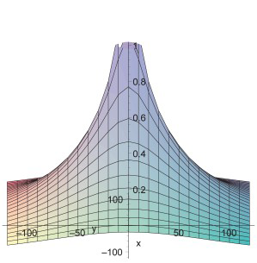
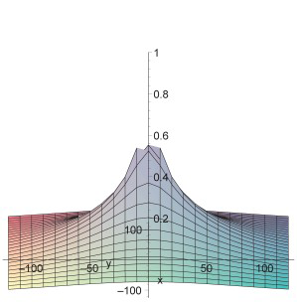
Carrier Sense Performance: Border Cases
Concurrency | Multiplexing
Very far: D = ∞ | Very close: D = 0
No Interference → concurrency is optimal | SNR 0dB → multiplexing is optimal

Slide 19
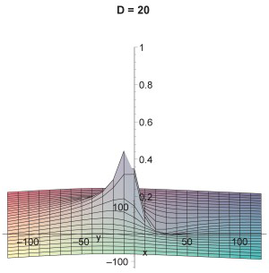
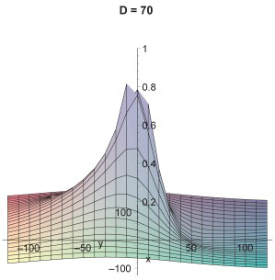
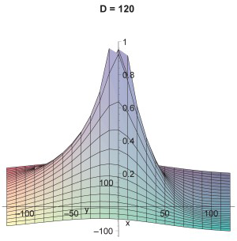
Capacity Landscape

Slide 20
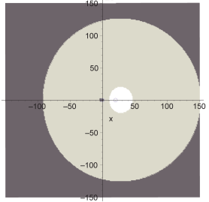
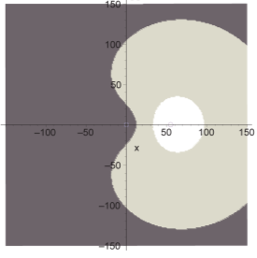
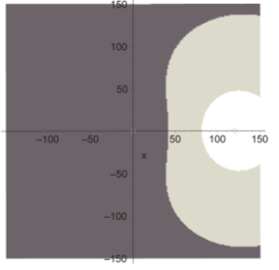
CS Performance: Receiver’s Choice
D = 20
D = 55
D = 120
Dark area: Receiver prefers concurrency
Light area: Receiver prefers multiplexing
White area: Receiver requires multiplexing

Slide 21
Quantitative Results
for α = 3 and σ = 8dB
D R_{max} | 20 | 55 | 120
20 | 96% | 88% | 96%
40 | 96% | 87% | 96%
120 | 89% | 83% | 92%
Percentage of optimal throughput with threshold = 55
D R_{max} | 20 | 55 | 120
20 (40) | 93% | 91% | 99%
40 (55) | 96% | 87% | 96%
120 (60) | 89% | 83% | 92%
Percentage of optimal throughput with optimized thresholds
Notes:
Poorest performance where D ~= Threshold and long range
Threshold selection improves throughput in short range networks, see slide with graphs

Slide 22
Quantitative Results: Consistency
Varying α from 2 to 4 and σ from 4dB to 12dB results in little change
Smaller α tend to make a network look more short range and larger α more long range
Reminder Signal power = $P_{0} ∗ r^{−α} ∗ L_{σ}$
α: path-loss coefficient
σ: shadowing distribution parameter

Slide 23
Global Threshold Selection
Threshold determines efficiency of carrier sense
Poor threshold choice leads to bad decision when selecting between multiplexing and concurrent transmission
Manufacturers of wireless chipsets need to select a default threshold

Slide 24
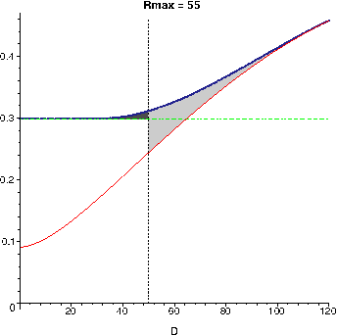
Global Threshold Selection
Multiplexing almost reaches optimal performance with a close interferer. Concurrency does the same with a distant interferer
Transition region is suboptimal, as receivers prefer a different method depending on location
optimal
multiplexing
concurrency
Notes:
Y axis: fraction to an optimal Rmax = 20, D = infinity

Slide 25
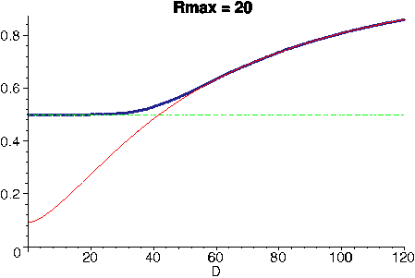
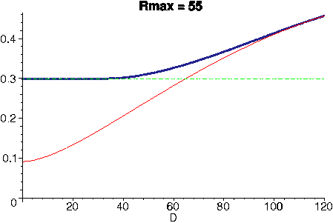
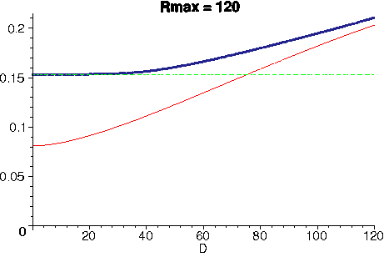
CS Performance: Throughput
Notes:
Y axis: fraction to an optimal Rmax = 20, D = infinity small gap with short range as interferer likely affects all receivers similar -> threshold is chosen similar.

Slide 26
Transition Region Performance
Adaptive bitrate protocols and the smooth propagation of interference prevent dramatic differences in throughput
Locality depends on the size (R_{max}) of the network. In short range networks, effects of an interferer are similar for all receiver locations. Long range networks where interference fades out below the noise floor on distant receivers suffer more localized effects
→ Carrier sense is significantly more efficient in short range networks

Slide 27
Picking a Global Threshold
Optimal threshold is at the intersection of multiplexing and concurrency throughputs
Requires knowledge of R_{max} and propagation environment
A good default lies in the middle of optimal thresholds of typical operating parameters supported by the hardware
optimal
multiplexing
concurrency
Notes:
Y axis: fraction to an optimal Rmax = 20, D = infinity

Slide 28
Long-range vs. Short-range Networks
Short-range networks usually have the threshold well outside of R_{max}. Long-range networks on the other hand usually have the threshold inside R_{max}, when interference affects a large part of the network.
Therefore, one can define:
long range → R_{thresh} < R_{max}
short range → R_{thresh} > 2R_{max}

Slide 29
Threshold Robustness
As the quantitative results have shown, performance is good even with suboptimal threshold choice
This is largely because data networking hardware operates in the regime around 10-25dB SNR
The range corresponds to the intermediate region between short-range and long-range range limits

Slide 30
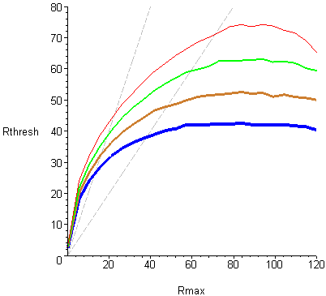
Threshold Robustness
On the left side lies the short-range limiting behaviour with thresholds approaching 0
On the right side lies the long-range limiting behaviour with threshold growth tapering off in R_{max} but spreads out in α
In between, neatly enclosed by two dashed lines representing R_{thresh} = R_{max} and R_{thresh} = 2R_{max} lies the transition region between the extremes
α = 2
α = 4
α = 3
α = 5

Slide 31
Threshold Robustness
In the short-range case, carrier sense performs well with an optimal threshold. However, optimal threshold grows rapidly with R_{max}
In the long-range case, carrier sense performance is suboptimal but robust under varying thresholds.
In the middle is a compromise of both extremes. This coincidentally is the primary operating regime for wireless network hardware
α = 2
α = 4
α = 3
α = 5

Slide 32
Throughput with Shadowing
Obstacles produce local differences of signal transmission → Shadowing
If differences too great, results might be unrealistic as environments without shadowing are rare
S₁
R₁
???

Slide 33
Shadowing: Signal Penetration
Most building materials are not opaque to radio.
An interior wall typically attenuates the signal for at most 10dB
R₁
R₂
S₁
S₂

Slide 34
Shadowing: Reflections
Materials reflect signals to a certain degree
Reflection typically incur losses of less than 10dB
R₁
R₂
S₁
S₂

Slide 35
Throughput with Shadowing
Edges lead to diffraction → Signals can propagate around corners
Example: 5m to wall, 2.4Ghz → 30dB loss
R₁
R₂
S₁
S₂

Slide 36
Throughput with Shadowing
Due to the central limit theorem, we can combine all possible contributions into a single Gaussian random variable
The resulting lognormal shadowing distribution typically has a standard deviation between 4 and 12dB
This is not enough to cause substantially different results
R₁
R₂
S₁
S₂

Slide 37
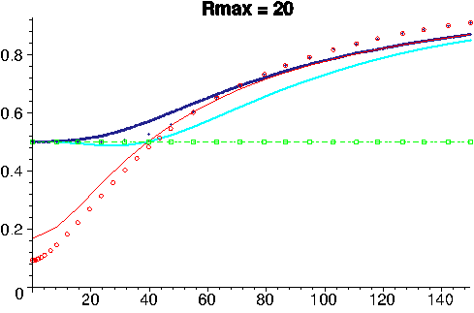
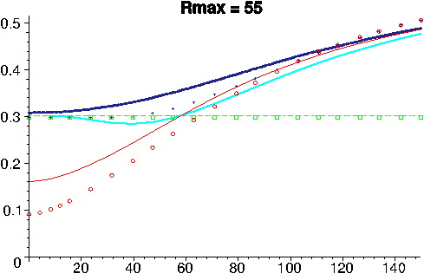
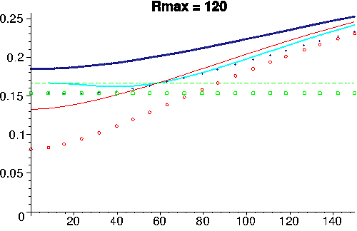
Throughput with Shadowing
σ = 0dB multiplexing
σ = 0dB concurrency
σ = 0dB optimal
σ = 8dB multiplexing
σ = 8dB concurrency
σ = 8dB CS D_{thresh} = 55
optimal

Slide 38
Experimental Evaluation
Indoor testbed of Atheros AR5212 and AR5213 based devices scattered over 2 floors of a modern office building
Senders continuously transmit 1400-byte packets for 15 seconds
Concurrency is achieved by turning off hardware carrier sense, multiplexing by first only enabling one sender, then the other
Runs with 6, 9, 12, 18 and 24 Mbps

Slide 39
Experimental Evaluation
A short-range network is simulated by only communicating with receivers that receive 94% of packets at 6 Mbps. This results in a SNR of about 27dB which corresponds to R_{max} = 30
A long-range network is simulated by including the receivers that receive 80% to 95% of packets. This results in a SNR of about 16dB which corresponds to R_{max} = 70

Slide 40
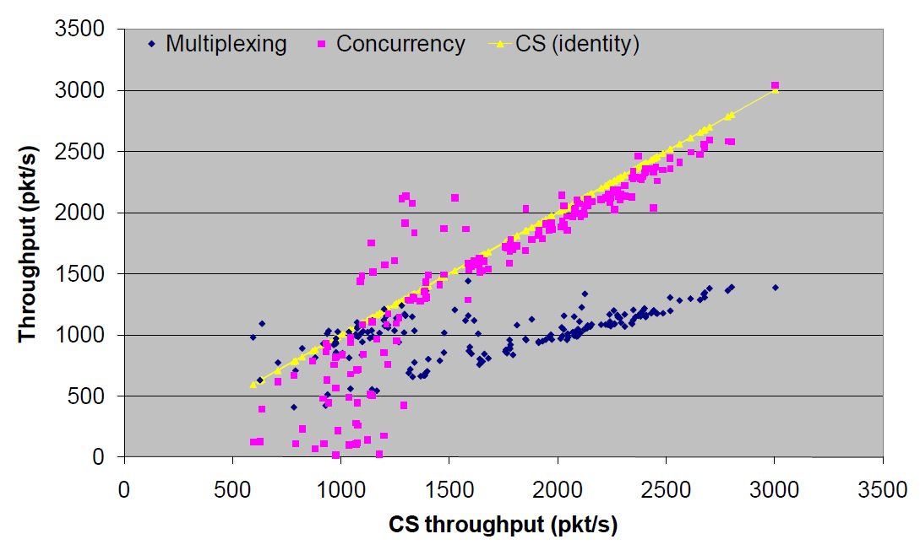
Experimental Evaluation: Short-Range

Slide 41
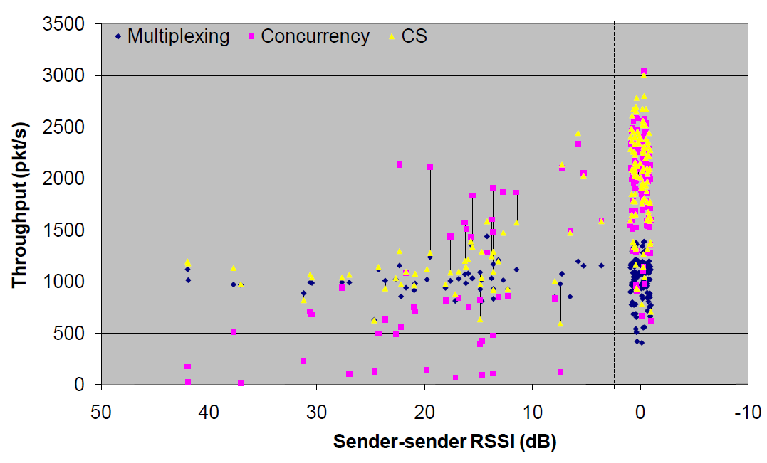
Experimental Evaluation: Short-Range

Slide 42
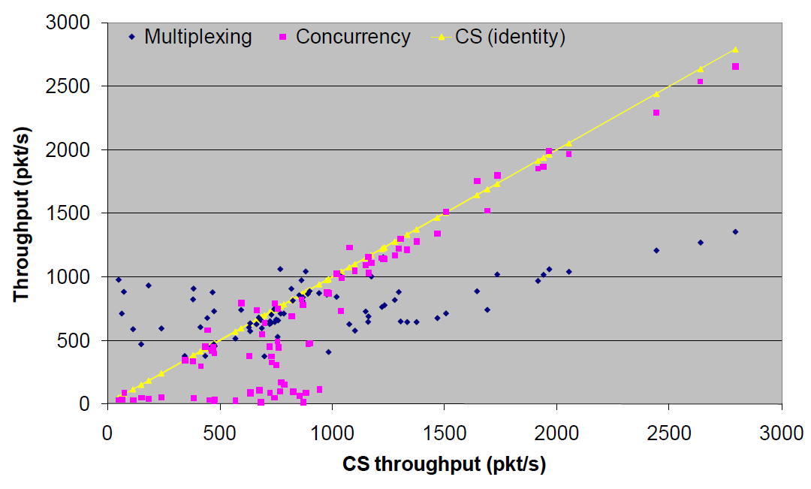
Experimental Evaluation: Long-Range

Slide 43
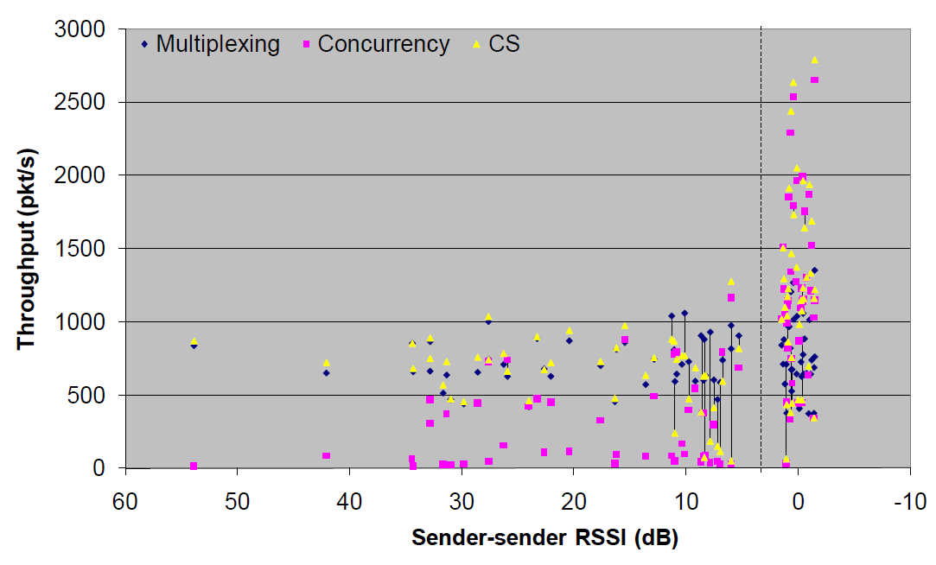
Experimental Evaluation: Long-Range

Slide 44
Conclusion
Carrier sense reaches near-optimal performance in the average case
Carrier sense performs particularly well in short-range networks
Shadowing does not introduce dramatic differences

