Slide 1
Small-World Navigability
Alexandru Moga @ Seminar in Distributed Computing

Slide 2
Talk about a small world…
Zurich, CH
Hunedoara, RO

Slide 3
From cliché to social networks
Milgram’s Experiment and The Small World Hypothesis
Boston, MA
Omaha, NE
Wichita, KS
Human society is a small-world type network characterized by short length paths
Notes:
Great distance in the US: socially and geographically.

Slide 4
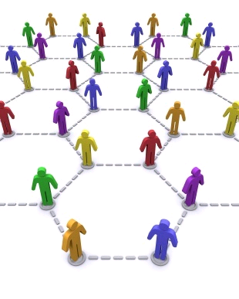
From social networks to CS
Models and Algorithms
Experimental studies
Impact in Computer Science?

Slide 5
Small-world phenomenon
Six degrees of separation
“We are all linked by short chains of acquaintance”
Watts-Strogatz model
Pervasive in networks arising in nature and technology
Fundamental factor in the evolution of WWW
Kleinberg: People can find short paths very effectively
Can we put an algorithmic price on that?
Notes:
Six handshakes to the President/Six degrees of Kevin Bacon

Slide 6
Small world characteristics
Long-range edges
(few random shortcuts)
Local edges (many)
1
4
2
3
5
B
A
High clustering
Short paths
What is a good network model that exhibits such characteristics?
Notes:
Superposition of structured subgraph (typical network structures: lattices, hierarchies, groups) with a random subgraph ~ geographical interpretation
Network is generated using some probability distribution function (related to the long-range edges)
Low network diameter (like uniform random networks)
Clustering: neighbours of x are also neighbours
What is a good network model that exhibits such characteristics?

Slide 7
Navigation
Estimated distance to target (global)
Acquaintanceship/Friendship
Source s
z
d_{zt}
x
d_{yt}
Target t
y
d_{wt}
w
Decentralized search (local)
Greedy search
d_{yt} = min{x’s neighbours}
Can we effectively navigate from s to t given a network model?
Notes:
Estimated distance has a global character (may not be a real distance)
Chain length has a local character (real distance)
Pr(x,y)=f(d(x,y)) for long-range edges

Slide 8
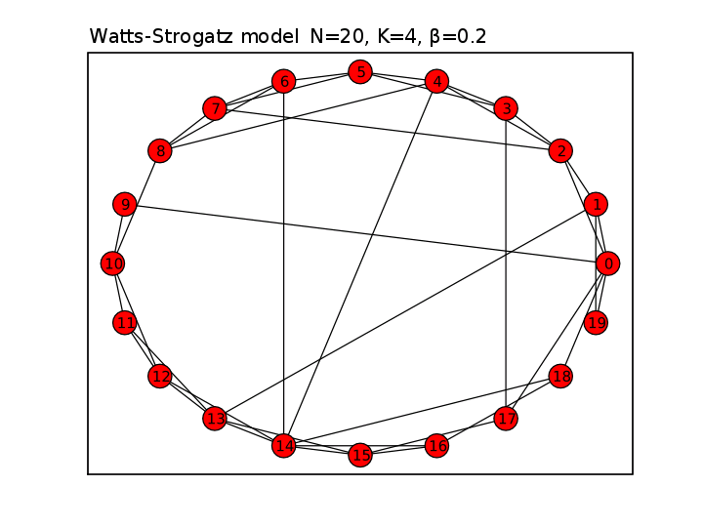
The Watts-Strogatz model
Re-wired ring lattice
Long-range edges (probability β)
Local edges
(K-nearest neighbors)
2
9
1
0
19
Notes:
Take a regular lattice, add random links, and you get a small-world
Example K=4, beta=0.2

Slide 9
Kleinberg’s model
N
Local edges(p)
A→E := d(A,E) ≤ p
E
v
D
A
B
N
C
w
Z
Long-range edges(q)
Pr(A→Z) ~ 1/[d(A,Z)]^{α}
Inverse α^{th}-power distribution
u
t
Lattice distance
d(A,Z) = |t-u| + |w-v|
Notes:
Two-dimensional grid network structure (n x n square)
Set of nodes {(i,j) : i ∈ {1,…,n}, j ∈ {1,…,n}}
N=6, p=1,q=0

Slide 10
Clustering exponent α
Family of network models with parameter α
α = 0
α > 0
Long-range contacts chosen independently of their position (~Watts-Strogatz model)
Long-range contacts tend to cluster in the nodes’ vecinity
Which α yields an effectively navigable network?
Expected delivery time T
Expected number of steps to reach the destination
Shortness (small T) of paths is defined as polylogarithmic
Notes:
Polylogarithmic: T grows slowly while N increases

Slide 11
Navigability in Kleinberg’s model
T > N^{β}
α = 0
α = 2
Inverse-square distribution (1/d²) is the unique distribution that allows polylogarythmic T < log²N
Generalization
For a k-dimensional lattice, paths are polylogarithmic iff α = k
Notes:
Alfa=2: Target area progressively closes as new nodes are added to the chain

Slide 12
Inverse-square distribution
Last phase
t
At most
logN steps
2^{j}
2^{j+1}
Phase j
s
→ ~logN phases
Initial phase

Slide 13
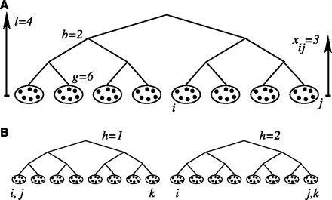
Plausible social structures (Watts et al.)
Individuals have identities
World is partitioned hierarchically (cognitively)
Group management is easier (typically 100 individuals)
Branching factor
Similarity of individuals
Depth
l.c.a.(i,j)
Group size

Slide 14
Plausible social structures
Network structure
Pr(acquaintance) decreases with decreasing similarity
Choose i and a link distance with Pr(x) = ce^{-αx}
Choose j that is in distance x from i
Continue until individuals have an average of z friends
α - shows homophily
e^{-α} << 1: cliques
e^{-α} = b: uniform random graph
x = 1
x = 2
x = 3
Notes:
Uniform random graph: everybody is equally likely to link to anybody.

Slide 15
Plausible social structures
Social world is multi-dimensional (H)
Each dimension corresponds to an independent hierarchical division (e.g. geography, occupation)
Node identity: H-dimensional vector
Perceived similarity yields “social distance”
Minimum similarity across all dimensions
x_{ij} = 1
x_{ij} = 4
y_{ij} = 1
y_{jk} = 1
y_{ik} = 4
y_{ij} +y_{jk} < y_{ik} !!!
Notes:
Same nodes, different hierarchies
Graphs build according to each hierarchy (superposition of graphs)
If i and j are very similar in a hierarchy, thery are also close socially

Slide 16
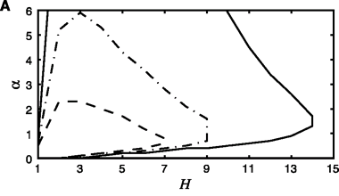
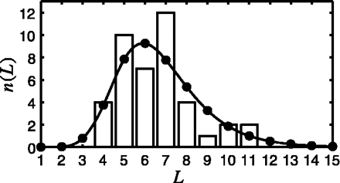
Searchability with social distance
Searchable networks
in the H-α space
N increases
Comparison to original
Milgram experiment
H=2, α=1
Individuals are basically homophilous
Similarity is judged along more than 1 dimenations (2-3)
L~6.5 (Milgram) vs. L~6.7
Notes:
Experimental setting similar to Milgram’s experiment
q= the probability of a chain reaching the target
Average z: avg no of friends in all dimensions (larger H implies fewer ties per dimension)
Upper limit of H: random walk

Slide 17
Experimental studies
Real-world social networks
Large-scale
Geography and occupation are crucial
Network structure alone may not be sufficient

Slide 18
Geography in small-world networks (Nowell et al.)
LiveJournal online community
~500.000 bloggers located in US
Friendship-based network
Global routing with GEOGREEDY
What is the importance of geography in navigation?

Slide 19
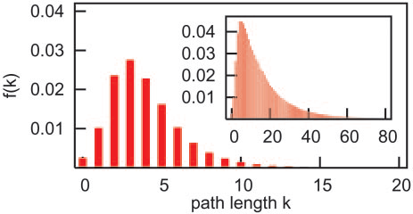
GEOGREEDY simulation
80% of chains completed with avg. length of 16.74
13% of chains completed with avg. length of 4.12
What is the relation between geography and friendship?
Notes:
Original experiment
Chain fails if u has no other friend v that is close to the target
Modified experiment
If d(v,t)>d(u,t), u picks a random person from the same city to continue
80% of chains completed with avg. length of 16.74
Geography seems to be enough → surface similarity to Milgram’s experiment (18% of messages completed)
13 % < completion rate < 80%

Slide 20
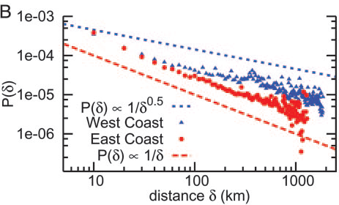
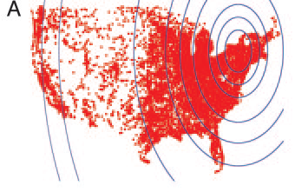
Geographic friendship probability
Pr^{Kleinberg}(δ) ~ 1/ δ²
+50.000 people
Ithaca, NY
Pr^{LiveJournal}(δ) ~1/ δ^{α} , α~1
LiveJournal network exhibits large variance in population density
What is a good interpretation of geographic friendship?
Notes:
P(delta) : proportion of pairs separated by delta/ or the probability of u,v within distance delta to be friends
Ill-approximation using Kleinberg model with pure geographic distance/network is still searchable

Slide 21
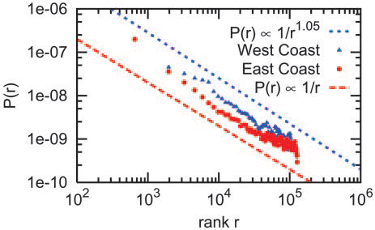
Rank-based friendship
Rural Iowa
Manhattan
rank_{u}(v) := |{w:d(u,w) < d{u,v}}|
Pr[u → v] ~ 1/rank_{u}(v)
In a network formed by rank-based friendship, GEOGREEDY can find short paths (polylogarithmic)
Notes:
Figure: much better approximation of population distribution
Theorem: Analytic evidence

Slide 22
Navigability in global social networks (Dodds et al.)
Routing in the LiveJournal community
Geography and occupation are the most important factors in establishing short chains
~70%
Source
Destination
geography-based
non-geography-based
Notes:
Search often transitions from geography-based (global/coarse-grained) to non-geography-based (local/fine-grained)
LiveJournal: only 2 thirds were geography-based friendships.

Slide 23
E-mail replication experiment
Human participants (not simulated)
~100k individuals, 18 targets in 13 countries

Slide 24
Geography vs. occupation
Geography matters more in the early stages of the chain (3 steps)
Occupation clearly takes over in the later stages
Notes:
People were also asked why they considered their chosen friend as a good recipient.

Slide 25
Results of the study
Without enough incentives, the small-world hypothesis may not hold
E.g. Target 5 (university prof.) accounted for 44% of the completed chains → good reachability
Network structure alone is not enough

Slide 26
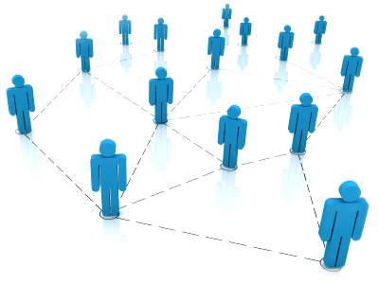
Case study: Freenet
P2P system
Collaborating group of Internet nodes
Overlay special-purpose network
Application-level routing
Freenet
Distributed anonymous information storage and retrieval
Unstructured system

Slide 27
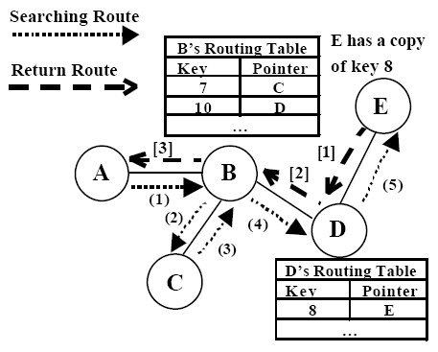
Case study: Freenet
File ids
File caching on the return path
Typical cache replacement policy: LRU
Backtracking

Slide 28
Case study: Freenet
At low load:
Freenet network shown to evolve into a “small-world” (high clustering + logarithmic paths)
At high load:
Frequent local caching actions
Clusters may break → small-world hypothesis might not hold

Slide 29
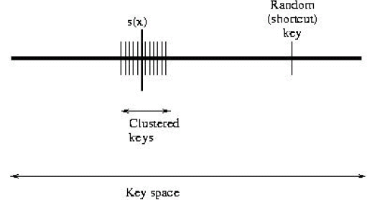
Case study: Freenet
Enhanced-clustering cache replacement policy
Preserve key clustering in the cache
Each node chooses a seed s(x) randomly from the key space
At node x (datastore full)
key u arrives
choose v which is farthest from the seed
Distance(u, seed) ≤ Distance(v, seed): cache u, evict v, create entry for u
Distance(u, seed) > Distance(v, seed): cache u, evict v, create entry for u with probability p (randomness)

Slide 30
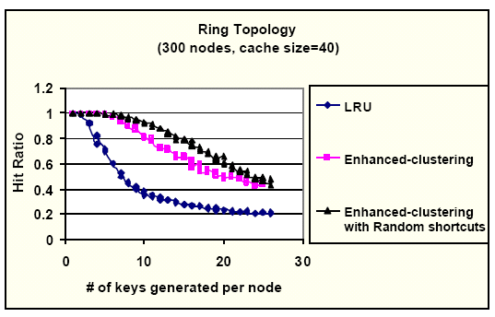
Case study: Freenet
Empirical results
Analytically
f(d(x,y)) ~ 1/d(x,y) = 1/|s_{x}-s_{y}|
Expected delivery time: O(log²n)
Notes:
* Analytical evidence

Slide 31
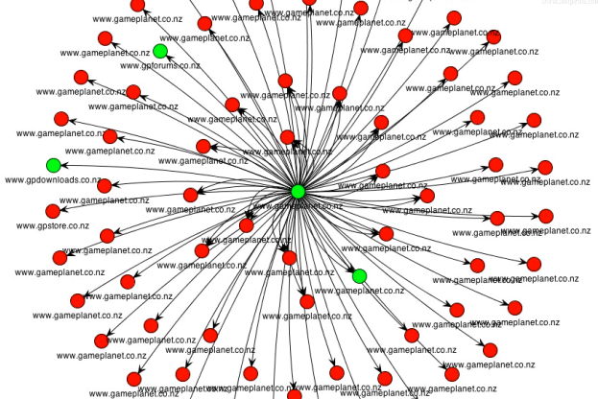
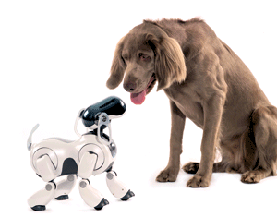
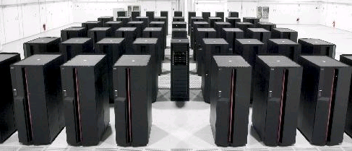
Other applications
Crawling the WWW
On-line search in the unknown
Supercomputing

Slide 32
Conclusion
A small-world network is characterized by:
High clustering of nodes
“Short” paths
Small-world phenomenon has two sides
Existential and Algorithmic
Unsupervised networks are generally small-worlds
Notes:
Take a structured network and add random links with probability depending on distance (position in the network)

Slide 33
References
Identity and Search in Social Networks Watts, D.J. and Dodds, P.S. and Newman, MEJ In Science 2002.
Small-World Phenomena and the Dynamics of Information, Kleinberg, J. In NIPS 2002.
Small-world Phenomena: An algorithmic perspective, Kleinberg, 2000
Navigation in a Small World, Kleinberg, Nature 406 (2000)
Geographic routing in social networks Liben-Nowell, D. and Novak, J. and Kumar, R. and Raghavan, P. and Tomkins, A. PNAS 2005.
An Experimental Study of Search in Global Social Networks Dodds, P.S. and Muhamad, R. and Watts, D.J. In Science 2003.
The Small World Web, L. Adamic, 1999
Growing and Navigating the Small World Web by Local Content, F. Menczer, 2002
Using the Small-World Model to Improve Freenet Performance, Zhang et al.

